Slide 1
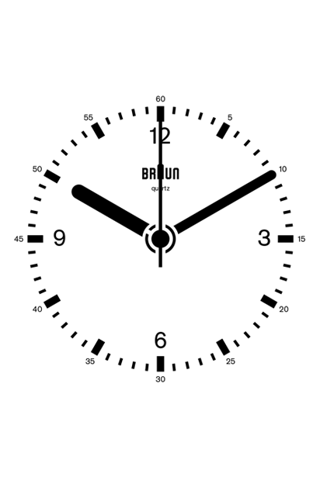
Unit 2: Pre-production and Planning
Learning objective 1.1: Evaluating the factors that need to be considered when planning.

Slide 2
Time Constraints
Learning outcome 1.1: Evaluating the factors that need to be considered when planning.
Time costs money
How?

Slide 3
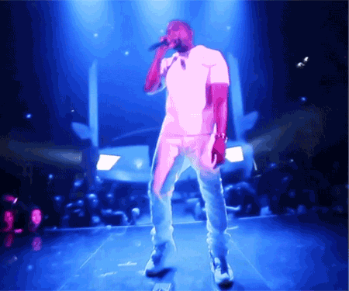
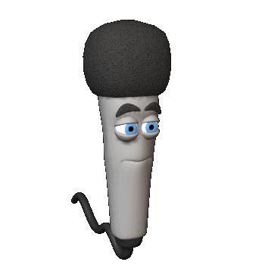
Other things to consider
Learning outcome 1.1: Evaluating the factors that need to be considered when planning.
Relevant Facilities
Personnel involved
Resources needed
Locations

Slide 4
Case Scenario
Learning outcome 1.1: Evaluating the factors that need to be considered when planning.
Create a piece of writing which answers these questions. Whilst we listen to the Podcast with production designer Pat Campbell, think about:
What does the role of a production designer entail?
During a production, which other members of the production and other areas of the production does the designer co-ordinate with?
What issues with locations can occur during the production of a TV drama?
What skills, education and experience is it beneficial for a production designer to gain?
During the production process itself, where are the working locations that a production designer tends to work and how do these relate to actual filming of the TV Drama?

