Slide 1
Unit 2: LO 2
Evaluating Client requirements.

Slide 2
Before we move on…..Check your learning
Are you able to evaluate factors that should be considered during the planning of a digital media product.
Can you realise which legal issues can affect a digital media product?
Have you got a strong understanding of which regulatory bodies should be considered during the planning of a digital media product?
Can you define what would be an ethical issue and how it can affect digital media products?

Slide 3
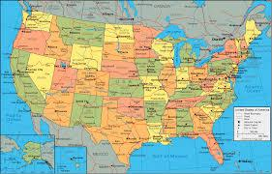
Analysing a brief: TOOLS
Tool 1:

Slide 4
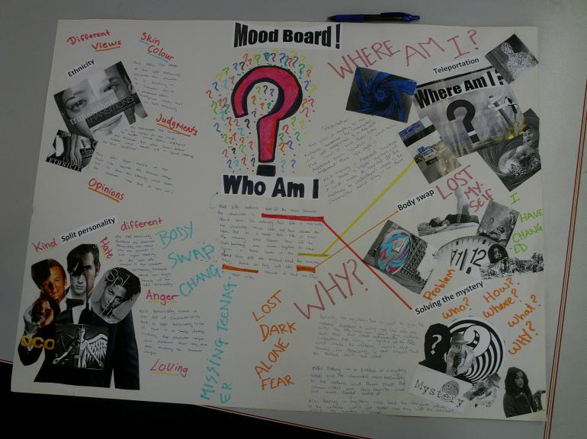
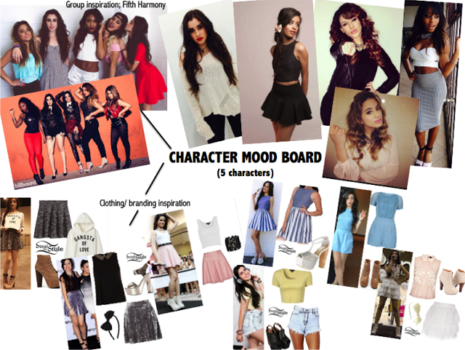
Analysing a brief: TOOLS
Tool 2:

Slide 5
Analysing a brief: TOOLS
Tool 3:

Slide 6
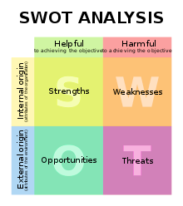
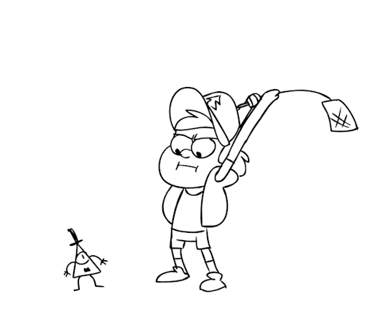
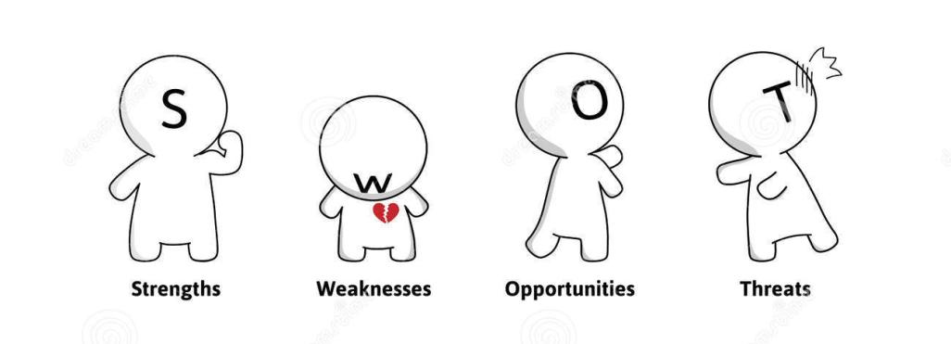
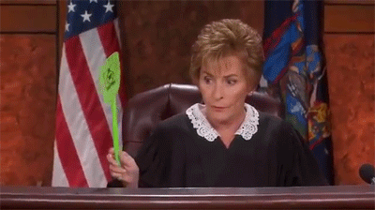
Analysing a brief: TOOLS
Tool 4

Slide 7
Brief
Group 1: Mind Map
Group 2: Mood Board
Group 3: Blue Sky
Group 4: SWOT
Client: Netherhall School
Audience: Future parents (parents of students in year 11) and year 11 students.
Product: A promotional product which will wow the potential students/parents
Context: The headteacher wants to put Netherhall more on the map and create more exposure. There has been a Local Government Donation given to the school of £2500 to fund this project.
Considerations:
Postive messages needed – no need to talk about other schools/colleges other than Netherhall
The school logo/badge must be clear on any product created
The school’s ethos must be clear : Inspiring, Individual, Inclusive.

Slide 8
Plenary
THINK ABOUT:
How did you find your individual analysing tool?
What did you find challenging?
Which tool would you find more useful?
Which tools would you like to practice using more in future?

