Slide 1
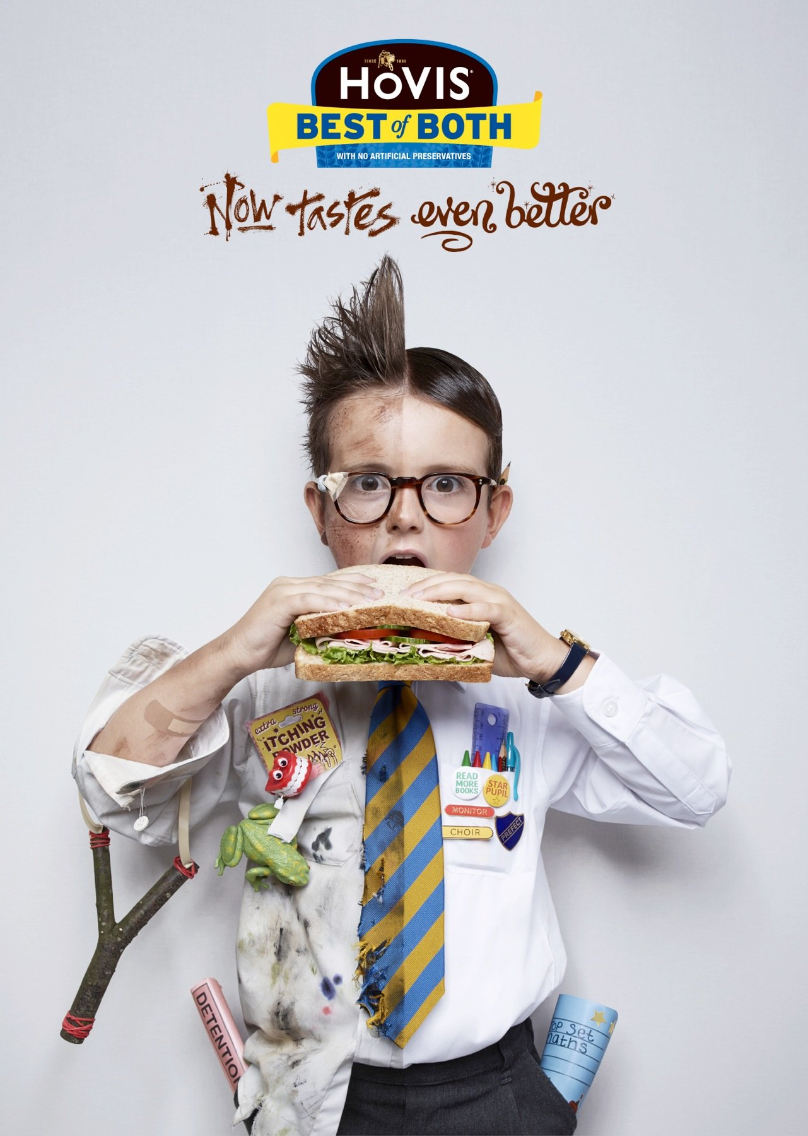
Advertising Lesson2
Learning Objective: To evaluate advert campaigns and identify representation in advertising.

Slide 2
Starter
Use a whiteboard to draw a stereotype you may see in an advertising campaign.
Group 1: Lady in her 60s
Group 2: Teenage boy
Group 3: A builder
Group 4: A lawyer.
3 minutes
Learning Objective: To evaluate advert campaigns and identify representation in advertising.

Slide 3
Learning Objective: To evaluate advert campaigns and identify representation in advertising.
What do you think of this advert?
How are women represented in this advert?
Is it a positive or negative representation?

Slide 4
ASA – Gender representation
Currently, the ASA bans ads for inappropriate sexualisation
Last Summer ProteinWorld’s advert campaign received hundreds of complaints and a petition with 60,000 names.
ASA have recognised 24/28 of their countries have restrictions on gender stereotyping.
Gender stereotyping is now being considered to be banned in UK (2008)
What are your thoughts? Can you think of any other negative stereotypes in advertising?

Slide 5
What is the message?
Learning Objective: To evaluate advert campaigns and identify representation in advertising.

Slide 6
The better version…..but again what is it saying?
Learning Objective: To evaluate advert campaigns and identify representation in advertising.

Slide 7
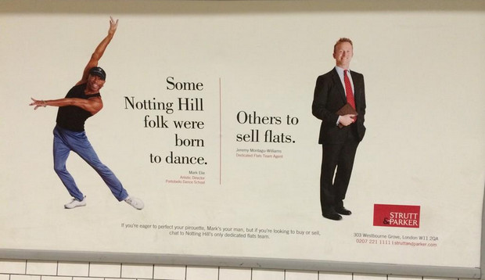
Representation
Learning Objective: To evaluate advert campaigns and identify representation in advertising.
CAGE
Class
Age
Gender
Ethnicity

Slide 9
Let’s explore representation here. What messages does this advert create?
Learning Objective: To evaluate advert campaigns and identify representation in advertising.

Slide 10
Task
Learning Objective: To evaluate advert campaigns and identify representation in advertising.
Using CAGE find a positive and negative representation in 2-3 advertising campaigns.
Screen shot and annotate what you feel has created that stereotype or countertype.
Stretch and Challenge:
If you were creating your product, based on representation what would you need to be aware of?

