Slide 1
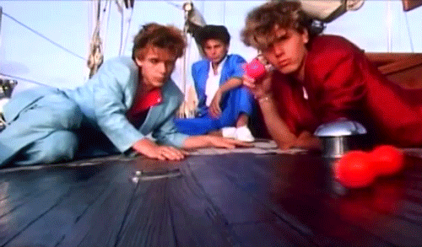
Advertising
Learning Objective: To identify and explore key features of advertising campaigns.

Slide 2
Learning Objective: To identify and explore key features of advertising campaigns.
What type of adverts are there?
e.g Television adverts

Slide 3
Entertain
Inform
What is an advert?
What is their purpose?
Sell Products
Educate

Slide 5
Complaints were received about this advert. Why do you think that is?
Who regulates advertising like this?
What do you think happened next?
Learning Objective: To identify and explore key features of advertising campaigns.
Heinz Baked Bean Advert

Slide 6
Complaints were received about this advert. Why do you think that is?
Who regulates advertising like this?
What do you think happened next?
Femfresh Advert

Slide 7
Learning Objective: To identify and explore key features of advertising campaigns.
Main Task
Investigate and research 3 advertising campaigns: 1 food item/company, 1 television series, 1 event/business. Create a PowerPoint presentation which explains your research.
What are the aims/objectives of the advertising campaign?
3. What platforms have they advertised on? How have they advertised?
4.Who is the target audience?
5. How have they tried to hook the audience in?
6. What is the call to action?
STRETCH YOURSELF:
What are the legal or ethical considerations of this advert? What might they have had to think about?

