Slide 1

Watch the three videos
Discuss in your groups:
Which of these adverts were banned?
Why do you think that?
What would production company need to consider?
What regulatory board would they need to abide by?

Slide 2
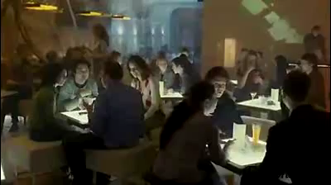
Watch the three videos
Discuss in your groups:
Which of these adverts were banned?
Why do you think that?
What would production company need to consider?
What regulatory board would they need to abide by?

Slide 3

Watch the three videos
Discuss in your groups:
Which of these adverts were banned?
Why do you think that?
What would production company need to consider?
What regulatory board would they need to abide by?

