Slide 1
Media Regulation: BBFC Case Study
L.O. - What does the examiner want to see in a Level 4 response?
How can we demonstrate an understanding of how the BBFC regulates the film industry?
How can we summarise key information from BBFC case studies?

Slide 2
Starter: Recap media’s regulatory bodies
Acronym | What it stands for | What they do
BBFC
IPSO
ASA
Ofcom
PEGI
Did you give everyone a copy of your information booklet?
Notes:
10 minutes to register and starter

Slide 3
Media Regulation: BBFC Case Study
L.O. - What does the examiner want to see in a Level 4 response?
How can we demonstrate an understanding of how the BBFC regulates the film industry?
How can we summarise key information from BBFC case studies?

Slide 4
Starter: Recap media’s regulatory bodies
Acronym | What it stands for | What they do
BBFC | British Board of Film Classification | classify films that are distributed in the UK
IPSO
ASA
Ofcom
PEGI
Did you give everyone a copy of your information booklet?
Notes:
10 minutes to register and starter

Slide 5
Starter: Recap media’s regulatory bodies
Acronym | What it stands for | What they do
BBFC | British Board of Film Classification | classify films that are distributed in the UK
IPSO | Independent Press Standards Organisation | regulate the content of all press and magazine copy
ASA
Ofcom
PEGI
Did you give everyone a copy of your information booklet?
Notes:
10 minutes to register and starter

Slide 6
Starter: Recap media’s regulatory bodies
Acronym | What it stands for | What they do
BBFC | British Board of Film Classification | classify films that are distributed in the UK
IPSO | Independent Press Standards Organisation | regulate the content of all press and magazine copy
ASA | Advertising Standards Authority | regulate all broadcast and non-broadcast advertising output
Ofcom
PEGI
Did you give everyone a copy of your information booklet?
Notes:
10 minutes to register and starter

Slide 7
Starter: Recap media’s regulatory bodies
Acronym | What it stands for | What they do
BBFC | British Board of Film Classification | classify films that are distributed in the UK
IPSO | Independent Press Standards Organisation | regulate the content of all press and magazine copy
ASA | Advertising Standards Authority | regulate all broadcast and non-broadcast advertising output
Ofcom | Office of Communications | regulate all broadcast content across the UK television channels
PEGI
Did you give everyone a copy of your information booklet?
Notes:
10 minutes to register and starter

Slide 8
Starter: Recap media’s regulatory bodies
Acronym | What it stands for | What they do
BBFC | British Board of Film Classification | classify films that are distributed in the UK
IPSO | Independent Press Standards Organisation | regulate the content of all press and magazine copy
ASA | Advertising Standards Authority | regulate all broadcast and non-broadcast advertising output
Ofcom | Office of Communications | regulate all broadcast content across the UK television channels
PEGI | Pan European Game Information | classify all video game content in the UK
Did you give everyone a copy of your information booklet?
Notes:
10 minutes to register and starter

Slide 9
Look at Q9 on your mock examination paper
Discuss the potential problems with regulatory practice in a media sector you have studied. Use examples to support your answer. [20]
What are the key words/phrases in this question? What does the question require us to do?
What did you need to do to improve?
Notes:
5 mins

Slide 10
Ways to improve answers to this question…
Know the case studies well
Link it to media theory
Focus on the structure of your response

Slide 11
Let’s look at an exemplar (and the mark scheme)
You are now the teacher!
In pairs, give a tick to a good point made and a double tick for an excellent point made
Underline when the student uses examples from their case studies and when they include media theory
What do they do well?
How could they improve?
How effectively do they answer the question?
Notes:
10 mins

Slide 12
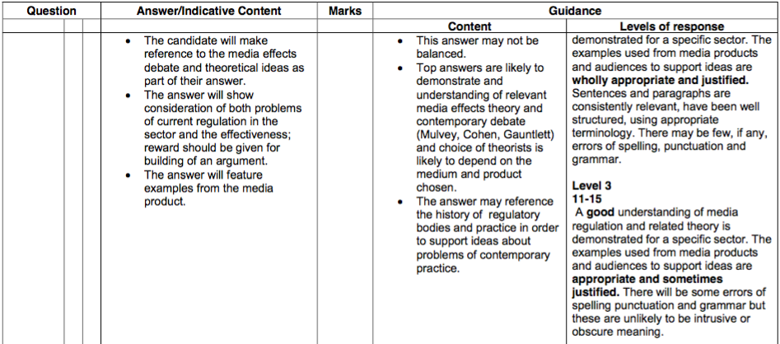
The mark scheme: Where would you put this response and why?

Slide 13
Let’s look at an exemplar (and the mark scheme)
You are now the teacher!
In pairs, give a tick to a good point made and a double tick for an excellent point made
Underline when the student uses examples from their case studies and when they include media theory
What do they do well?
How could they improve?
How effectively do they answer the question?
Notes:
10 mins

Slide 14
Examiner’s commentary
The candidate has clearly discussed an appropriate media product (GTA), identified the target audience and regulatory certification (e.g. PEGI) and understood the question (the possible problems with regulatory practice). Suggested theory (e.g. moral panics) was used to demonstrate thorough understanding of the media effects debate. The candidate has also clearly learnt terminology relevant to the topic (e.g. hypodermic syringe). The candidate has also structured the essay to show that they understanding that this is a debate question, and this is backed up by statistics (60 million games sold). The candidate also brings wider knowledge of the course (Web 2.0) to expand their argument and conclude ideas. There are detailed examples from the video game to support theoretical ideas or potential problems. The candidate has also demonstrated their wider knowledge of the effects of their specific product on the audience. This is why this is a high level answer.
Notes:
5 mins

Slide 15
So what theories could we include for the regulation question?
The question is linked to the media effects theories, as regulation is there to protect audiences and what media products they consume.
Theories we have looked at (you should revise these and see how they link to your case studies):
hypodermic syringe model
passive audience theory
cultivation theory
moral panic
active audiences (pick and mix theory)
Notes:
5 mins

Slide 16
Let’s build on our BBFC case study

Slide 17
Your task (approximately 15 minutes):
In pairs, you will be assigned a BBFC film case study that focuses on a film that sparked some controversy. You need to carefully read the case study and make notes to build on your BBFC knowledge of regulation. Make notes on the following (do this in a Word document, so you can share your findings):
the BBFCinsight on the film (this is a sentence that accompanies the film to give audiences an idea of what it contains)
what rating the filmmakers wanted. Why do you think this was?
what complaints were made to the BBFC? (public, director, politicians etc.)
how did the BBFC respond?
any other important points you think are raised in the article
How can you link your findings to the media effects debate?
Extension activity: use the Internet to find more information on your film and its BBFC rating. Look at newspaper articles and interviews with the filmmakers etc.
Notes:
10 mins

Slide 18
Feedback:
the BBFCinsight on the film (this is a sentence that accompanies the film to give audiences an idea of what it contains)
what rating the filmmakers wanted. Why do you think this was?
what complaints were made to the BBFC? (public, director, politicians etc.)
how did the BBFC respond?
any other important points you think are raised in the article
How can you link your findings to the media effects debate?
Notes:
10 mins

Slide 19
Discuss the potential problems with regulatory practice in a media sector you have studied. Use examples to support your answer. [20]
So what ‘potential problems’ might there be with BBFC regulation?
Notes:
5 mins

Slide 20
What have we done?
we have now found all of the information we need to succeed in answering a question on regulation
we can put this together to start planning for an answer, which we will do next lesson
the structure we plan will help you to answer 12 and 20 mark questions, as they need to be written like a mini essay

Slide 21
Possible structure to the 20 mark answer
Introduction – break down the examination question: What is regulation? Which regulator are you focusing on and why?
Paragraph 2 – Problem number 1: not everyone is happy with the BBFC rating of a film – The Dark Knight: rating it received and why, ‘disappearing pencil’ scene and complaints from parents. Link to passive audience theory. What was the response from the BBFC?
Paragraph 3 – Problem number 2: politicians complained about the knife violence – why is this an issue with young people and society? What was the response from the BBFC?
Paragraph 4 – Problems with other film certificates/ratings: The Hunger Games and/or This is England
Conclusion – quickly sum up your main points and offer your own opinion on regulation – do these problems mean that the BBFC is not fit for purpose? Do problems help the BBFC to adapt and change their rating criteria?

