Slide 1
Summary of my brief:
Character inspiration:
Any other character information:
Age of audience:
Personality/interests/job:
Character Name:

Slide 2
My Character’s body:
Facial features:
Clothing / colours:

Slide 3
Summary of my brief:
A game which encourages pre-teens to visit London zoo.
Character inspiration:
EXAMPLE
Age of audience: 10-12
Personality/interests/job/any other character information:
Zoo animal, pre-teen human features. Likes music, playing computer games, sarcastic, sassy, creative, mischevious

Slide 4
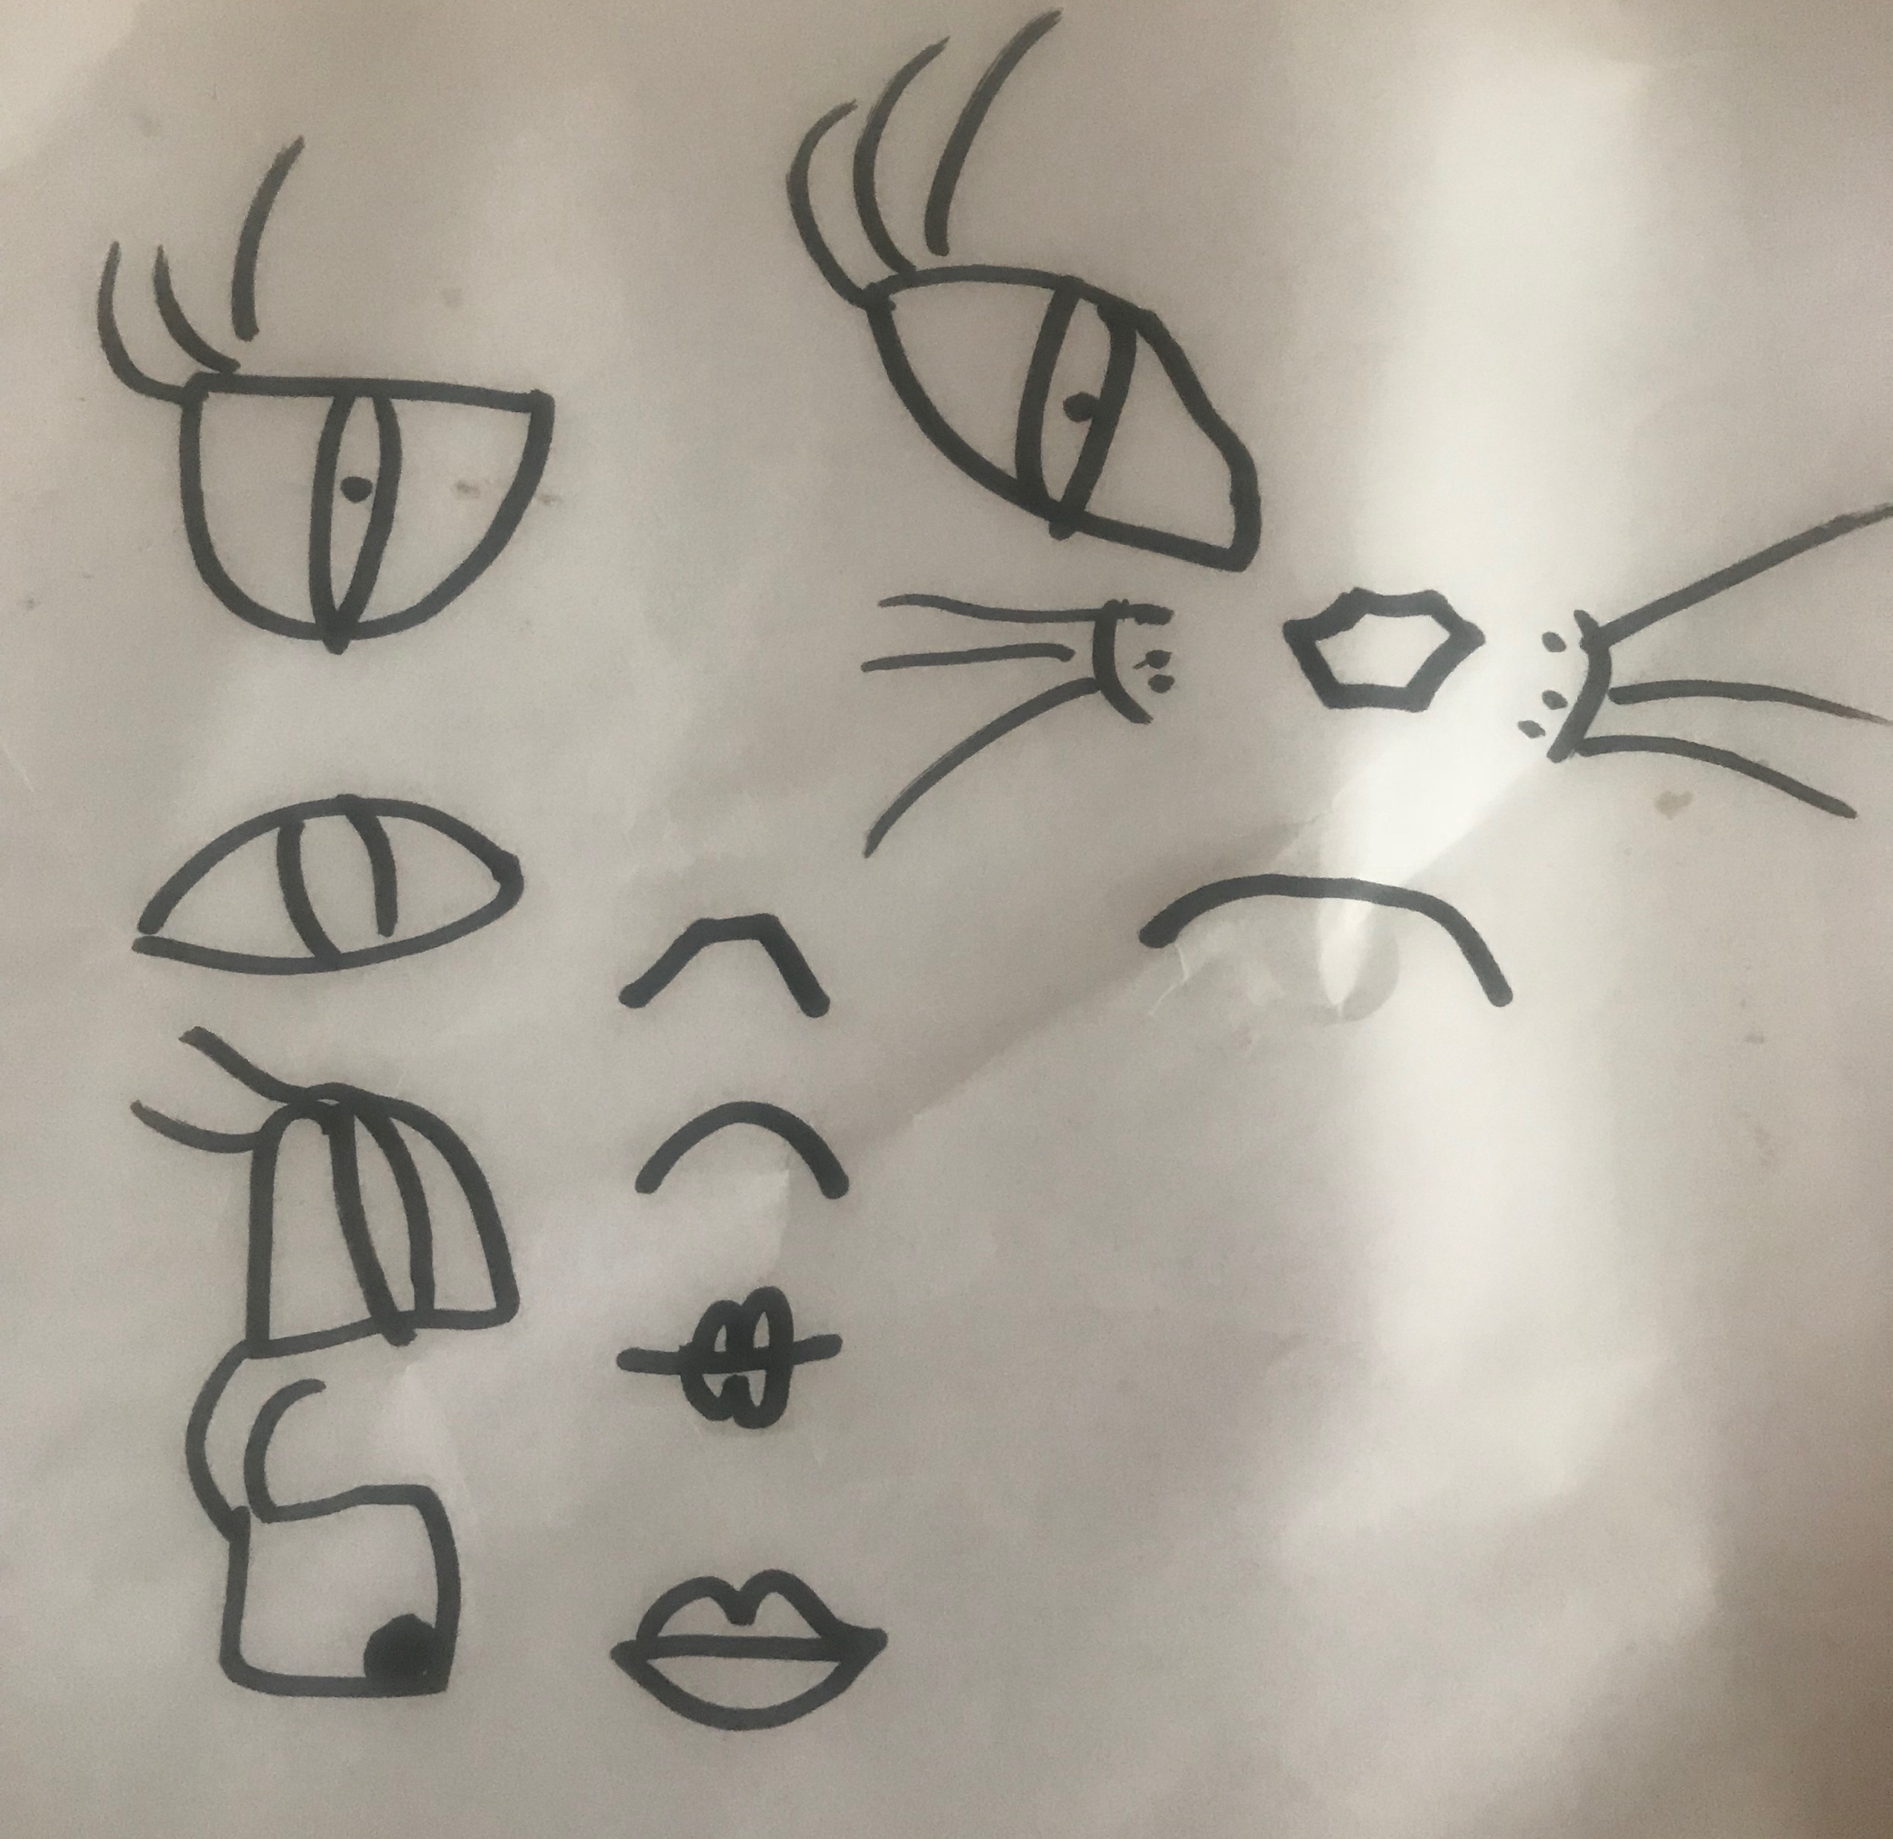
My Character’s body:
You could use Photoshop or these sites:
https://mybluerobot.com/create-your-own-avatar/
http://www.toondoo.com/
https://www.cartoonify.de
https://www.mixamo.com
https://join.secondlife.com
Facial features:
Clothing / colours:
You can hand-draw this or digitally create your character

Slide 5
Summary of my brief:
Character inspiration:
Any other character information:
EXAMPLE
Age of audience: 15-18
Personality/interests/job:
Character Name:

