Slide 1
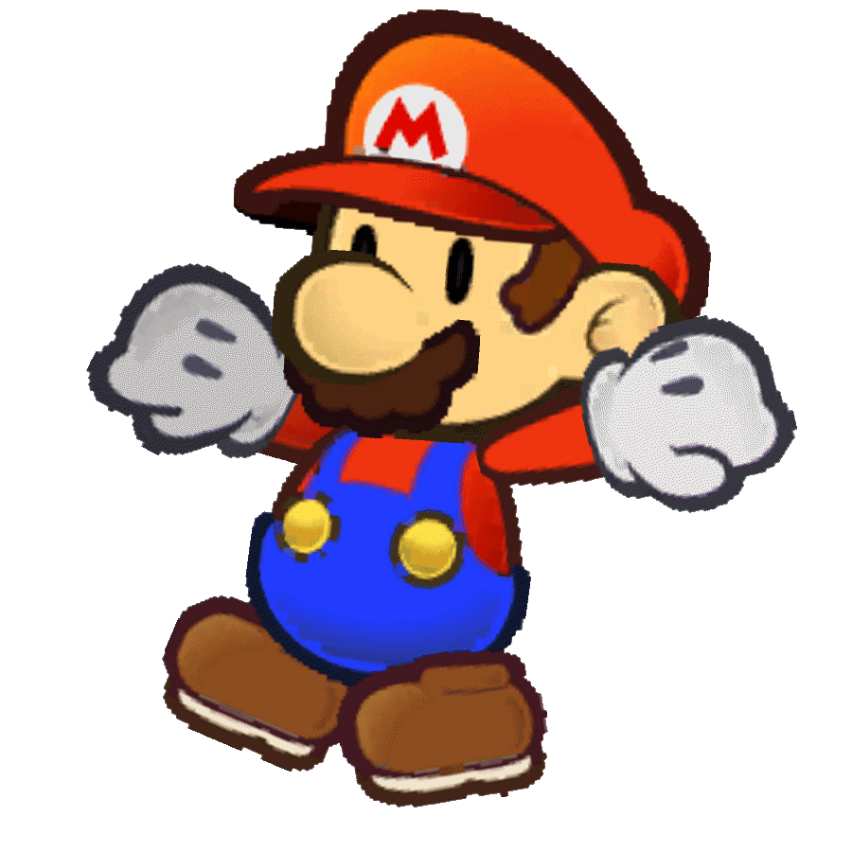
Character Creation
Learning Objective: To create concept art and illustrate digital characters suitable for your target audience.

Slide 2
Starter: Character creation
Work in your teams to create the ideal character (protagonist or antagonist).
Which body parts, colours would you use?
What is suitable for your audience?
Use our class brief from Sport UK: to get more 5-6 year olds interested in sports and the Olympics from an early age.
Stretch and Challenge:
label and annotate why you have chosen each part. How does it relate to the brief/target audience?
Learning Objective: To create concept art and illustrate digital characters suitable for your target audience.

Slide 3
Character Creation: Peer Assessment
What do you like?
What do you think could be developed more or done differently?
Which character suited the brief best?
Learning Objective: To create concept art and illustrate digital characters suitable for your target audience.

Slide 4
Lessons up to end of term
Create a mood board for the characters, genre, narrative and game world.
Develop our mind maps to explain and illustrate our initial ideas.
Strengthening our research on target audience and create a profile for them.
Working on our individual game idea presentations (which will continue and develop after Easter).
Learning Objective: To create concept art and illustrate digital characters suitable for your target audience.

Slide 6
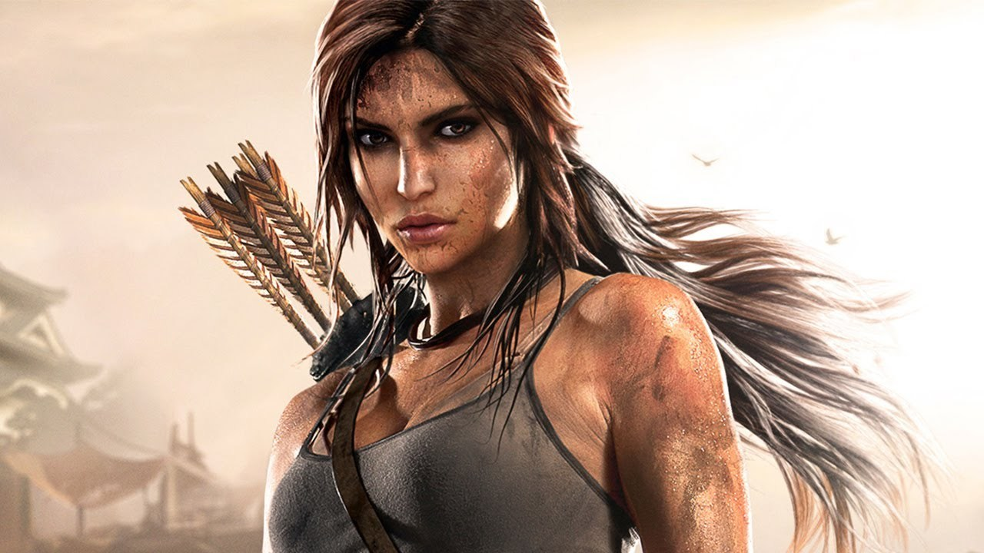
What makes these character successful in the game market?
Learning Objective: To create concept art and illustrate digital characters suitable for your target audience.

Slide 8
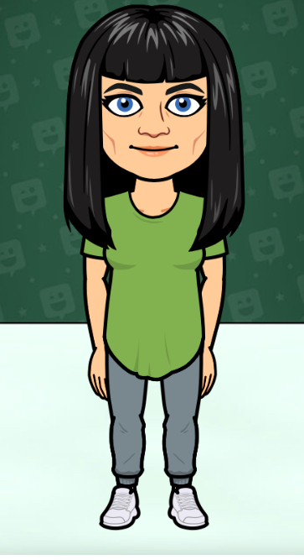
”A typical female in her 30s”
Learning Objective: To create concept art and illustrate digital characters suitable for your target audience.

Slide 9
Job – Teacher
Aged – 31
Likes – HipHop, Grime, R’n’B music, films, radio, jewellery, shopping, going bowling.
Colours – purple, red, blue, black.
Personality – happy, outgoing, friendly.
Learning Objective: To create concept art and illustrate digital characters suitable for your target audience.

Slide 10
Learning Objective: To create concept art and illustrate digital characters suitable for your target audience.
Use the worksheet to create concept art designs to develop your character ideas.
This can be digital or hand-written/drawn
Exam Board note: learners don’t have to be good artists and drawing skills are not assessed in the unit. It is the concepts and detail that are important.
Stretch and Challenge: create a mood board for your character – capture their hobbies, personality, clothing, emotions. This can be digital or hand drawn.

Slide 11
Plenary
Make sure your worksheets have your name on them. Hand them back to Miss Samuels, before you leave.
List 3 things which are needed to make a good digital game character.
Stretch and Challenge: ”I’ve ensured my character will suit my target audience by____________”
Learning Objective: To create concept art and illustrate digital characters suitable for your target audience.

