Slide 1
Coursework Lesson 1
Genre and Research
Learning objective: To recall and explain different genres from the TV world.

Slide 2
Marks available
10 – Statement of Aims and Intentions
20 – creating a product that meets the requirements of the brief. Matching form, genre, industry, context and target audience.
30 – creating a product that uses media language to communicate meaning and construct representations.
60

Slide 3
Brief 1 – Main production
A cross-media production for a new television programme in a factual or fictional genre (or sub-genre/hybrid) of your choice.
Create an AV sequence from a new television programme focusing on a key turning point OR a point of significant conflict OR a resolution.
2 minutes and 30 seconds to 3 minutes

Slide 4
Cross media element
Choice of either Online or Print
Either a functioning website with a homepage and one linked page to promote the television programme. Needs 30-45 seconds of embedded audio or AV material related to the topic.
OR
A front cover and double page spread feature article to publicise the television programme in a new lifestyle magazine. 3 pages

Slide 5
Learning objective: To recall and explain different genres from the TV world.
What are your thoughts so far?
Factual
Fictional

Slide 6
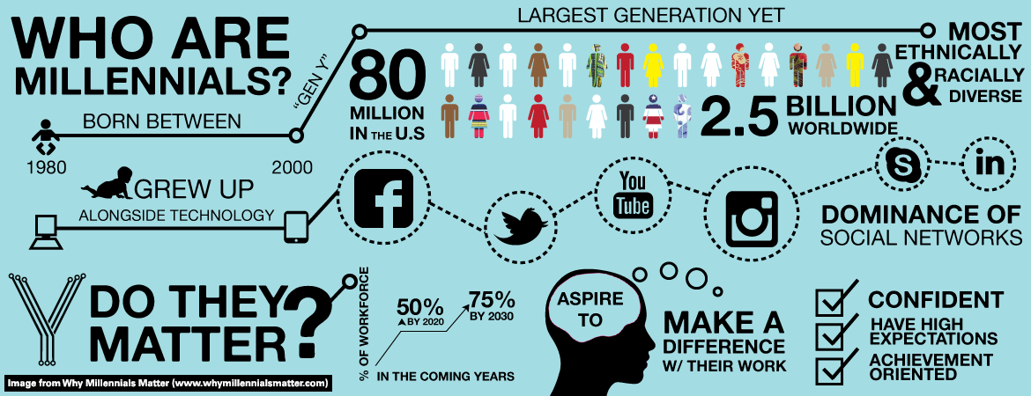
Who is the audience?

Slide 7
What do you watch?
1.Write down your favourite programmes.
2.What do you like about them?
3. Are they factual/fictional?
4. Who are the main people involved? (presenter/characters)
5. What genre are they?
6. What keeps you watching it?
10 minutes
Learning objective: To recall and explain different genres from the TV world.

Slide 8
In pairs
Stretch and challenge: Think of 3 genres which are hybrid. List their conventions.
List 3 examples for each genre you have in your envelopes.
What are key conventions of that genre?
Example: Romantic comedy : Love sick – features conversation and events which are funny and about intimate relationships
Learning objective: To recall and explain different genres from the TV world.

Slide 9
For the brief you have…
What are the requirements? Annotate key words – what is it wanting you to do?
What are the potential mistakes you could make (wrong genre, wrong target audience etc?)
What skills would you need to demonstrate?
What key terms do you need to understand? What would you need to research?

