Slide 1
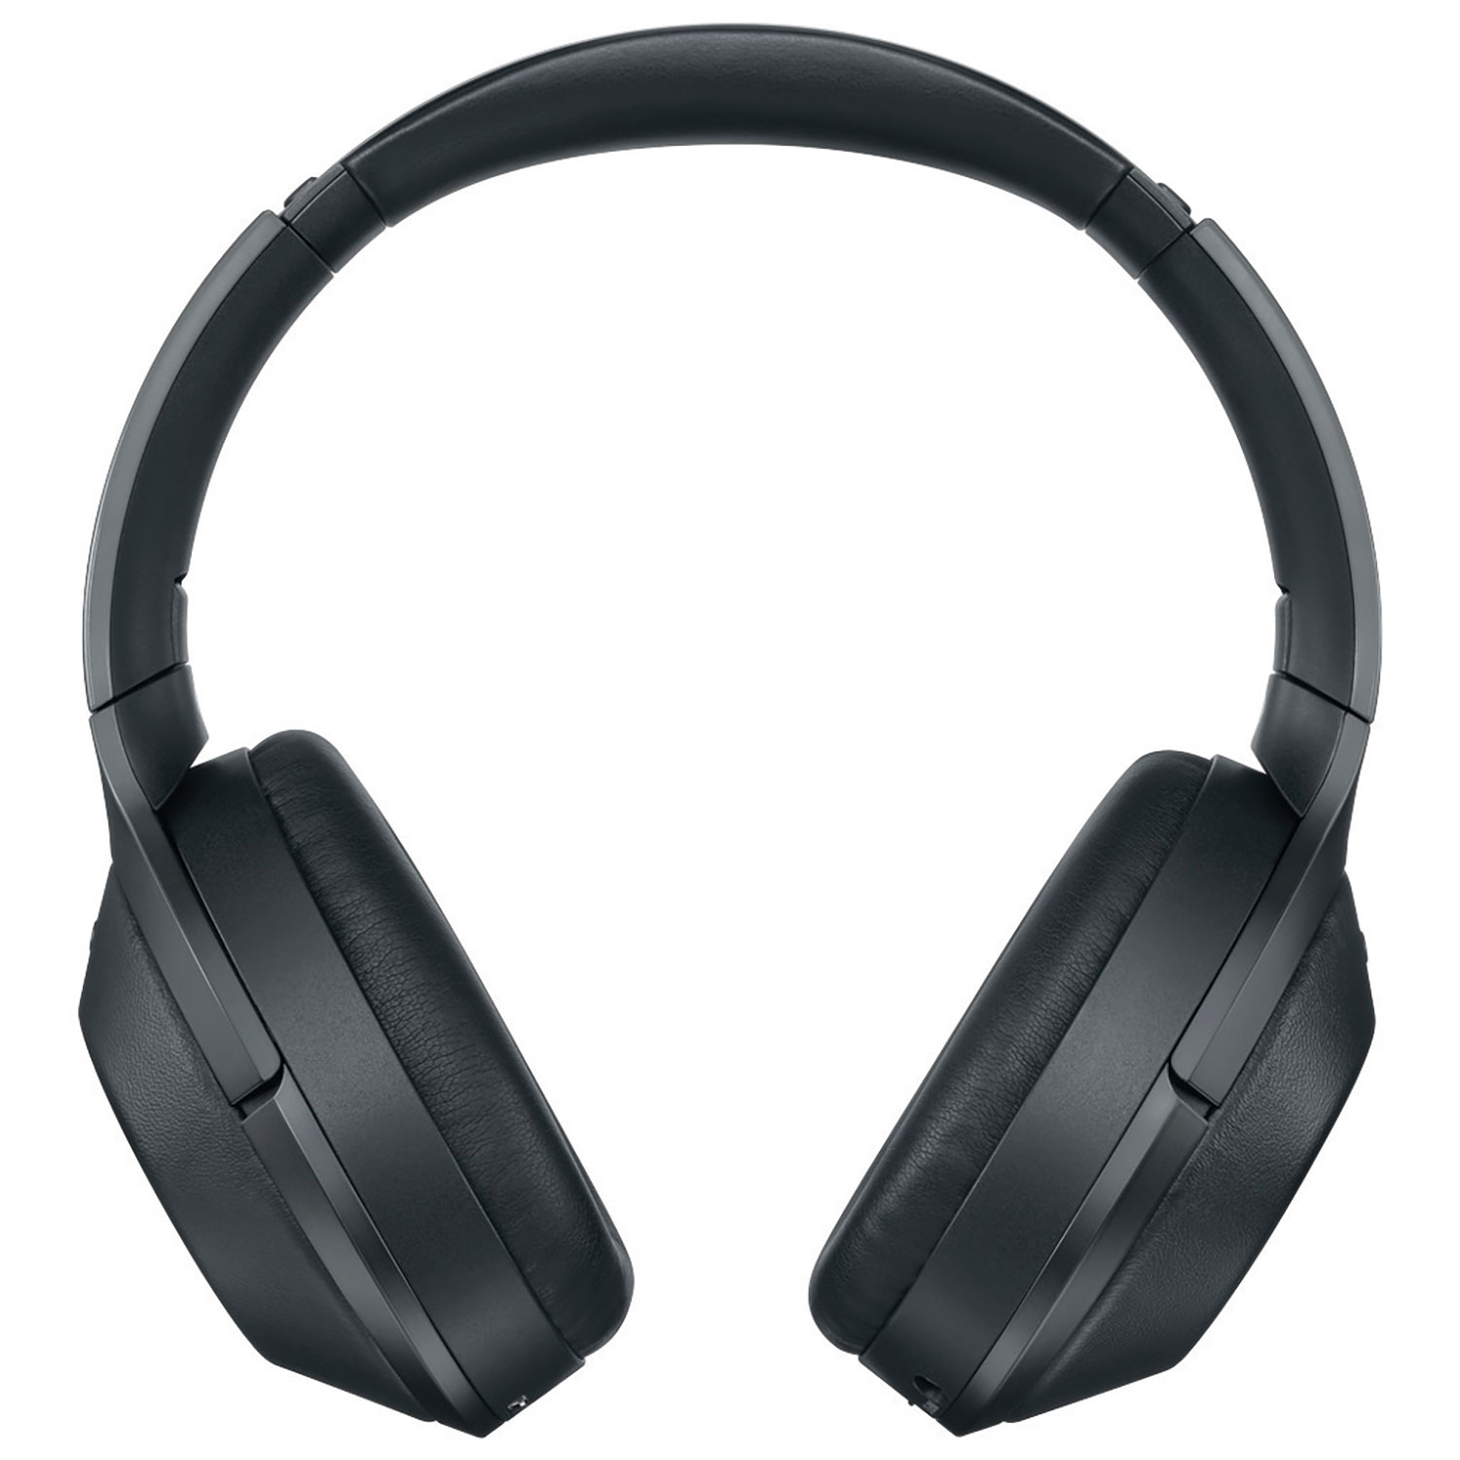
Radio Production: Unit 14
Learning Objective: To complete Podcasts and Prezi’s to a significant standard, ready to start planning your radio programmes.

Slide 2
lAST TWO weekS
5 TASKS TO COMPLETE:
Prezi – radio stations / job roles
Podcast – radio station focus
Report/prezi/podcast script : analysing the structure of a radio station and show.
Blog post – including vox pops / audience data: survey monkey and FM/DAB/MW/AM WRITE UP.
STUDIO AND TECHNOLOGY LABEL BLOGPOST OR A VIDEO TOUR OF A LIVE STUDIO.

Slide 3
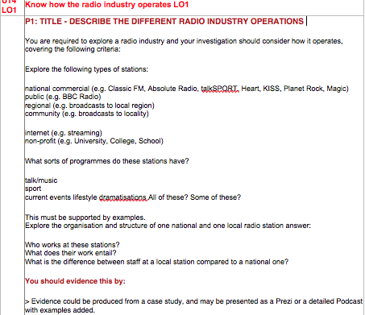
Learning objective: to hone your work to a professional standard.
Task 1. Exploring Radio Prezi : Focus on 2 radio stations and look at their job roles.

Slide 4
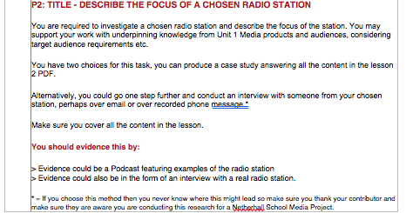
Learning objective: to hone your work to a professional standard.
Task 2: pODCAST – Talk about chosen radio station, it’s focus and it’s audience

Slide 5
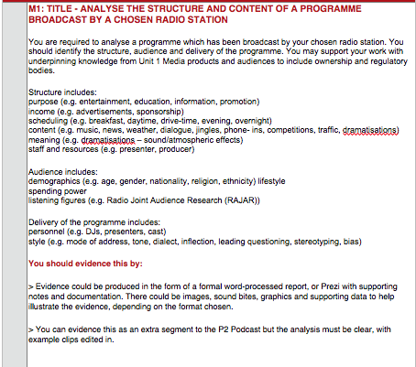
Learning objective: to hone your work to a professional standard.
tASK 3: m1 analyse the structure and content of a programme broadcast. Also an audience analysis. This could be a written report, podcast or Prezi. If Podcast – a script needs to be added to blog. Include images, soundbites and research data.

Slide 6
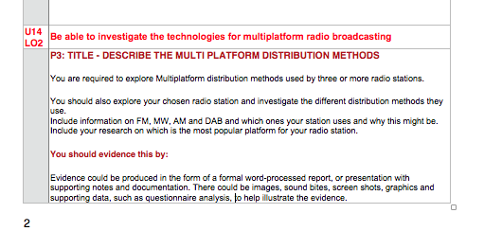
Learning objective: to hone your work to a professional standard.
Task 4: A Prezi, written report or blog post with screen shots, vox pops, questionnaire analysis can be added.
Detail on the different types of radio broadcast / platform
Research on the best way to broadcast for the listener and what you would choose if was in charge of Netherhall radio.

Slide 7
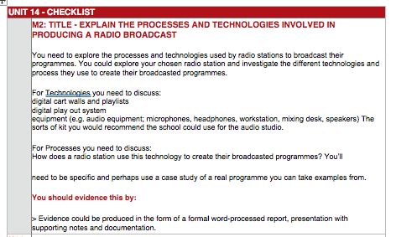
Learning objective: to hone your work to a professional standard.
TASK 5 – Photo or video of a studio and labelled. A blog post talking about how technology is used in broadcast.

