Slide 1
Designing a Game Concept
Learning Objective: To create ideas to develop into a digital game

Slide 2
Learning Objective: To create ideas to develop into a digital game
Starter
How creative are you?
How many ways can you use a paper clip?

Slide 3
Learning Objective: To create ideas to develop into a digital game
4 ways to plan and
develop ideas
Say what you see…….

Slide 4
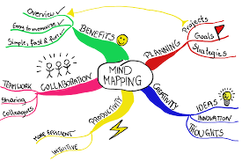
Analysing a brief: TOOLS
Tool 1:

Slide 5
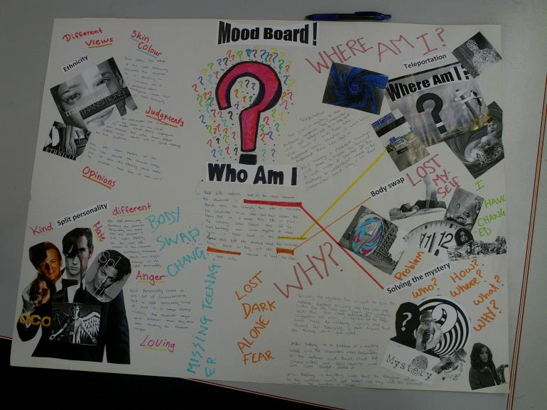
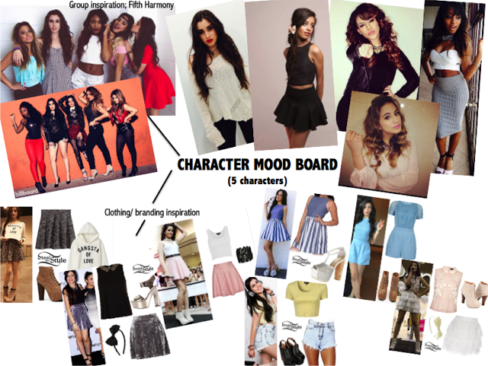
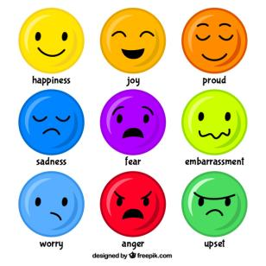
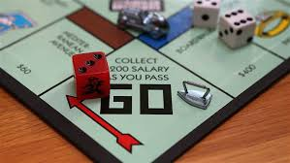
Analysing a brief: TOOLS
Tool 2:

Slide 6
Analysing a brief: TOOLS
Tool 3:

Slide 7
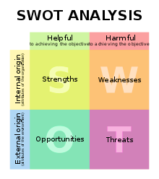
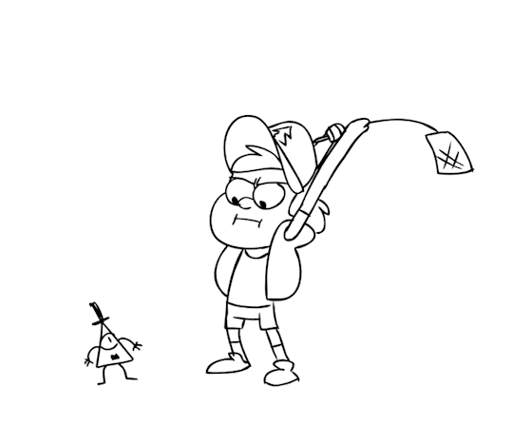
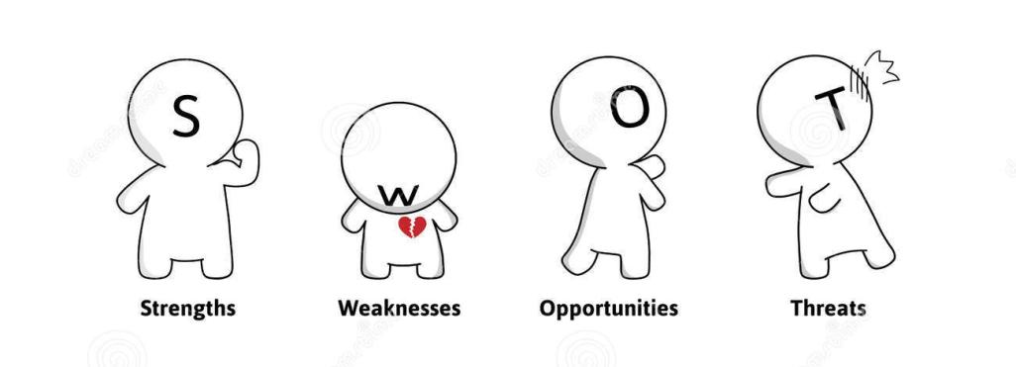
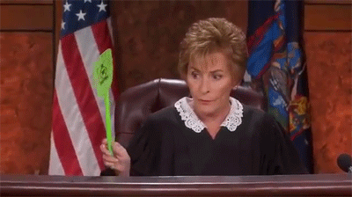
Analysing a brief: TOOLS
Tool 4

Slide 8
Learning Objective: To create ideas to develop into a digital game
Brief 1
You have been asked to write a proposal for a new game which will help to improve road safety. Your client is a government department that wants a game-based learning method to replace the ‘public information films’ produced by the Central Information Office to inform and educate the public.
The game must be aimed at a target audience of 12–18 year olds. It could focus on some or all of the following groups of road users:
• pedestrians
• cyclists
• drivers of motor vehicles.

Slide 9
Learning Objective: To create ideas to develop into a digital game
You have been asked to write a proposal for a new game by the government to encourage healthier lifestyles. With reports that childhood obesity has risen by 42% in the last 5 years, the local government would like a game to be created which inspires young people to make healthier choices.
The game must be aimed at a target audience of 12–18 year olds. It could focus on some or all of the following:
Exercise
Healthy food swaps
Creating recipes
Making smart choices
The game proposal must explain your chosen game components, narrative and gameplay. The client has no preference for any particular platform or hardware for the game.

Slide 10
You have been asked to write a game proposal by the local education authority who believe students entering secondary school need help with developing their math skills.
The client would like you to create a game which is tailored to females aged 8-12 and allows them to learn new skills and gain confidence in some/all of the following:
Multiplication
Subtraction
Timetables
Division
Fractions
Learning Objective: To create ideas to develop into a digital game

Slide 11
The Science museum has commissioned a new game to be created which mirrors their exhibition on the human body.
The client would like the game to be created so that 12-18 year olds are encouraged to take more of an interest in biology and would want to visit the Science museum more.
The client doesn’t mind what platform is used for the game but would like it to do some/all of the following:
Explore the human skeleton
Encourage kids to learn about the human body in a fun way
Entice kids to learn cool science facts.
Develop observation skills
Teaching about the anatomy.
Learning Objective: To create ideas to develop into a digital game

Slide 12
Blue-Sky Thinking
Learning Objective: To create ideas to develop into a digital game
Read through your chosen brief in silence.
In silence write down ANY ideas that come to mind
What could game play be like? What colours would suit your game? Locations? Game objectives? Characters? Challenges? Platforms?
Think of words which associate to your project
Fill your page.

Slide 13
Evaluate your ideas
Learning Objective: To create ideas to develop into a digital game
Read through your ideas.
Highlight 3-5 of your best ideas.
Expand on points to develop your ideas further.
Which ideas could be developed?
Which are ideas that are ready to be created into a game today?
Which ideas need to be on the scrap heap?
Photo your finished blue sky thinking ready to add to your project portfolio
Stretch and challenge: using your ideas, write down what narrative or game objective could you create?

