Slide 1
Unit 91 Designing a Game Concept
Learning Outcome: To identify computer game objectives.

Slide 2
Learning Outcome: To identify computer game objectives.
What is an objective?
Use the white boards to list as many game objectives that you can think of.
Stretch and Challenge: write down games which use these type of objectives.
For example: Super Mario FINDS and RESCUES Princess Peach

Slide 3
Learning Outcome: To identify computer game objectives.
The Main Objectives we’re concentrating on:
solve
find
move to
destroy
escape from.
What games can you associate with these objectives?

Slide 4
Learning Outcome: To identify computer game objectives.
Fill these in on the worksheet
Game objectives relates to Bartel player type theory:
Achievers
Socialisers
Explorers
Clubbers
Stretch and Challenge: Think about what kind of gamer you are and why. Right a short paragraph as to which card relates to you.

Slide 5
Learning Outcome: To identify computer game objectives.
In your group identify as many game titles that associate with your card type.
Why do they fit with that card?
Stretch and challenge: Create and describe your own game idea based on your card type.

Slide 6
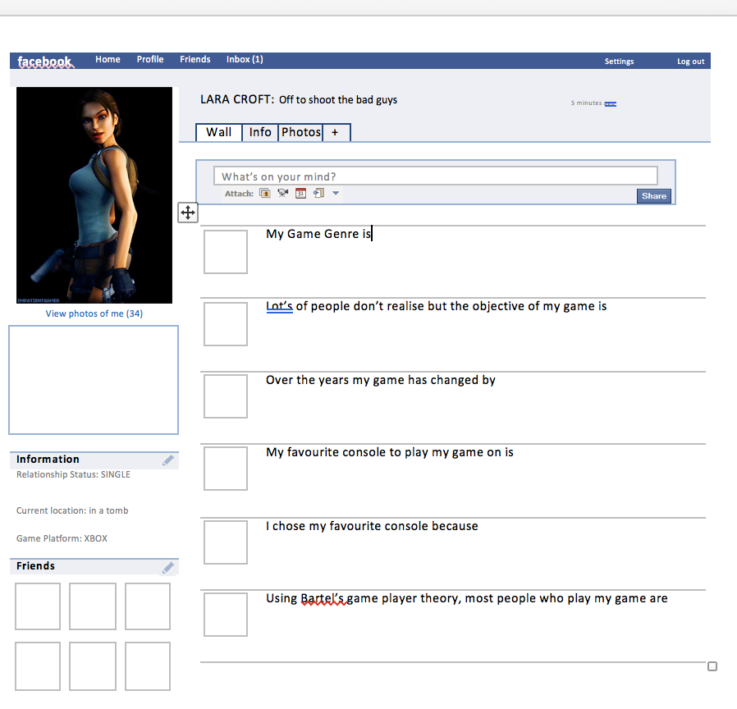
Learning Outcome: To identify computer game objectives.
Stretch and Challenge: Research how the digital game has developed over the years. Has graphics or game play changed?
Final Task
1.Download the Facebook game objective sheet from the R091 Cnat 10 page (just above cover work).
2.Choose a game and character from that game.
3.Create a gamer profile – write about the platforms they use, what is their game objective and their genre.

Slide 7
Name:
Stretch and Challenge: Think about what kind of gamer you are and why. Right a short paragraph as to which card relates to you.
c
Stretch and challenge: Create and describe your own game idea based on your card type.

Slide 8
Name:
Game Objectives:
c
Stretch and challenge: Create and describe your own game idea based on your card type.

Slide 9
Write down which each card means
Name:
Game Player Types (Bartel)
Game Objectives:
The Main Objectives we’re concentrating on:
(below name a game where this is the objective)
solve :
find :
move to :
destroy :
escape from:
c
Task: With your chosen card list games and genres which would relate
Example: If diamond – you’re an achiever so what game titles are games you play to achieve points, prizes or awards?

