Slide 1
Unit 6: Globalisation
L.O. – How can we understand the impact of social media and globalisation on media audiences and producers?

Slide 2
A reminder…
Wikinonmics – the ways that media technologies have changed the production and distribution of products
What examples can you discuss?

Slide 3
What is globalisation?
Globalisation – the process of international integration arising from the interchange and exchange of products, ideas, politics and popular culture. Globalisation is also seen as a way that international boundaries that once existed are broken down due to the onset of new technologies.

Slide 4
The positive impacts and benefits of social media and globalisation
What do you think they might be for personal use and for professional use of social media?

Slide 5
Connectivity of ideas
McLuhan (1964) suggested that new media technologies would create a type of global village
What do you think he meant by this phrase?
A global village is where people from all over the world can come together and can access a wealth of information, as well as sharing and collaborating instantaneously

Slide 6
Web utopians
Web utopians – those who see online and social media technologies as a benefit to society. They believe that social media and Web 2.0 allow societies to come together to promote social good or the utopian ideal
David Gauntlett is a web utopian and believes that geographical boundaries are non-existent thanks to social media and connectivity
Can you give real world examples where this takes place for both personal and professional users? (Make notes of these examples, as they will help in the examination)

Slide 7
Sharing of technology and innovation
Rheingold (1991) foresaw the sharing of technology, software, ideas and content and termed the phrase electronic agora
This describes the online meeting spaces (forums and chatrooms) where people can discuss topics, ideas and ways to achieve collaboration of projects
In the mid-2000s people went online to a digital environment called ‘Second Life’ where they socialised using avatars and it helped facilitate distance learning
EVE online (2003) allowed users to make money in the real world trading in the virtual world

Slide 9
Sectors that benefit from the sharing and downloading material
Gaming and computer science
Cloud 9 is an environment that allows coders to swap and share ideas
eSports allows gamers to compete professionally online
SoundCloud allows music to be distributed and shared to creative prosumers (amateur producers that use digital and online technologies to create and distribute media products)

Slide 10
Generation of funding
Crowdfunding platforms (like Kickstarter) are allowing creative users to gain funding to start projects that they would never have been able to do previously
The projects don’t have to be media projects, like TV programmes, music, films and video games, as all kinds of projects can be funded
This enables ‘normal people’, not backed by big businesses, to be able to gain funds to create new and interesting projects. Thanks to social media this can be on a worldwide platform
To date, Kickstarter has funded over 144,000 projects and $3,688,465,948 has been pledged

Slide 11
The negative impacts and disadvantages of social media and globalisation
What do you think they might be for personal use and for professional use of social media?

Slide 12
Negative impacts for users and industry
Online stalking and trolling: sharing of images and data, not checking security settings, accepting ’friends’, constant use may mean hard to get away from it
Personal and professional users need to know how to keep themselves safe and information provate in this digital world

Slide 13
Cyber-bullying
Social media is immediate and can be made available to many people
Children might be more vulnerable, as perpetrators can be anonymous, or as someone they think they can trust
It is reported that more than 42% of young people have been victims of cyber-bullying

Slide 14
Moral panic
moral panic – when the media creates fear in the population over an issue that appears to threaten or harm normal social order
Stanley Cohen created this theory in 1972
What moral panics have been used for the use of social media?
http://www.bbc.com/future/story/20180104-is-social-media-bad-for-you-the-evidence-and-the-unknowns

Slide 15
Loss of privacy
We forget that what we put online is there for all to see
Security settings can often be badly advertised (why?), complicated and/or change over time and we can forget to update them
Potential employers could look you up and access unfavourable material from years ago

Slide 16
Decreased productivity
Businesses might use social media to find and communicate with clients, but these sites are also a big distraction for employees and are very easy to access
Individuals could also post inappropriate things about their workplace, which could lead to disciplinary action

Slide 17
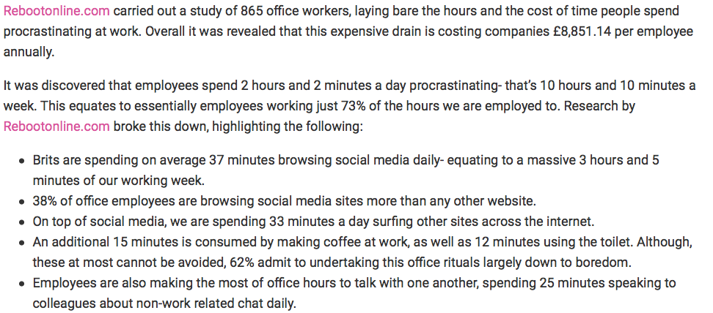

Slide 18
Negative publicity
Some social media campaigns can cause harm to a business brand or image
Public might parody campaigns or make political or social statements about a brand by creating sarcastic memes, which can go viral
https://awario.com/blog/starbucks-best-and-worst-marketing-campaigns/

Slide 19
Impact on wider society
Moral panics have also focused on the impact social media has on the celebrity-obsessed culture and how women are represented online
Instagram features heavily photoshopped images of female celebrities that cause societal concerns, as often the images are highly sexualised and/or graphic in content
These could be seen as role models to young people

Slide 20
The media effects debate…a Unit 1 reminder!

Slide 21
Theories that state we are heavily influenced by the media we consume
Think about how they can be applied to social media through the use of real world examples

Slide 22
The media effects debate
how much of an effect the media has on us has been a topic of great debate
many theories have been created trying to explain how audiences might be influenced by violent and sexualised images and the impact on social media

Slide 23
Passive audience theory
This references Packard’s idea of the mass media injecting ideas in to our minds
States that audiences are unable to reject media messages
This means that they are vulnerable to the negative effects of the media products they consume
They worried about ‘copycat’ effects where audiences copy what they see

Slide 24
Gerbner and Gross – Cultivation theory
This suggests that over time, repetitive viewing of violent acts allows certain ideas and values to become normalised
Repeated viewing of violent images, in TV, film and video games, may make audiences become immune to negative and/or violent representations
Audiences become desensitised to negative images, accepting them to be ’normal’
desensitisation – the idea that prolonged exposure to violent images numbs the effect of them and we become accustomed to them

Slide 25
Theories that state we are not so easily influenced by the media we consume
Think about how they can be applied to social media through the use of real world examples

Slide 26
Active audiences
The ’effects debate’ has been criticised for being outdated
Gauntlett (2004) states that these effects models are inadequate, as they see media texts as the root of the problem rather than sociological and psychological factors
This theory argues that audiences don’t passively receive information from the media, but are actively involved, often unconsciously, in making sense of the messages within their own personal and social contexts

Slide 27
‘Pick and mix’ theory
David Gauntlett’s theory understands that an audience is autonomous and counteracts theories that state audiences are affected by what media they consume
The theory focuses on how magazines and advertisements attract and represent audiences (although it can relate to all media texts)

Slide 28
Does globalisation and interconnectivity increase imperialism?
Imperialism – the way culture and technologies of a more powerful society may impact on, and potentially erode, a less developed society.
Western popular culture is promoted to less developed countries on social media and often for commercial gain by large institutions
Why might this be a bad thing?
Socially and ethically, is this right?

