Slide 1
Component 1: Section A Analysing Media Language and Representation
L.O. – What are the basics when analysing media texts?

Slide 2
The first part of the media framework we will focus on is media language
Media language – how the media communicate meaning through their forms, codes and conventions and techniques
forms – different types of media (newspapers, magazines, radio etc.)

Slide 3
You must understand this…
The creators of media products encode messages and meanings within the product through media language
Audiences decode these messages and respond to them in different ways
encode – communicate ideas and messages through a system of signs
decode – the process through which an audience interprets a message

Slide 4
Signs L.O – How do media texts communicate to an audience? What is a sign? BLP – Making links

Slide 5
Reading Media Texts
sign - a word or image that is used to represent an object or idea

Slide 6
What is a media text?
A media text is a phrase used to describe any media product, such as television programmes, photographs, films, newspaper articles, magazines, web pages, radio programmes, video games, advertisements etc.
We will analyse many media texts and one of the keys to understanding the meanings in texts is the use of codes
codes – signs contained within a media product that give clues to the product’s meaning

Slide 7
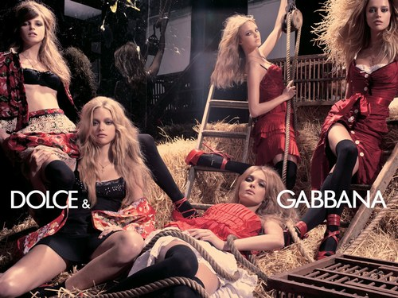
This advertisement is a sign

Slide 8
Signs
Fiske and Hartley (Reading Television, 1978) describe the sign as being made up of two components: the signifier and the signified
signifier+ signified = sign
the signifier is a physical object, for example a sound, printed word, advertisement
the signified is a mental concept or meaning conveyed by the signifier

Slide 9
This print advertisement is a sign
The signifier is the printed magazine / billboard advert
The signified is what might be suggested by the advert. What is this advert suggesting about the D & G brand?

Slide 10
Homework
Analyse and label a sign
Write down what is the signifier and signified
Write in detail about the signified, as this is the most important part
This is the first piece of work that I will see, so make it your best!

Slide 11
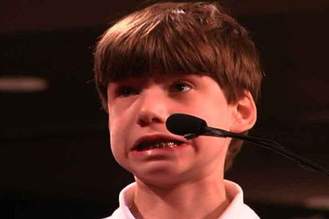
A single image could be considered open, as the meaning is uncertain. A caption or written messages will limit the meaning of an image, making it become more clear or closed.This caption can help to anchor the meaning of an image. This is known as anchorage, the fixing or limiting of a particular set of meanings to an image, usually seen underneath a photograph.
If an image has many interpretations it is known to be polysemic. Anchorage can be used to limit the number of interpretations for an audience.
How could a caption anchor this image? How could anchorage be used to manipulate an audience?

Slide 12
Dentist permanently freezes boy’s mouth.

Slide 13
Britain’s dentists are heading towards the perfect smile!

Slide 14
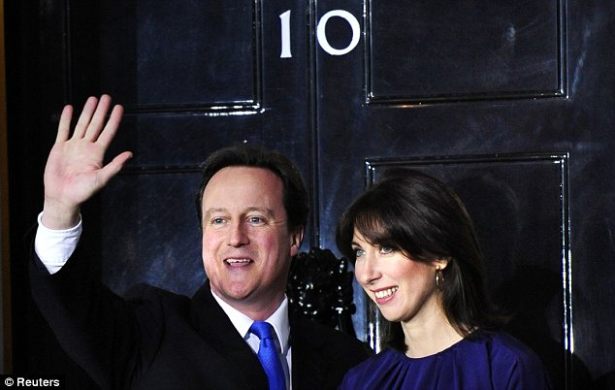
What anchorage text might appear with the following image in both The Sun and The Mirror?

Slide 15
Fill in the blanks
Media texts are __________, which means ___________________________________.
When a media text has many different interpretations it is called ________, so ___________ is used to _______ the various meanings, helping us to analyse it in the way the producer intended us to.

Slide 16
Five minute task!
Without the wording the Dolce &Gabbana photograph could be very ambiguous and difficult to put into context. Try putting different captions to the photograph to illustrate some of it’s possible meaning and suggest where else the photograph might appear.

Slide 17
D & G in a positive way
New Dolce & Gabbana campaign increases profit tenfold

Slide 18
D & G in a negative way
New D & G campaign criticised for showing negative stereotype of men

Slide 19
What does the following advert tell us about cultural experiences?
HSBC advert

Slide 20
Reading Signs L.O – How do media texts communicate to an audience? What is denotation and connotation?

Slide 21
Reading Signs
Denotation and Connotation

Slide 23
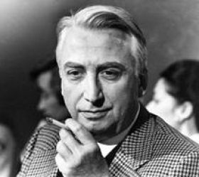
Roland Barthes
Barthes believed that we, the ‘reader’, go through various stages when we deconstruct the meaning of a sign.
The first stage is denotation, which refers to what is reproduced in the text, describing what is there in its most simplest of forms
The next stage is connotation where the ‘reader’ adds their own pieces of information. We fill in what is missing from the denotation stage and attempt to identify what the sign is signifying (meaning/inferring)

Slide 24
DENOTATION
CONNOTATION
flower
green stem
red petals
passion
love
romance
England
England rugby team

Slide 25
Definitions (write these down)
denotation- what an image actually shows and what is immediately apparent, rather than the assumptions an individual reader might make about it
connotation – the meaning of a sign that is arrived at through the cultural experiences a reader brings to it

Slide 26
The ‘Harry Potter and the Deathly Hallows’ film poster denotes a male character wearing dirty clothes and blood on his face. This connotes that this film will be darker in tone than the previous Potter films, because it features violent scenes. The denotations of the poster include a male character at the front of the poster connoting that he is the main character.

Slide 27
How might a still image communicate information to an audience?
A still image can communicate to a reader in many ways, including:
How the image is framed
The angle of the image. How might a low angle affect the image in contrast to a high angle?
Body language
Lighting
Colours present

Slide 28
Look at the following images and think about what is being communicated to an audience? Do you think that these connotations were what the photographer intended?

Slide 29
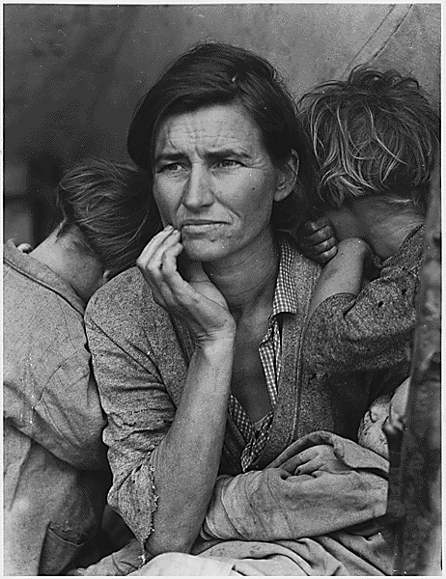

Slide 30
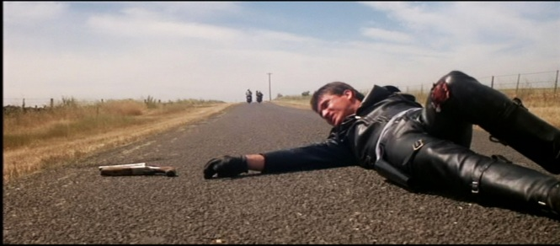

Slide 32
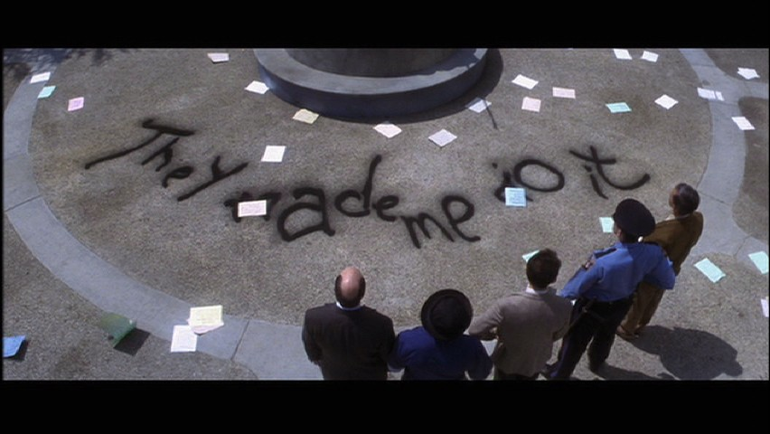

Slide 34
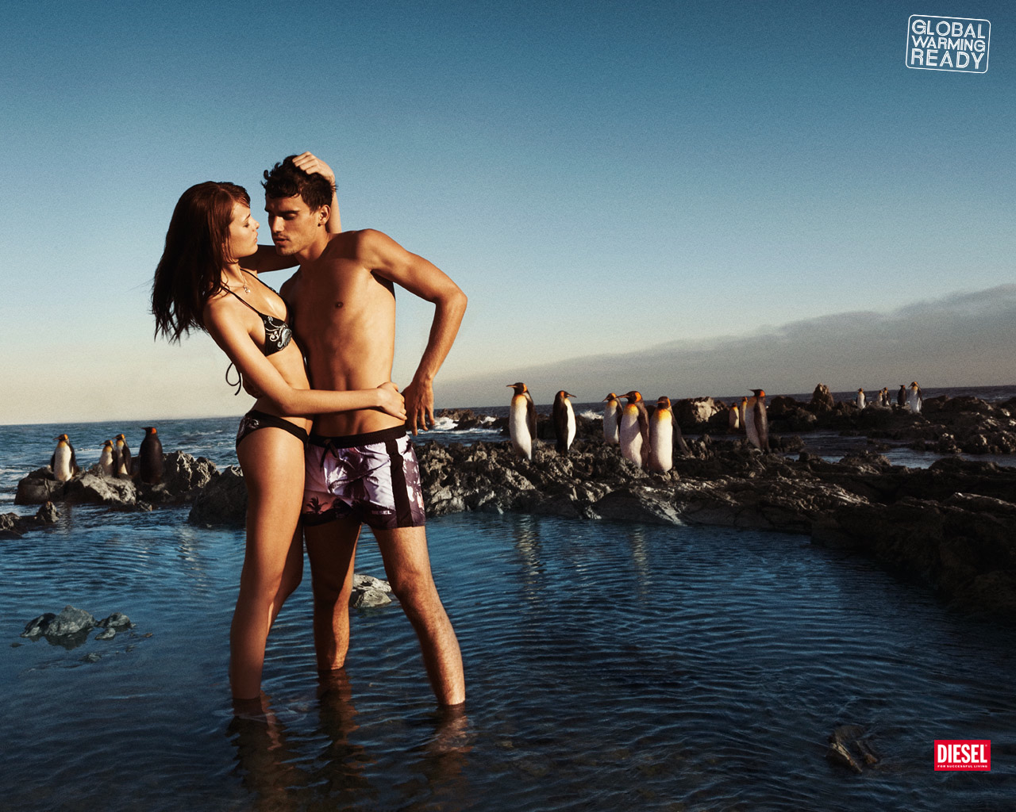

Slide 35
Your task
Find an interesting image from a magazine (this could be an advert, DVD cover, film poster etc). Cut the image out and annotate it in detail, focusing on the codes present and what is signified
You must use as much media language as possible!

Slide 36
Codes
L.O. - What type of codes are at work in media texts?

Slide 37
Codes
Signs often work through a series of codes that, like signs, are socially constructed and, therefore, agreed upon by society.

Slide 38
Dress codes
These relate to what people wear in particular situations; people in evening dress may be seen as glamorous, wealthy and sophisticated

Slide 39
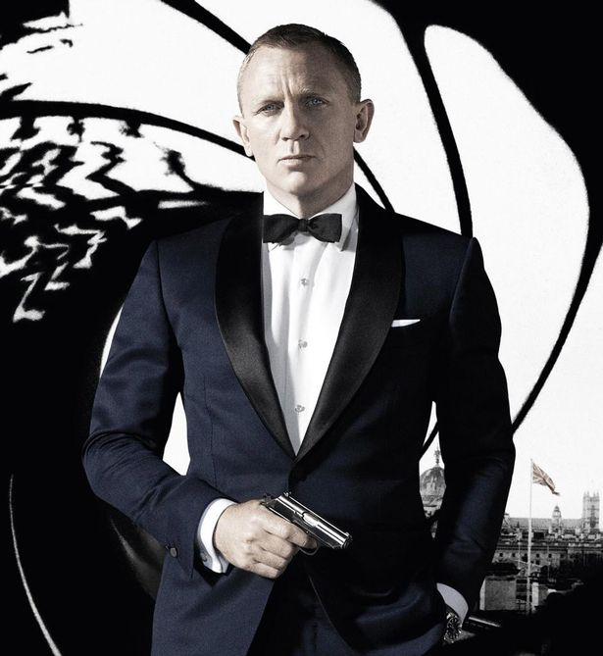
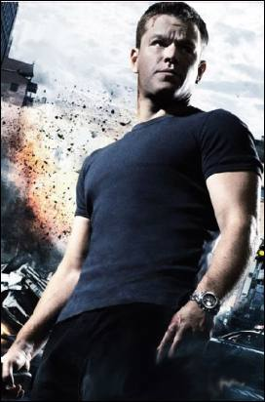
What do the dress codes say about these agents/spies?

Slide 40
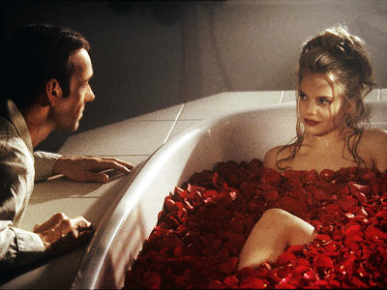
Colour codes
These vary depending on the culture: black is the colour for funerals in Western society, but some Asian countries wear white
Red can signify danger, passion or socialism
How does the use of the colour red affect the reader in relation to the characters?

Slide 41
Non-verbal codes
These codes are to do with gesture and body language, which also vary from culture to culture, as in Western society we shake hands when we meet, whereas in others they kiss on the cheek
facial expressions, different postures or gestures and proxemics (the way in which the people appear close together or keep their distance) are all analysed

Slide 42
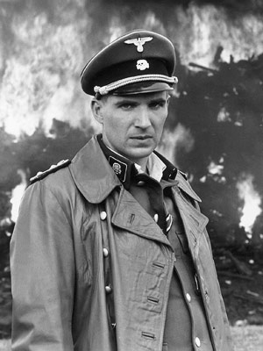
Technical codes
These relate to the way in which texts are reproduced and the media used and include camera shots, camera angles and editing
This could be a photograph or a film, such as Schindler’s List, that is shot mostly in black and white to convey the idea of documentary ‘realism’
It could be the use of close-up in a film to show strong emotions or an extreme long shot to show the environment

Slide 43
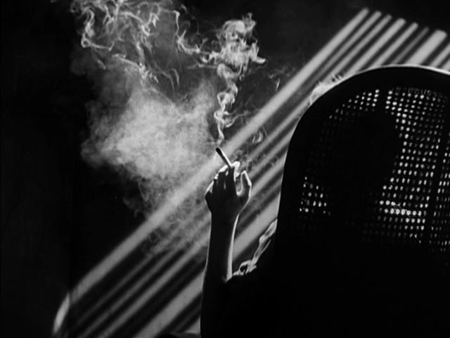
Lighting
Lighting is part of mise en scene, but is also included in technical codes
There are two types of lighting:
High key lighting eliminates shadows so most things in the shot are lit well and clearly seen
Low key lighting has fewer light sources and is used to create shadow

Slide 44
Mise-en-scene
mise-en-scene (pronounced ‘mise on sen’) is a French term that refers to a series of elements of film construction that may be seen within the frame of a single shot
it means ‘putting on stage’ and is really a theatre term
It includes: lighting, setting, costume and make up, props, colour and body language

Slide 45
Audio codes
There is an expectation that certain audio codes will appear in specific genres:
sound effects
diegetic sound – natural sound that is part of the scene (sounds the characters can hear)
non-diegetic sound – sound which is superimposed or ‘sound you can’t see’, like a voiceover or music to establish a mood
https://www.youtube.com/watch?v=NTi0Sx5UXec

Slide 46
Watch the opening to Donnie Darko and analyse the audio codes
What diegetic and non-diegetic sound do we have?
What do the sounds signify? What do they infer about the: narrative? Setting? Characters? Themes?

