Slide 1
Unit 14: Radio Production
Learning Objective:
To explore different radio broadcast styles
To identify key codes and conventions of radio broadcast

Slide 2
What different styles of radio are there?
Quick Reminder
Music radio
Lifestyle radio
Documentary
Speech radio
News based radio
Radio drama
Interviews
Reviews
Comedy radio
Phone-in discussion
Quiz
Travel

Slide 3
News Radio – Key Codes
Write this down
Jingle – start and end of a broadcast to signify it’s the news
Bed – music under the spoken word, usually upbeat or suitable to news story.
Sting / Stab – a short version of jingle or swift sound to separate stories
Sound Levels – some voices may be louder than others to define who is important / main reporter
Crescendo – music gets louder to demonstrate more drama or tension in the story.

Slide 4
News Radio – Key Codes
Write this down
Vox Pops – short sound bites of people talking about and giving opinion on the news story.
Introduction – presenter introduces the news stories, possibly with soundbites of upcoming news.
Trail – “Coming up” talking about news stories on the way in an entertaining way – something not to miss.
Copy stories – brief stories. Usually 4 lines long – summary of main story.

Slide 5
News Radio – Key Codes
Write this down
Silence – to emphasise emotion or tension.
O.B – Outside broadcast. Usually from a portable radio station truck. Will feature sounds of the location (possible crowds at a festival) to help listeners visualise.
S.O.C – Standard out cue. Conclusion to the news bulletin. Usually will involve the website/social media details and a time check.

Slide 6
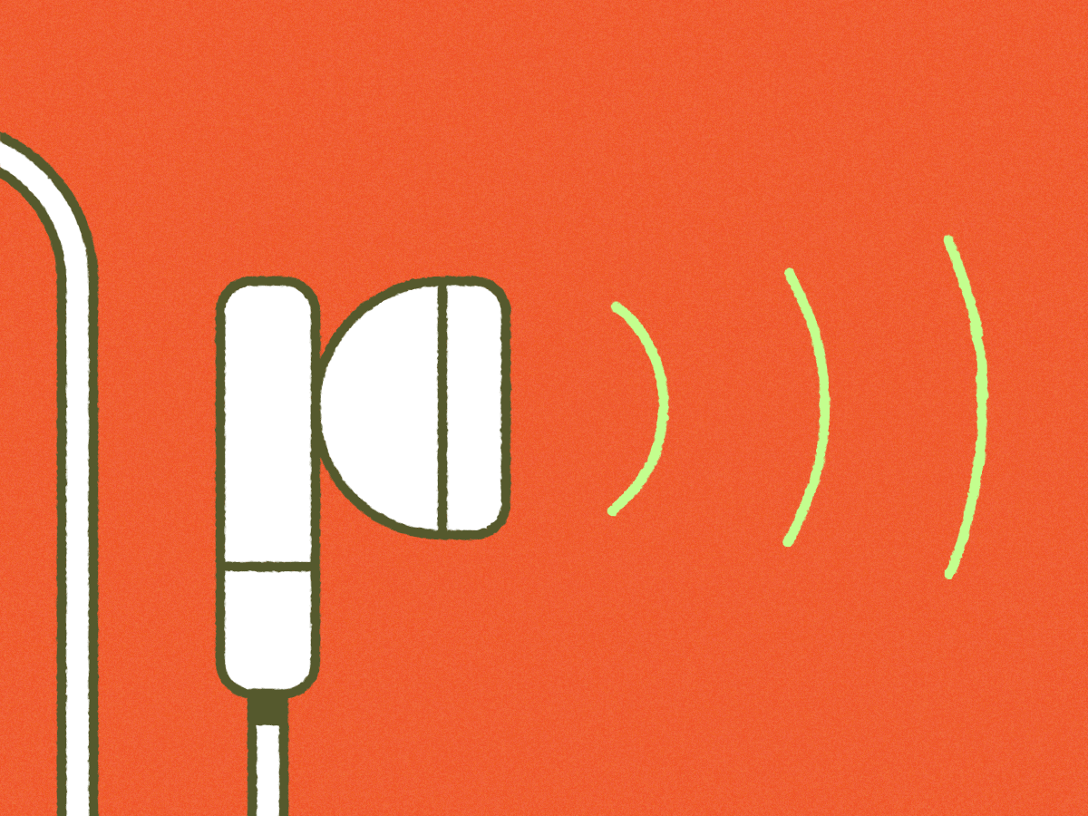
What conventions do you spot?
Newsbeat Live broadcast
Learning Objective:
To explore different radio broadcast styles
To identify key codes and conventions of radio broadcast

Slide 7
News – mini docs
Learning Objective:
To explore different radio broadcast styles
To identify key codes and conventions of radio broadcast
What conventions do you spot?
Anorexia Documentary

Slide 8
What do you feel are important to a news broadcast?
Learning Objective:
To explore different radio broadcast styles
To identify key codes and conventions of radio broadcast

