Slide 1
Unit 9: Comics and graphic novel storytelling
L.O. – What do we have do do for this unit?
How can we research comic books/graphic novels to understand their conventions?

Slide 2
What is the purpose of a comic book?
In pairs, list as many reasons why people might read comic books
‘comics can inform, persuade, and encourage new behaviors in readers.’ https://govbooktalk.gpo.gov/2012/02/07/society-through-a-comic-lens/

Slide 3
What is a comic book?
‘A magazine that presents a serialized story in the form of a comic strip, typically featuring the adventures of a superhero.’ (https://en.oxforddictionaries.com/definition/comic_book)
‘A comic book is a magazine that contains stories told in pictures.’ (https://www.collinsdictionary.com/dictionary/english/comic-book)
‘A comic book or comicbook,[1] also called comic magazine or simply comic, is a publication that consists of comic art in the form of sequential juxtaposed panels that represent individual scenes. Panels are often accompanied by brief descriptive prose and written narrative, usually dialog contained in word balloons emblematic of the comics art form.’ (https://en.wikipedia.org/wiki/Comic_book)

Slide 4
So what do we have to do for Unit 9
This will be a good time to print off the Unit 9 Checklist and read it through together…

Slide 5
Unit aim
Comic books and cartoon strips have been around for a very long time from the earliest cave paintings depicting graphic scenes to the digital comics we see today. Comics have developed their own style, characters and following. Comics have served many purposes; firstly to entertain but secondly, in the case of some comics, to purvey a message to those who read it.
By completing this unit, you will understand the comic and graphic novel world. You will understand the content of a graphic novel or comic and how it relates to its target audience. You’ll be able to develop one character for an original graphic novel or comic, and plan and produce panels for an original graphic novel or comic for this character.

Slide 6
Your brief

Slide 7
You are to develop a brand new graphic novel or comic for a teenage audience. This will be an original story that will introduce the character and main narrative arc.
To do this you will need to:
Research comic book publishers, graphic novels/comic book titles, narratives and characters portrayed within them
Plan for the production of an original graphic novel or comic, creating a detailed proposal, script and page layout, storyboard and ways you might develop your main character further
Develop ideas for a character to be used in a story arc within your comic
Produce an original graphic novel or comic that conforms to your planned ideas

Slide 8
The grading criteria
This can be found on the website too

Slide 9
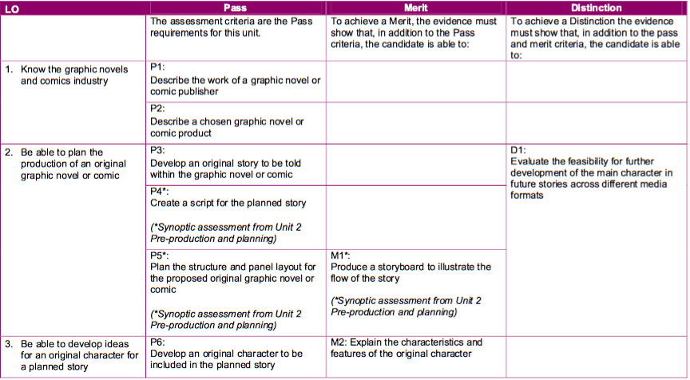
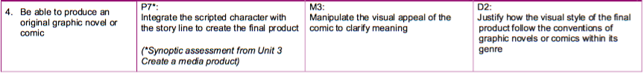

Slide 10
'What’s the point? The print industry is dying!’
This might be true for magazines and newspapers, but not necessarily for comics (https://www.cnbc.com/2016/06/05/comic-books-buck-trend-as-print-and-digital-sales-flourish.html)
Why might this be?

Slide 11
An introduction to the comics industry
(taken from https://www.thoughtco.com/comic-books-101-overview-and-history-804292)

Slide 12
Formats:
Comic Book – The comic book as we know it today is a softcover magazine of sequential artwork (a number of pictures in order) and words that when used together tell a story. The cover is usually a glossy paper with the interior of a higher quality paper with the consistency of newspaper. The spine is usually held together by staples. Comic books today cover a variety of subjects. There are horror, fantasy, sci-fi, crime, real life, and many other subjects that comic books cover. The subject most comic books have become known for is superheroes.
Comic Strip – This is what you would find in a newspaper such as Garfield, or Dilbert and what was originally referred to with the term, “comic.”
Graphic Novel – This thicker, and glue bound book is seeing a great amount of success today. This format has been used by some publishers to help distinguish the content from comics with more mature subjects and content matter. Lately, the graphic novel has seen a large amount of success by collecting a comic series, allowing purchasers to read a whole comic story in one sitting. Although still not as popular as the regular comic book, the Graphic Novel has been outpacing comic books in terms of annual sales growth.
Webcomics – This term is being used to describe both comic strips and comic books that can be found on the Internet. Many are smaller endeavors by people who just want to find a creative outlet, but others have turned their webcomics into successful industries such as Player Vs. Player, Penny Arcade, Order Of The Stick, and Ctrl, Alt, Del.

Slide 13
Publishers
Many different publishers in the comic industry
Two are the most popular, taking up almost 80/90% of the market
DC Comics (owned by Warner Bros.) and Marvel (owned by The Walt Disney Company) are often referred to as ‘The Big Two’
Smaller publishers have started to build a big presence in the comic book world and are growing – pushing the boundaries of comic book content and creator owned content (e.g. Image comics and ‘The Walking Dead’)

Slide 14
There are four categories of comic book publishers

Slide 15
Main Publishers
These publishers have been around for quite some time and have developed a large following of fans due to their amount of popular characters.
Marvel – X-Men, Spider-Man, The Hulk, Fantastic Four, Captain America, The Avengers
DC – Superman, Batman, Wonder Woman, The Green Lantern, The Flash, The JLA, Teen Titans

Slide 16
Small Publishers
These publishers are smaller in nature but attract many creators due to the fact that they can have much more control over the characters they create. They won’t offer as many comics as the larger publishers, but that doesn’t mean the quality will be any less.
Image – Godland, The Waking Dead, Invincible,
Dark Horse – Sin City, Hellboy, Star Wars, Buffy the Vampire Slayer, Angel, Conan
IDW – 30 Days of Night, Fallen Angel, Criminal Macabre
Archie Comics – Archie, Jughead, Betty and Veronica
Disney Comics – Mickey Mouse, Scrooge, Pluto

Slide 17
Independent Publishers
These publishers are usually on the fringe of popular culture. Almost all are creator owned (the creator keeps the rights to the characters and stories they create), and some of the topics may contain mature content.
Fantagraphics
Kitchen Sink Press
Top Shelf

Slide 18
Self-Publishers
These publishers are generally run by the people who make the comic books. They handle most if not all of the duties of making the comics, from writing, and art to publishing and press. The quality can vary drastically from publisher to publisher and the fan base is usually local. Due to the internet, however, many of these self-publishers have been able to market their comics to many others. Some have even found some success with self-publishing such as American Splendor (now with DC), Shi, and Cerebrus.
Chibi Comics
Halloween Man
Altered Fates
Coffeegirl Productions
Prize Fighter Press
Crusade Fine Arts

Slide 19
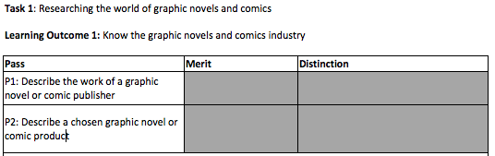
Your task:
You are to use today’s lesson to research comics and look at examples from different comic publishers
This will link in to our Task 1 on the checklist:

Slide 20
Research at least one example from each of the types of publishers
This work will not go directly into your blog, but will give you information on different publishers, as you want to choose two contrasting publishers for P1
It will be easier to research something that you are interested in, so have a look at the types of comics from each of the different types of publishers and think which two you would like to focus on in more detail next lesson

