Slide 1
Learning Outcome 2: Be able to create a proposal and pitch for an original media product based on a given brief.
P2: Create a proposal and client documentation to support the pitch

Slide 2
Pitch proposal
L.O. – How can we create a proposal for our TV programme pitch?

Slide 3
What is a proposal?
A proposal is not the same thing as a treatment:
A treatment is a short story narrative written in simple, non-technical language (i.e. no camera angles, transitions, etc.)
A proposal, which frequently includes a treatment, is a thorough description of all aspects of a project. It is created in the pre-production stage of a documentary project to persuade funders, distributors and others to support the project

Slide 4
Proposals are used to:
Describe a project so that people involved share an understanding of interpretation and approach
Create a paper document that can help secure funding, distribution, and other resources
Provide guidance in the structuring and editing of a project
You should only write a proposal after conducting the initial research that will fulfil the scenario/proposal

Slide 5
Usually a proposal will contain the following information:
Length of work, format
Who is the intended audience?
Goal or intended purpose(s) of the project
What other similar programmes are out there? What is new, different, interesting, engaging about your approach?
Style (Any key stylistic elements in writing, shooting, audio, editing, etc.)
What about the soundtrack? (Any music, narration, etc.—If so, who? what?)
Who is working on the project? And what similar projects have they done in the past? (Credibility of production team)
How will this work be distributed? (BBC3 website, but how else might people get to see the programme?)
Who, what, where, when, how, why?

Slide 6
Let’s look at an example of a proposal for a print-based product
Remember: Many media companies have their own formats for proposals, so they can look different. We can use and adapt what suits our proposal, as long as you include all of the information the examiner expects to see

Slide 7
How is this effective?
Anything missing?

Slide 8
You now need to start pulling your ideas together

Slide 9
Use sub-headings to help shape your ideas, but focus on these things as a minimum:
Title of new product
Programme duration
An executive summary (aims of product, outline of ideas, synopsis)
Statement of need (unique selling point, target audience (including psychographics) and medium chosen and why)
Product description
Budget
Details of production company. What resources and personnel are needed? (see next slide)
Images and graphics to create visual support to the planning ideas
Examples of existing products that may be drawn on for inspiration in terms of form, etc.
How you might market and distribute the programme

Slide 10
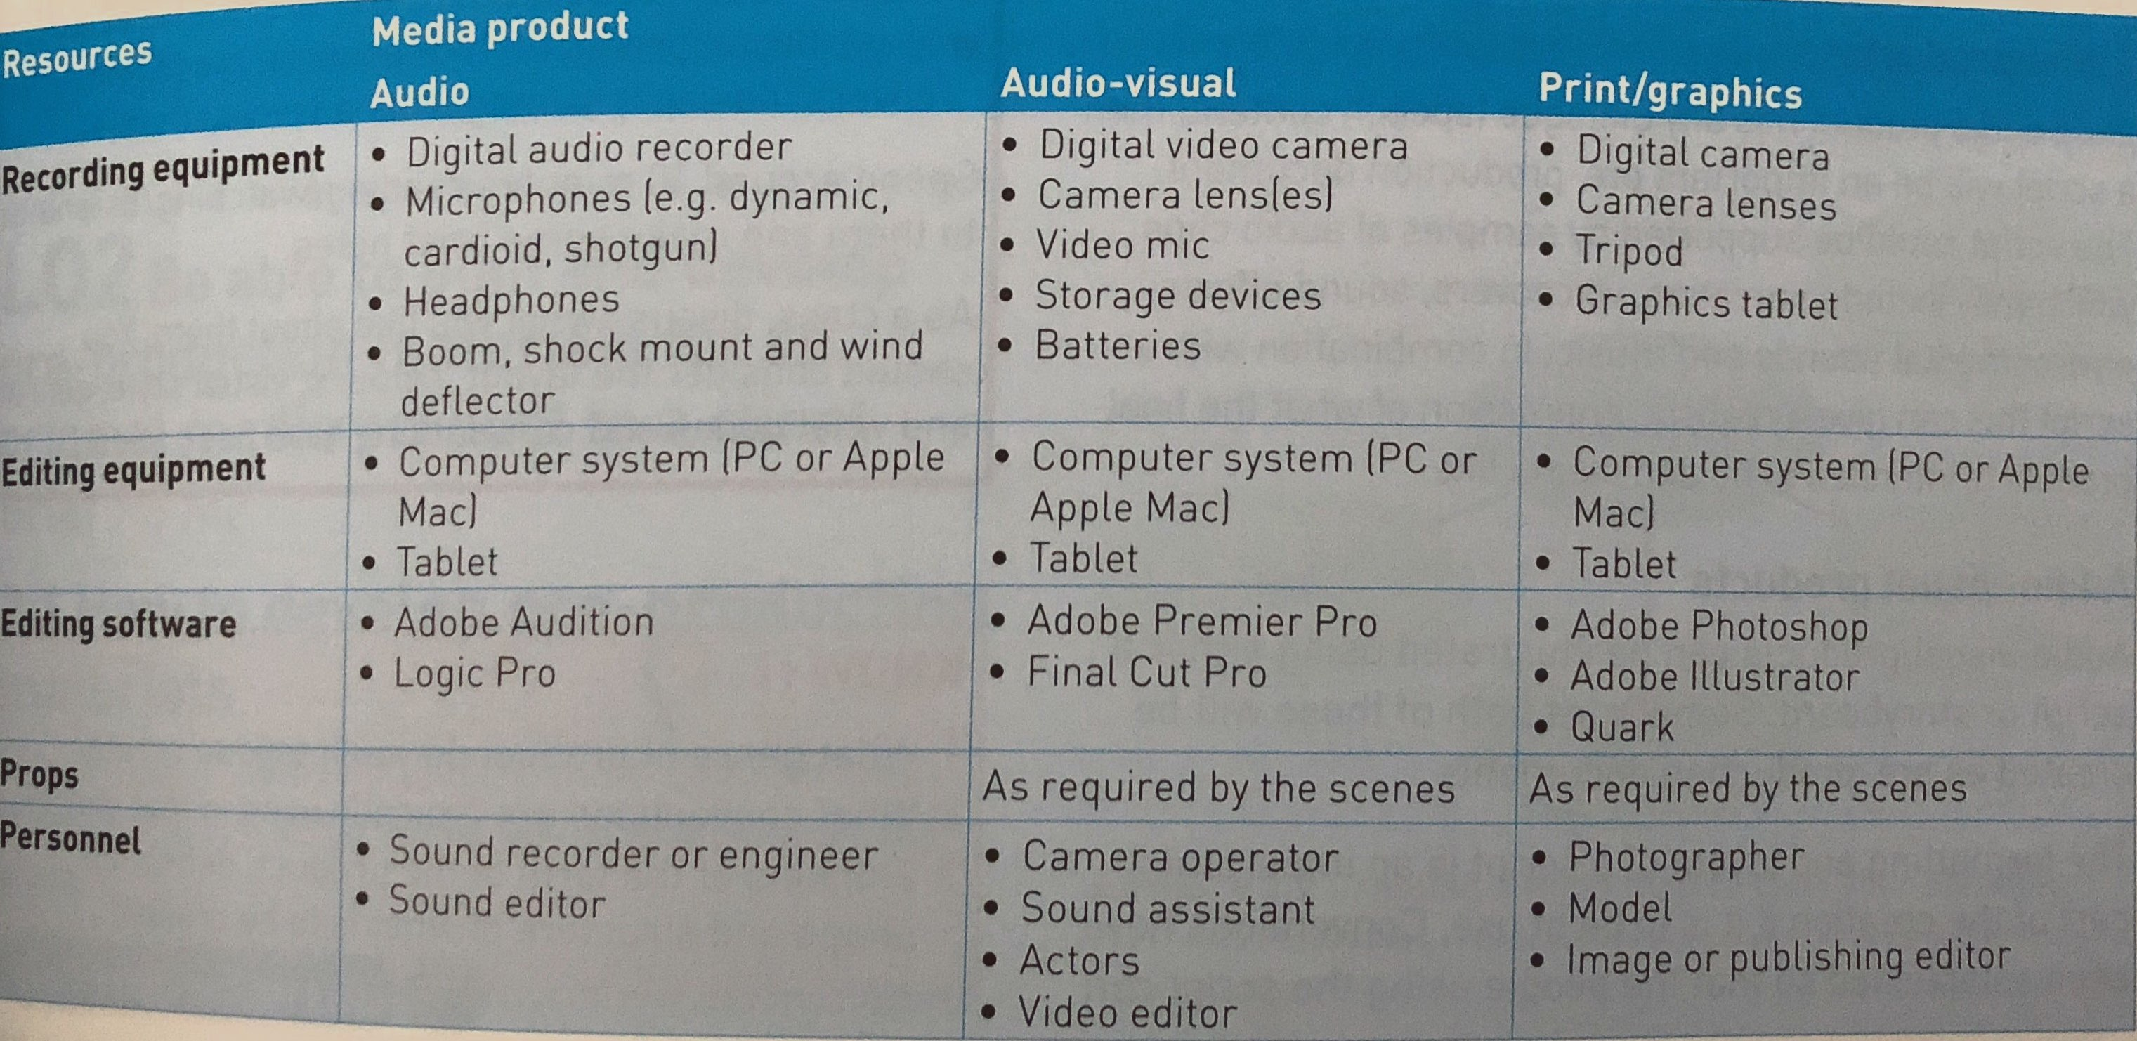

Slide 11
Have you included all of these areas in your proposal? If not, where can you fit them?
Length of work, format
Who is the intended audience?
Goal or intended purpose(s) of the project
What other similar programmes are out there? What is new, different, interesting, engaging about your approach?
Style (Any key stylistic elements in writing, shooting, audio, editing, etc.)
What about the soundtrack? (Any music, narration, etc.—If so, who? what?)
Who is working on the project? And what similar projects have they done in the past? (Credibility of production team)
How will this work be distributed? (BBC3 website, but how else might people get to see the programme?)
Who, what, where, when, how, why?

Slide 12
Client Documentation
L.O. – What documentation can you include to support the proposal?

Slide 13
The sample material to support the proposal could include (choose at least 4 examples):
Title of TV drama and font used (use a few examples and choose the most effective – perhaps ask the target audience to decide)
Characters (3-4 main characters)
Detailed plot outline
Set design
Storyboard (title sequence and opening scene)
Script
Which ones will you focus on and why?

