Slide 1
Unit 9: Comic book/graphic novel conventions
L.O. – What are the conventions of a comic book/graphic novel?

Slide 2
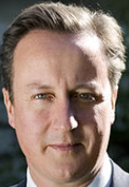
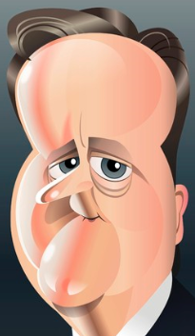
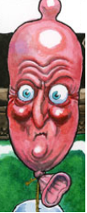
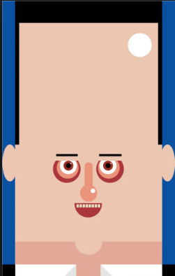
Lifelikeness
Can think of cartoon style as existing on a linear scale:
Realism
Caricature
Abstraction
Characters and setting may be similar or different in how lifelike they are. What are the connotations of the images and why have they been chosen?

Slide 4
Representation
Comics use images/drawings to depict emotions, actions, text…in fact, everything that we see!
How are things like emotions, sounds, movement represented in a comic?

Slide 5
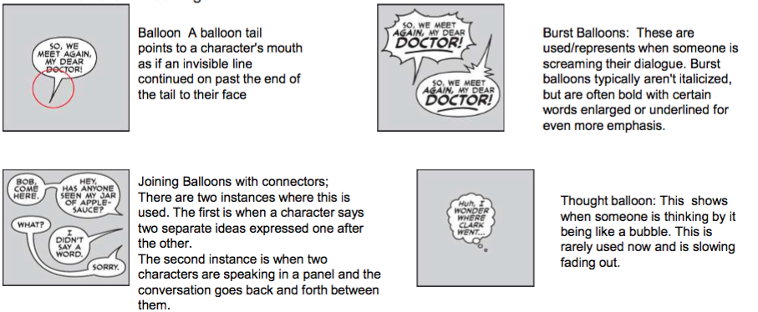
Speech and thought

Slide 6
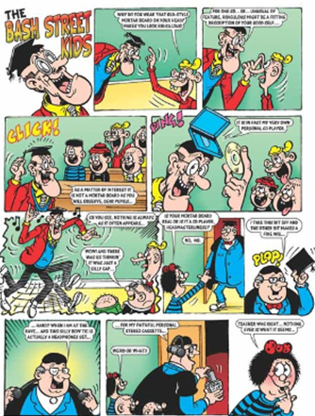
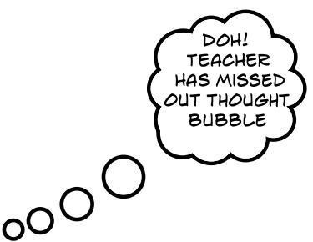
COMIC STRIP TERMINOLOGY
Title
Panel/frame
Speech bubble
Sound effect/
SFX
Bleed
Symbols/
emanata
A CAPTION IS A BOX USED (USUALLY RECTANGULAR) FOR NARRATION: e.g.
“MEANWHILE…”
Speed/
motion lines
Gutter
TEXT IS USUALLY ALL IN CAPITALS

Slide 7
Comic strip as a medium
Cartoon strip: page-based story-telling through a sequence of frames containing text and images
Because comic strip is a sequence of frames similar to a filmed sequence of shots it uses film conventions: use of shot distance (ELS, LS, MS, MCU, CU, ECU) and angle (high, straight, low, canted); zoom in/out; shot-reverse shot; eyeline match
Direction: left-right, top-bottom (in Western culture)
Black and white or colour
All strips use similar basic conventions
Comic strip artistry comes from:
breaking basic conventions in expressive ways to represent character, emotion, situation, action
distinctive artwork and lifelikeness
cultural/intertextual references in image and language

Slide 8
Cartoon Strip Structures
Micro-structures: inter-frame relationships: shot-reverse shot, zoom in/out, repetition, contrast, Q/A, moment-moment, action-action, subject-subject, scene-scene, aspect-aspect, non-sequitur, flash-forwards, flashback, …
Macro-structures: Consistent style; narrative structure e.g. beginning (setting/ characters/ actions), middle (problem, effect), end (possible solution/cliffhanger). They will focus on issues of representation and establish genre conventions
Comic strip narrative structure is often similar to that of mainstream film and television e.g. Todorov’s narrative stages (equilibrium, disruption of the equilibrium, reinstatement of the equilibrium), utilises Propp’s character types (hero, heroine, villain, helper etc.)

Slide 9
P2: Describe a chosen graphic novel or comic product
L.O. – How can we research a chosen graphic novel or comic created by a publisher?

Slide 10
Your task:
You need to choose a comic book or graphic novel product from a comic book publisher (look at the task first to ensure that your choice will give you enough to focus on).

Slide 11
Analysing a Comic/Graphic Novel
Analyse a comic/graphic novel that you are focusing on and use screen shots to support your findings (use this and the checklist to ensure you are covering everything that needs to be covered):
Give background/backstory to comic/main characters/series and the publisher. How successful is it?
Identify the genre and target audience
Identify stages in the narrative and character types. What is it about? What does it focus on?
Evaluate artistry (degree of lifelikeness, artwork, use of repetition and contrast, expressive breaking of basic conventions). How are the characters represented by the artist (gender, sexuality, age, race etc.)?
Why are they represented in this way? Are they stereotypical? Non-stereotypical? Why? Link to the effect on the audience.
Identify comic conventions and their connotations/reasons for use. Focus on: panelling, dialogue, sound effects, narrative (visual narrative: facial expressions, colours used and their connotations, representation of powers)
Purpose? Primary/secondary
Don’t just say WHAT you see, but explore WHY it has been included and its intended effect on the target audience. Use terminology you have studied in Unit 1, as well as comic specific terminology outlined earlier in this presentation.

