Slide 1
Unit 3: Sample Materials
L.O. – What sample materials should we create to support our proposal?

Slide 2
Look at the new style checklist
Print it out
Thoughts?

Slide 3
When researching, did anyone think to focus on:
Researching your client (Cambridge City Council – employees, what they are responsible for, areas they are responsible for, why they would need this product)
Use their logo in your media product

Slide 4
Firstly, let’s have a recap of what you should have completed by now
Your proposal (look at the new checklist to see if you’ve included all of them)
Have you included a mind map on your blog?
Include ‘your take’ on culture and how you are defining it within your media product
Add lots on the target audience of your media product
Resources and personnel?
Distribution and marketing methods
Examples of existing products

Slide 5
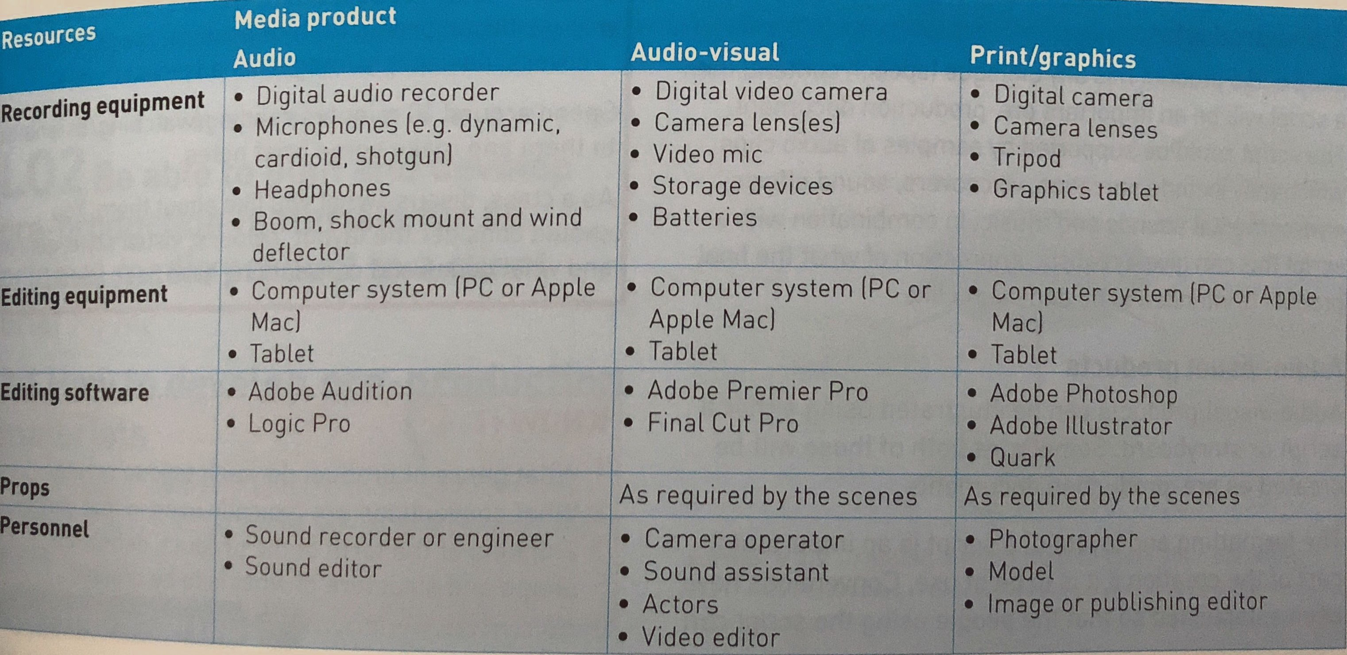

Slide 6
Now we need to include sample materials to support our proposal

Slide 7
You need to create:
a storyboard for the first page of action (include framing, transitions, camera directions/actions, sound and timings)
the first page of a script (using dialogue from the voiceover/presenter and text on screen and the shots you’ll include)
font styles used for any text on screen
ideas for your audio-visual product
What have you done before? What would you include?

Slide 8
You will get an additional three lessons to work on these tasks
You will need to work hard and fast
You will need to use some of your study periods to ensure the work is up to date
You must link your tasks directly to the client brief

Slide 9
Merit criteria (M1)
You are required to justify:
content (what you are including/focusing on in your media product)
distribution and marketing methods that are realistic and feasible for the media product you are going to produce (you will have already mentioned them, but this is going to be in more detail)
This must be detailed to gain the M1 for this LO compared to evidence for P1.
Remember: Justify means that you state what you have chosen and why it is suitable for your media product – link to codes and conventions, target audience, client brief etc.
You must link this to the client brief. Think about who the client is, why they want you to create the media product, who it is for, why you have included the ideas you have and their intended effect.

