Slide 1
Comic Script
L.O. – How can we create an effective script for our comic idea?

Slide 2
Task 2: Planning for an original graphic novel or comic idea Learning Outcome 2: Be able to plan the production of an original graphic novel or comic

Slide 3
P4: Create a script for the planned story
You should create a script for the story for an original graphic novel or comic. The evidence must be a formal script.
You should evidence this using a document embedded within the blog

Slide 4
How do I do a script for a comic?
The format for a comic script is very different to a film/TV script
You must state what is happening on the specific panel using words to describe the picture and then the dialogue that would feature in the comic
You need a title page and then you describe the action for each panel and each page (you should do 6 to 10 pages)
Let’s look at an example

Slide 5
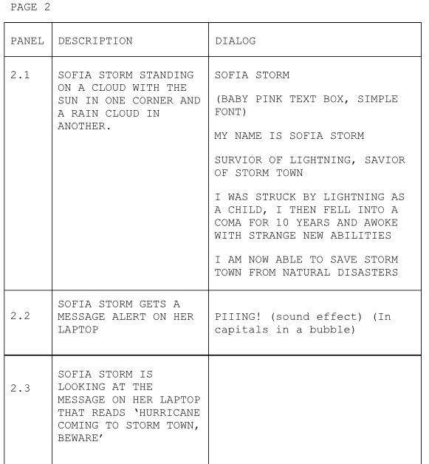

Slide 6
This then will be the ideas you will eventually put on the page of your comic…

Slide 7
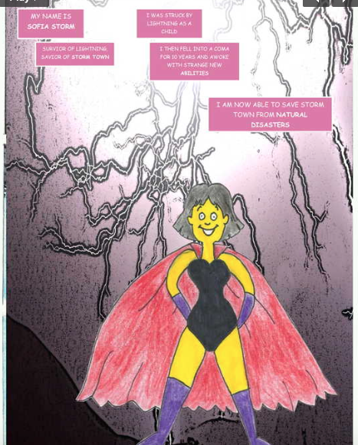

Slide 8
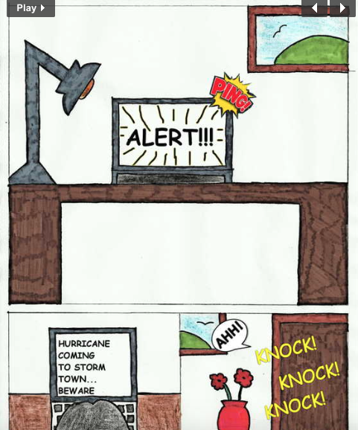

Slide 9
So is it easy?
What you should do is start thinking about the panel layouts for your pages
Be inspired by the comics you have read
You could sketch the panel layout now to help with your script and formalise it for P5 (Plan the structure and panel layout for the proposed original graphic novel or comic)
Working with a rough panel layout will help with your script and this will help make P5 easy to complete

Slide 10
Now it’s your turn…

