Slide 1
Timescales and milestones
L.O. – How can we add to our LO2 pre-production materials to include timescales and milestones?

Slide 2
What should we have done so far
A recap

Slide 3
Task 3: Create production materials Learning Outcome 3: Be able to create production materials for an original media product to a client brief.
L.O. – How do we create production materials to comply with the client brief?

Slide 4
P4: Create production materials to be used in the original media product.
You must produce production materials to create content for the production.
Your evidence must include relevant production materials for the chosen medium:
audio-visual products: setting up cameras, locations to film, raw footage and logging rushes (e.g. reviewing all footage/audio recorded and specifying which footage/audio is useable or not useable and why) – you must reference any sourced content (graphics, music or sound effects etc.) not created by you. They should be copyright free or you have permission to use them
ensure safe working practices are followed
you’re using the pre-production materials to inform your production
Make sure that you document the processes with photos and comments, particularly when using equipment – take photos of you setting up the equipment and taking the shots

Slide 5
M3: Create production material that follows the codes and conventions of the chosen genre for the media product.
You must produce production materials that reflect the codes, conventions and genre for the media product being produced. Choose parts of the film you have created and textually analyse it, linking it to the codes and conventions of similar products. Use examples and be specific – use key terms learnt in Unit 1: genre, representation, narrative, connotations, etc.
You must include specific references to the client brief.

Slide 6
What to do next…
Now that we have finished our filming and editing

Slide 7
Task 2: Remember the things we were going to do retrospectively?

Slide 8
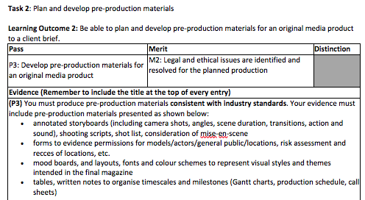

Slide 10
What have you done before? What would suit this task?
tables, written notes to organise timescales and milestones (Gantt charts, production schedule, call sheets)
You will get this lesson to go back to LO2 and complete this part retrospectively

