Slide 1
Comic Panelling
L.O. – How can we structure our comic pages?

Slide 2
Task 2: Planning for an original graphic novel or comic idea Learning Outcome 2: Be able to plan the production of an original graphic novel or comic

Slide 3
P5: Plan the structure and panel layout for the proposed original graphic novel or comic
You should plan the structure and scripted panel layouts including the script and panel layout
You should evidence this using rough designs for the page layouts and a script proposal.

Slide 4
To do this you must focus on the following:
Discuss:
Break writing plot into page breaks/panel breaks
Develop a script for the character
Break each page into panels, plan panels on each page to fit narrative
Include dialogue bubbles/thought bubbles/captions; sound effects should be considered for panels
Consider camera angles/shots (e.g. bird’s eye view, close-up)
You need to state why you are making these choices and link it to comic conventions and the intended effect on the audience

Slide 5
Additionally, you should discuss ideas for creation of the comic world such as:
Props that could be used within the comic (e.g. vehicles, guns etc.)
Terrain
Objects in the environment
Colouring of the environment
Again, you need to state why you are making these choices and link it to comic conventions and the intended effect on the audience

Slide 6
Examples

Slide 7
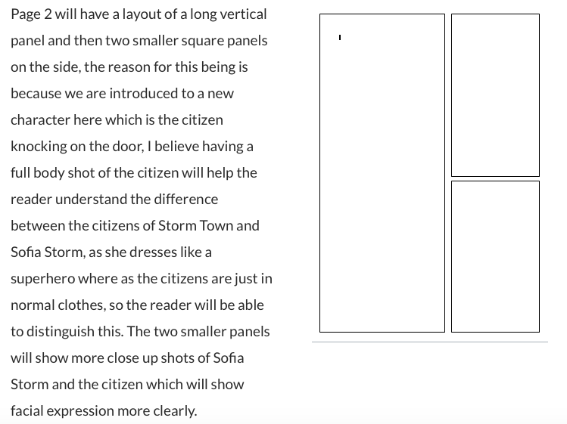

Slide 8
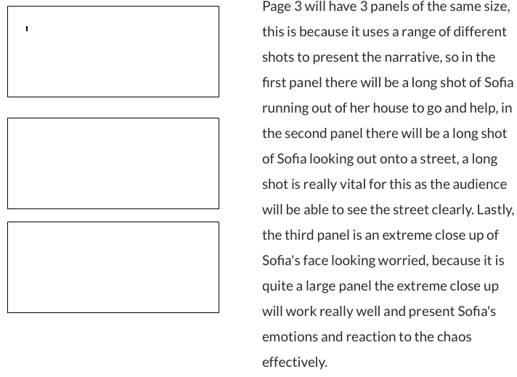

Slide 9
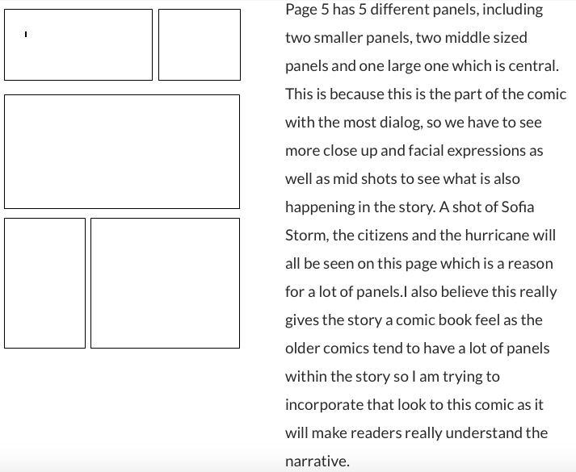

Slide 10
Dialogue, sound effects, captions etc.

Slide 11
You are to give examples of the way you will show text in your comic, offering reasons why you have made those choices. This needs to be linked to your comic research and learning from previous lessons. You must link your choices to your comic genre, audience expectations and the intended effect (connotations) your choices might have on the reader.

Slide 12
Let’s look at some examples
What have they done that has made this section effective?
How could it be improved?

Slide 14
