Slide 1
Analysing our production
L.O. – How can we analyse our production material to highlight how effectively we have conformed to the codes and conventions?

Slide 2
We have to keep in mind Tasks 4 and 5
Have you done these things for Task 4? If not, what do we need to do?
How can we ensure Task 5 is completed effectively?

Slide 3
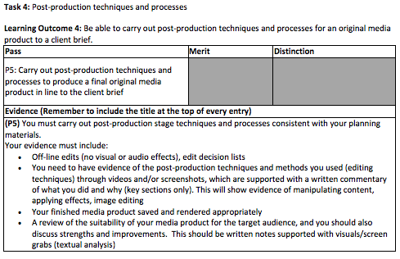

Slide 4
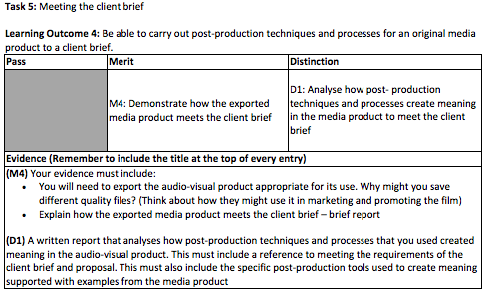

Slide 5
Task 3: Create production materials
Learning Outcome 3: Be able to create production materials for an original media product to a client brief
Now we have completed our production we need to analyse it effectively. How does it conform to the codes and conventions that we highlighted in P1?
How does it conform to the client brief?
These need to be discussed in detail in the next stage of your blog entry.

Slide 6
M3: Create production material that follows the codes and conventions of the chosen genre for the media product
Look at your checklist.
You must produce production materials that reflect the codes, conventions and genre for the media product being produced
Choose parts of the film you have created and textually analyse it, linking it to the codes and conventions of similar products (you should’ve analysed these in detail in P1 so reread your blog entry - refer to these findings specifically)
Use examples from your production and be specific – use key terms learnt in Unit 1: genre, representation, narrative, connotations, etc.
You must include specific references to the client brief. How does your product: promote the cultures within Cambridge? Conform to the client brief? (how might it win the award? How does it show Cambridge as a unique city that celebrates culture? Is the content original? Have you used copyright-free sources? Have you referenced them?)

