Slide 1
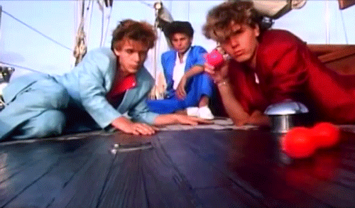
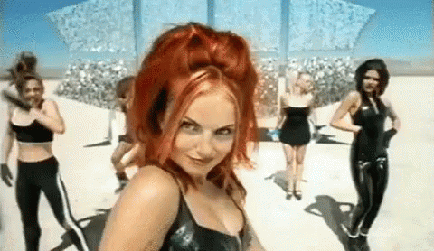
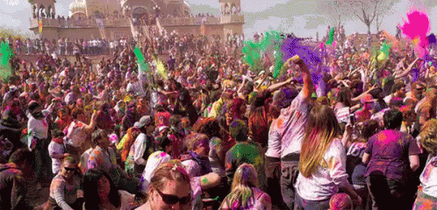
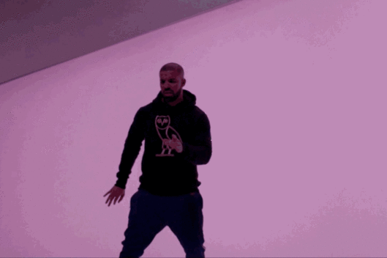
Unit 15: Audio-Visual Promo
Learning Objective: To identify and discuss key ethical, moral and legal issues to consider for your Audio-Visual promo.

Slide 2
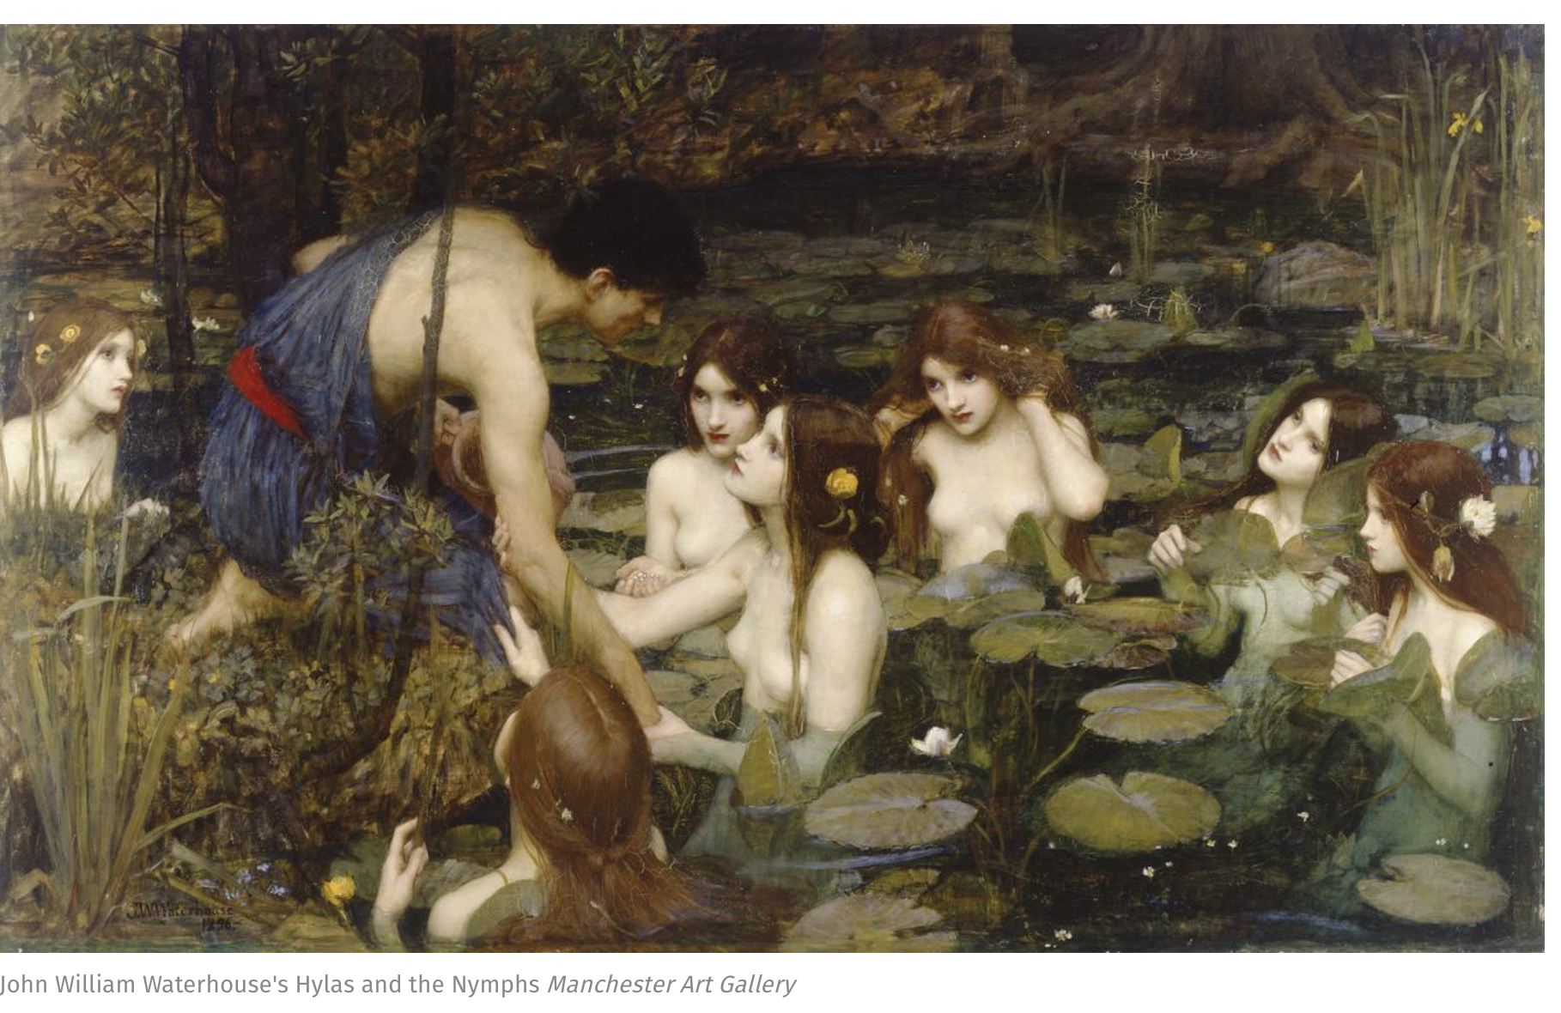
Learning Objective: To identify and discuss key ethical, moral and legal issues to consider for your Audio-Visual promo.
What do you think of this recent news story in relation to yesterday’s lesson?

Slide 3
Learning Objective: To identify and discuss key ethical, moral and legal issues to consider for your Audio-Visual promo.
To ensure you can film (P4) you will need to complete P2 and P3 by Friday after half term latest. (We’ll look at this more on Thursday)

Slide 4
M2: Learners must identify the legal ethical and moral issues they will need to consider when producing their audio-visual promo.
Learners could then decide what rules they will need to abide by from the main regulatory bodies.
Learners could justify their thoughts about how the rules will impact on the content of their promo.
Learners could offer three alternative suggestions to ensure the content meets regulatory guidelines.
This can be evidenced using a formal written report or presentation with detailed speaker notes. This can be a continuation of the evidence produced for P3.
Learning Objective: To identify key ethical and legal issues to consider for your Audio-Visual promo.

Slide 5
Main Task
Learning Objective: To identify and discuss key ethical, moral and legal issues to consider for your Audio-Visual promo.
Find the web link for your regulatory board/s and investigate their requirements.
Which parts effect you and your project?
What legally do you need to think about with your production?
What alternative suggestions or solutions can you suggest? E.g scheduling.
What ethical issues may arise?
What do you need to do to protect your audio-visual piece?
Stretch and Challenge: Find some examples from similar media texts and look at how solutions have been made to protect the artistic licence.
Include videos or screen shots in your blog.

Slide 6
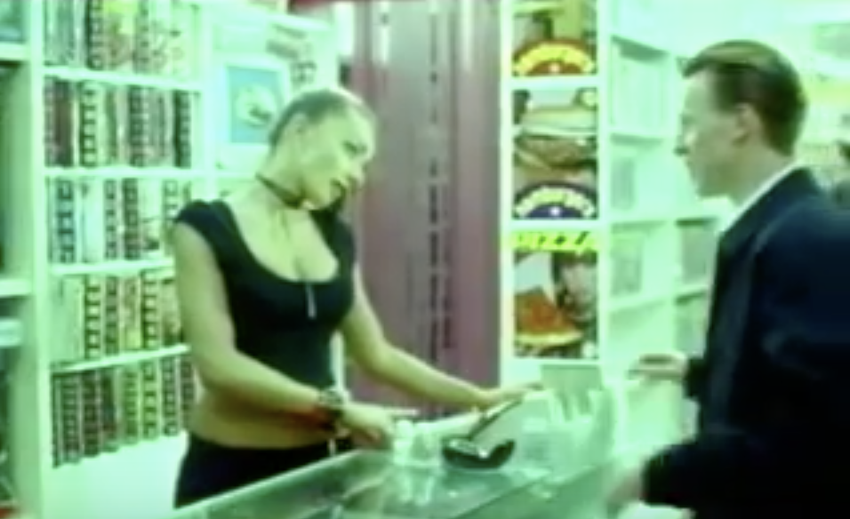
EXAMPLE
To ensure my advert is suitable for my audience and following guidelines, I will think about the framing and camera angles when in production. I also need to consider appropriate clothing for my protagonist because she needs to be considered as a positive role model and this can be conveyed through the Mise-En-Scene. Looking at guideline 1.67 from http://www.asa.thisisntthewebsite.com it states:
“Advertising the female image should be done in a blah blah blah blah, not sure what it actually says, why not go and look for yourself”
An advert which received complaints on this was the Pot Noodle (2010) campaign where blah blah blah blah are you even reading this year 13. You get point of what I meant right? Good. Now get on with your actual work. You can do this.

