Slide 1
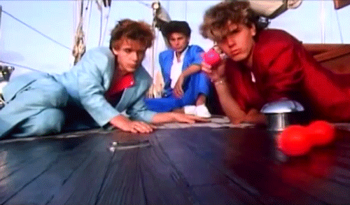
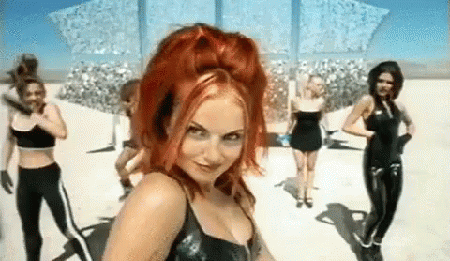
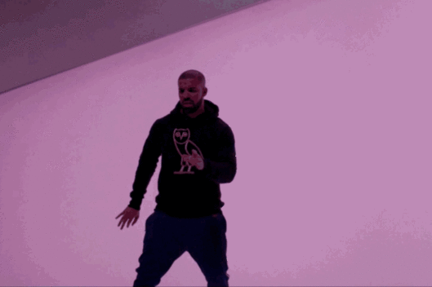
Unit 15: Audio-Visual Promo
Learning Objective: To identify key ethical and legal issues to consider for your Audio-Visual promo.

Slide 2
Learning Objective: To identify key ethical and legal issues to consider for your Audio-Visual promo.
To ensure you can film (P4) you will need to complete P2 and P3 by Friday after half term latest. (We’ll look at this more on Thursday)

Slide 3
Complaints were received about this advert. Why do you think that is?
Who regulates advertising like this?
What do you think happened next?
Learning Objective: To identify key ethical and legal issues to consider for your Audio-Visual promo.
Heinz Baked Bean Advert

Slide 4
Complaints were received about this advert. Why do you think that is?
Who regulates advertising like this?
What do you think happened next?
Learning Objective: To identify key ethical and legal issues to consider for your Audio-Visual promo.
Femfresh Advert

Slide 5
M2: Learners must identify the legal ethical and moral issues they will need to consider when producing their audio-visual promo.
Learners could then decide what rules they will need to abide by from the main regulatory bodies.
Learners could justify their thoughts about how the rules will impact on the content of their promo.
Learners could offer three alternative suggestions to ensure the content meets regulatory guidelines.
This can be evidenced using a formal written report or presentation with detailed speaker notes. This can be a continuation of the evidence produced for P3.
Learning Objective: To identify key ethical and legal issues to consider for your Audio-Visual promo.

Slide 6
Main Task
Get on unit 15 on the Netherhall Media website.
In the centre panel (Legal lesson task) download and watch the relevant video.
Discuss and answer the questions in your group.
Fill in the worksheet to support your ideas.
Stretch and Challenge:
Find the web link for your regulatory board/s and investigate their requirements. Which parts effect you?
Learning Objective: To identify key ethical and legal issues to consider for your Audio-Visual promo.
20 MINUTES

Slide 7
Blog Task
This is LO2- Merit 2.
Presentation or written report.
Which regulatory body do you need to pay attention to?
What legally do you need to think about with your production?
What ethical issues may arise? What do you need to do to protect your audio-visual piece?
Learning Objective: To identify key ethical and legal issues to consider for your Audio-Visual promo.

