Slide 1
Unit 14: rADIO INDUSTRY
lEARNING OBJECTIVE: To recall how radio can be distributed.

Slide 2
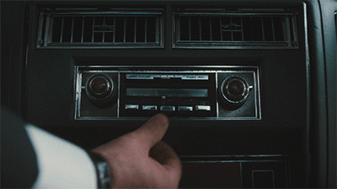
How do you listen to the radio?
What do you physically do?
Where do you listen?
How do you listen?
LEARNING OBJECTIVE: To recall how radio can be distributed.

Slide 3
In groups research:
15 MINUTES TO RESEARCH
What is the difference between FM, AM, MW and DAB?
What is the pros and cons of DAB radio? How does it impact on FM, AM and MW?
What would you rather listen to? Why?
LEARNING OBJECTIVE: To recall how radio can be distributed.

Slide 4
Worksheet task: In Pairs
Stretch and Challenge: Explore the social media channels for each of the stations/shows you find – how do they encourage an audience? How do they interact with their audience?
Create a listening schedule for each of the audience members – use the Tunedin App, BBC website and Media Uk directory to explore different radio stations
LEARNING OBJECTIVE: To recall how radio can be distributed.

Slide 5
Audience research Task:
Create a Prezi or Podcast which explores the results
Create a survey monkey and get 10 voxpops to upload.
How do audiences listen to the radio?
Which is the most common way?
What radio stations are mainly listened to?
What do people look for in the choice of presenter, music, content, style?
LEARNING OBJECTIVE: To recall how radio can be distributed.

