Slide 1
Radio Production
Learning objective: To explain how a radio studio functions and what is needed to create a broadcast.

Slide 2
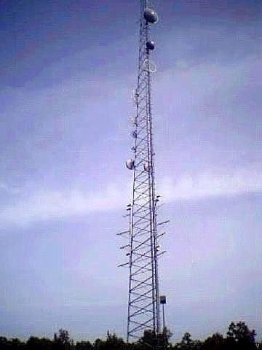
Learning objective: To explain how a radio studio functions and what is needed to create a broadcast.
Recap from last lesson:
VOXPOP tips
http://www.bbc.co.uk/academy/production/article/art20130702112136311
Get 10 voxpops and upload to Prezi looking at your audiences and radio listenership.

Slide 3
Task: LO2
M2: TITLE - EXPLAIN THE PROCESSES AND TECHNOLOGIES INVOLVED IN PRODUCING A RADIO BROADCAST
A labelled and detailed photograph of an active radio studio. Or a video tour.
How does a radio station use this technology to create their broadcasted programmes?
For Technologies you need to discuss: digital cart walls and playlists digital play out system equipment (e.g. audio equipment; microphones, headphones, workstation, mixing desk, speakers)

Slide 4
Label the equipment of the radio studio
What do you think is the most important part of a radio studio?

Slide 5
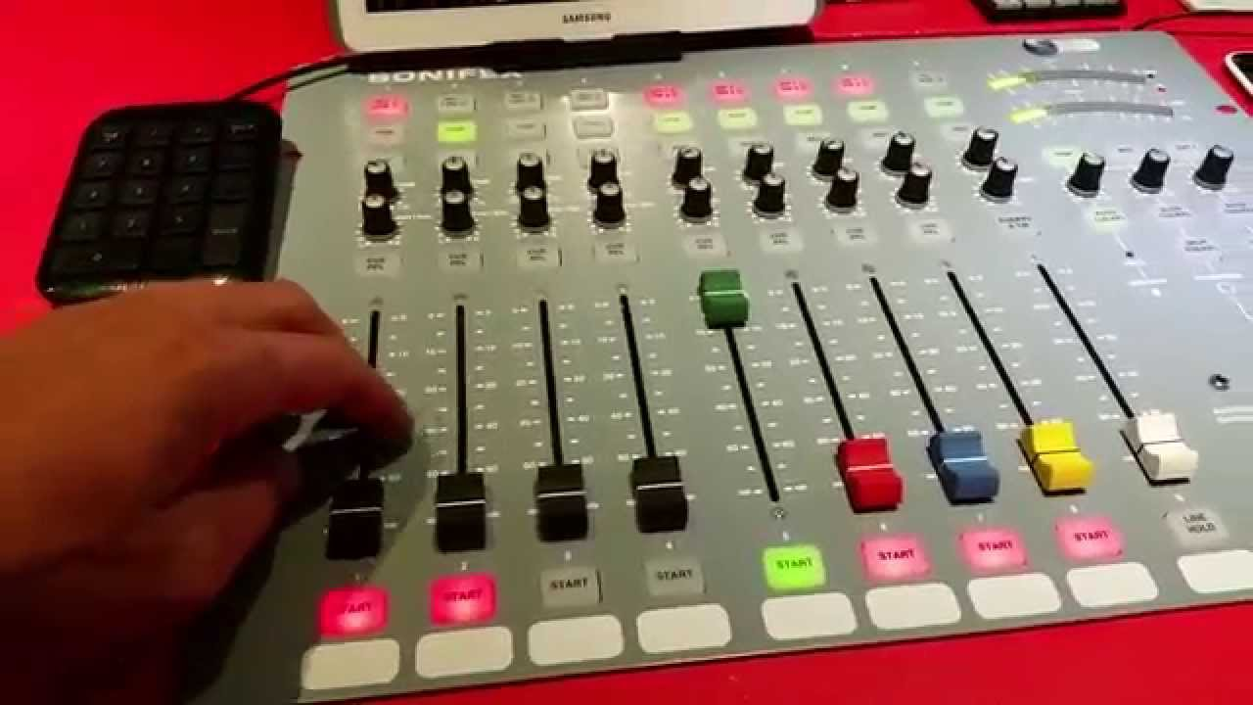
Learning objective: To explain how a radio studio functions and what is needed to create a broadcast.
Inside the studio:
http://www.bbc.co.uk/academy/production/article/art20130702112135562
Mixing desk

Slide 6
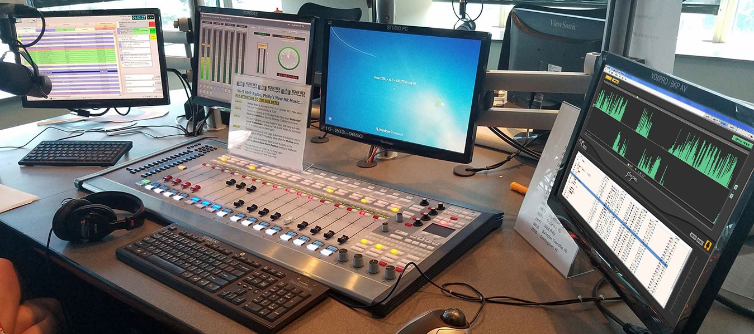
Learning objective: To explain how a radio studio functions and what is needed to create a broadcast.
Playout system/ cartwall
Social media/content screen
Microphone: http://www.bbc.co.uk/academy/production/article/art20130702112136172
Adobe Audition:
Pre-record / features/ phonecalls

Slide 7
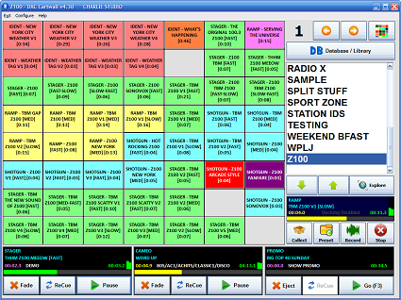
Learning objective: To explain how a radio studio functions and what is needed to create a broadcast.
Stretch and Challenge:
Use the iPad: IAC Cartwall and create a sequence which you could use in a show. Why do you think the cart wall is useful to a presenter? Where could it go wrong?
Audio levels:
http://www.bbc.co.uk/academy/production/radio/recording-audio/article/art20130702112135224
Cart wall

Slide 8
Task: LO2
M2: TITLE - EXPLAIN THE PROCESSES AND TECHNOLOGIES INVOLVED IN PRODUCING A RADIO BROADCAST
A labelled and detailed photograph of an active radio studio. Or a video tour.
How does a radio station use this technology to create their broadcasted programmes?
For Technologies you need to discuss: digital cart walls and playlists digital play out system equipment (e.g. audio equipment; microphones, headphones, workstation, mixing desk, speakers)

