Slide 1
The Start of LO2
Learning Objective: To explain how audiences can be categorised.

Slide 2
What ways do we target audiences?
Learning Objective: To explain how audiences can be categorised.

Slide 3
By the end of today
Create a blog post on word / Prezi : Target Audience
Explain how target audiences are categorised.
Talk about your previous audience research and how that can be used by target audiences.
Create your blog.
Stretch and Challenge: Research a game: Target Audience Blog task.
Learning Objective: To explain how audiences can be categorised.

Slide 4
What is a target audience?
Learning Objective: To explain how audiences can be categorised.

Slide 5
Learning Objective: To explain how audiences can be categorised.
DEMOGRAPHIC
AUDIENCE PROFILE
Class, occupation and income

Slide 6
Learning Objective: To explain how audiences can be categorised.

Slide 7
QUESTION
TIME

Slide 8
Lastly…..
We learnt about Bartel’s theory : why we play games last term. This is a type of target audience.
Harold Lasswell in 1940 said we consume media because of 4 reasons. This is also used today to categorise target audiences.
Learning Objective: To explain how audiences can be categorised.

Slide 11
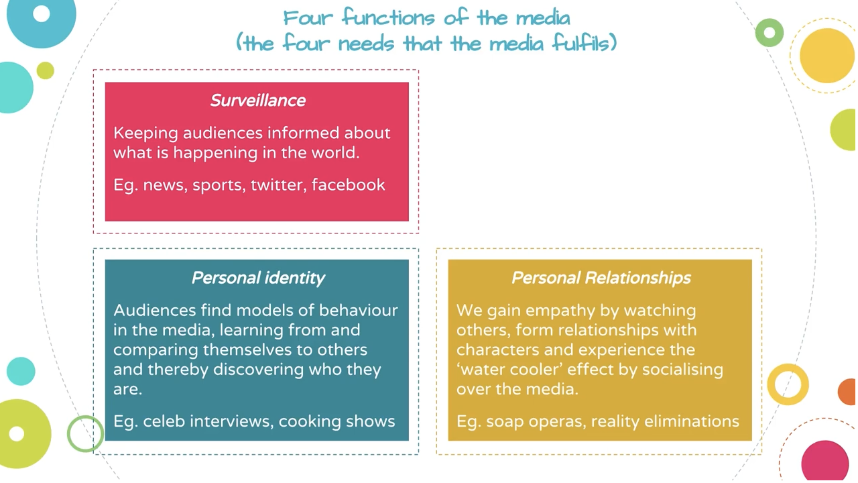

Slide 12
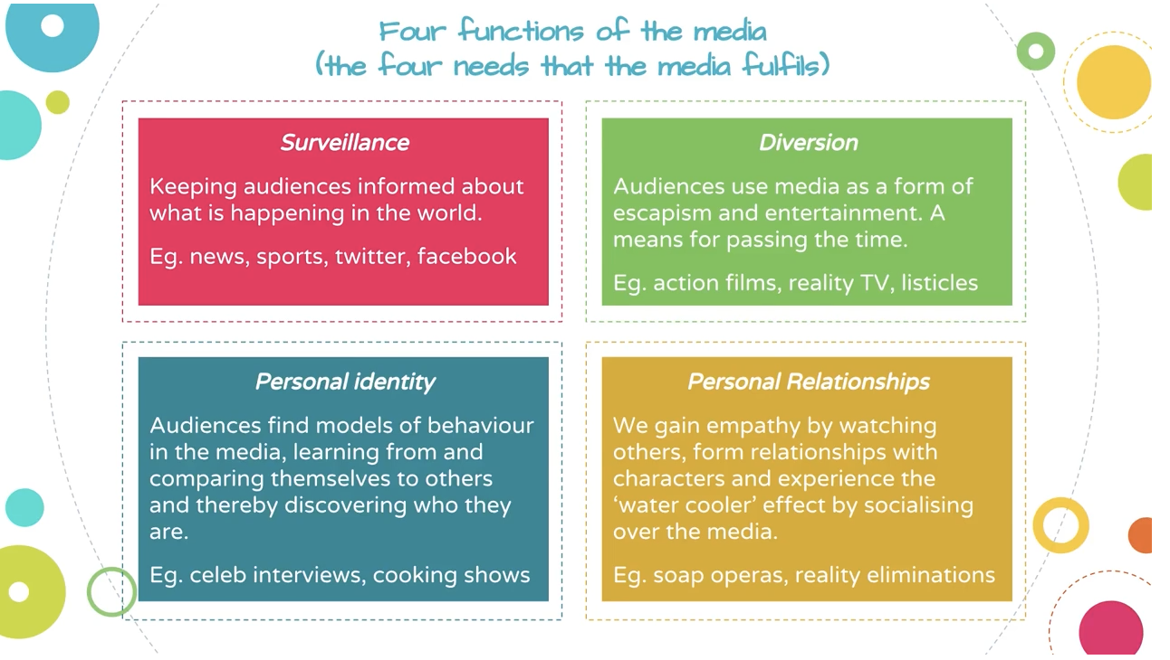

Slide 13
Target Audience Task
Create a blog post on word / Prezi : Target Audience
What are the different ways audiences can be targeted?
Which do you think is most important for game sales? Why?
Talk about your previous audience research and how that can be used by target audiences.
Use the worksheet to create your own blog.
Stretch and Challenge: Research a game: Target Audience Blog task.

Slide 14
QUESTION
TIME

