Slide 1
LO1.3 /4: Game Genre and Game Objectives
Create a PowerPoint and research 2-3 digital games from different game genres. Make your PowerPoint visual and explain the characteristics and variations of game genres and game objectives. With all games ensure you answer the following questions, you can include images, screen shots and videos.
What is the game, who is it aimed at? What tells you that?
What are the characters or game worlds/locations of the game like? What colours, images or music beds do you spot? How does this suit the game?
What is the game genre?
What are the features of this genre normally?
What genre features does this game have? How does this impact the game?
How do you play the game?
What is the game objective? What is the purpose/narrative?
What do you think of the game? How does it compare to the other digital games you’ve chosen in terms of genre and suitability for the audience?

Slide 2
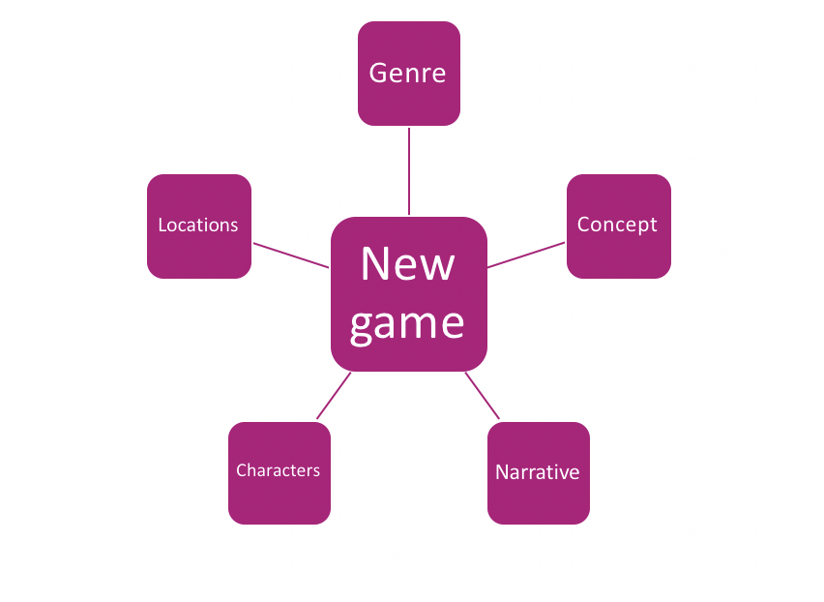
Game outline variation report:
1.Photo your blue-sky thinking (A3 Plans).
2. Write a paragraph to explain the initial ideas you had from this thinking task.
3. Think about and describe another idea which could work if you used a different platform device. How would this change the game? How would the game play out.
4. Describe how this game could be played if it was a different game genre or had a different outcomes. For example if it was an explorer game or a battle/clubber game. How would the game work then along your brief?
5. Change the audience. Either to older/younger or gender. What changes would this make to your game and how you play it?
6. If your game had a narrative – what could it be? Describe three different stories/backgrounds for the game. (Imagine Disney want to help produce your game idea and fund the project, so your game needs to be able to franchise into a film idea).

