Slide 1
Unit 2: Pre-Production and Planning
Learning objective: creating a comprehensive swot analysis by using a professional media brief.

Slide 2
Task 1:
What is a SWOT analysis? Use your blog to explain it and why it’s crucial for analysing a brief and planning a media product.

Slide 3
Breaking down a brief
During the process of interpreting the product brief, it is vital that you are clear about what is required by the client. Where any interpretation is required there is always danger that you will misunderstand what the client actually requires. To help stop this happening constant communication with the client is required. It is better to get this clearly set out at the early stage before you start producing the media product, when any changes that need to be made can be costly in terms of money, resources and time.

Slide 4
Interpreting a brief - KEYWORDS
Implicit- these will be inferred from the brief; you will have to interpret.
Open- There is some freedom for you to make decisions about how to best create a successful product.
Constraints – These are boundaries that the project must work within, e.g. legal, ethical, time and cost.
Explicit – These are clearly stated and must be met when producing the product.

Slide 5
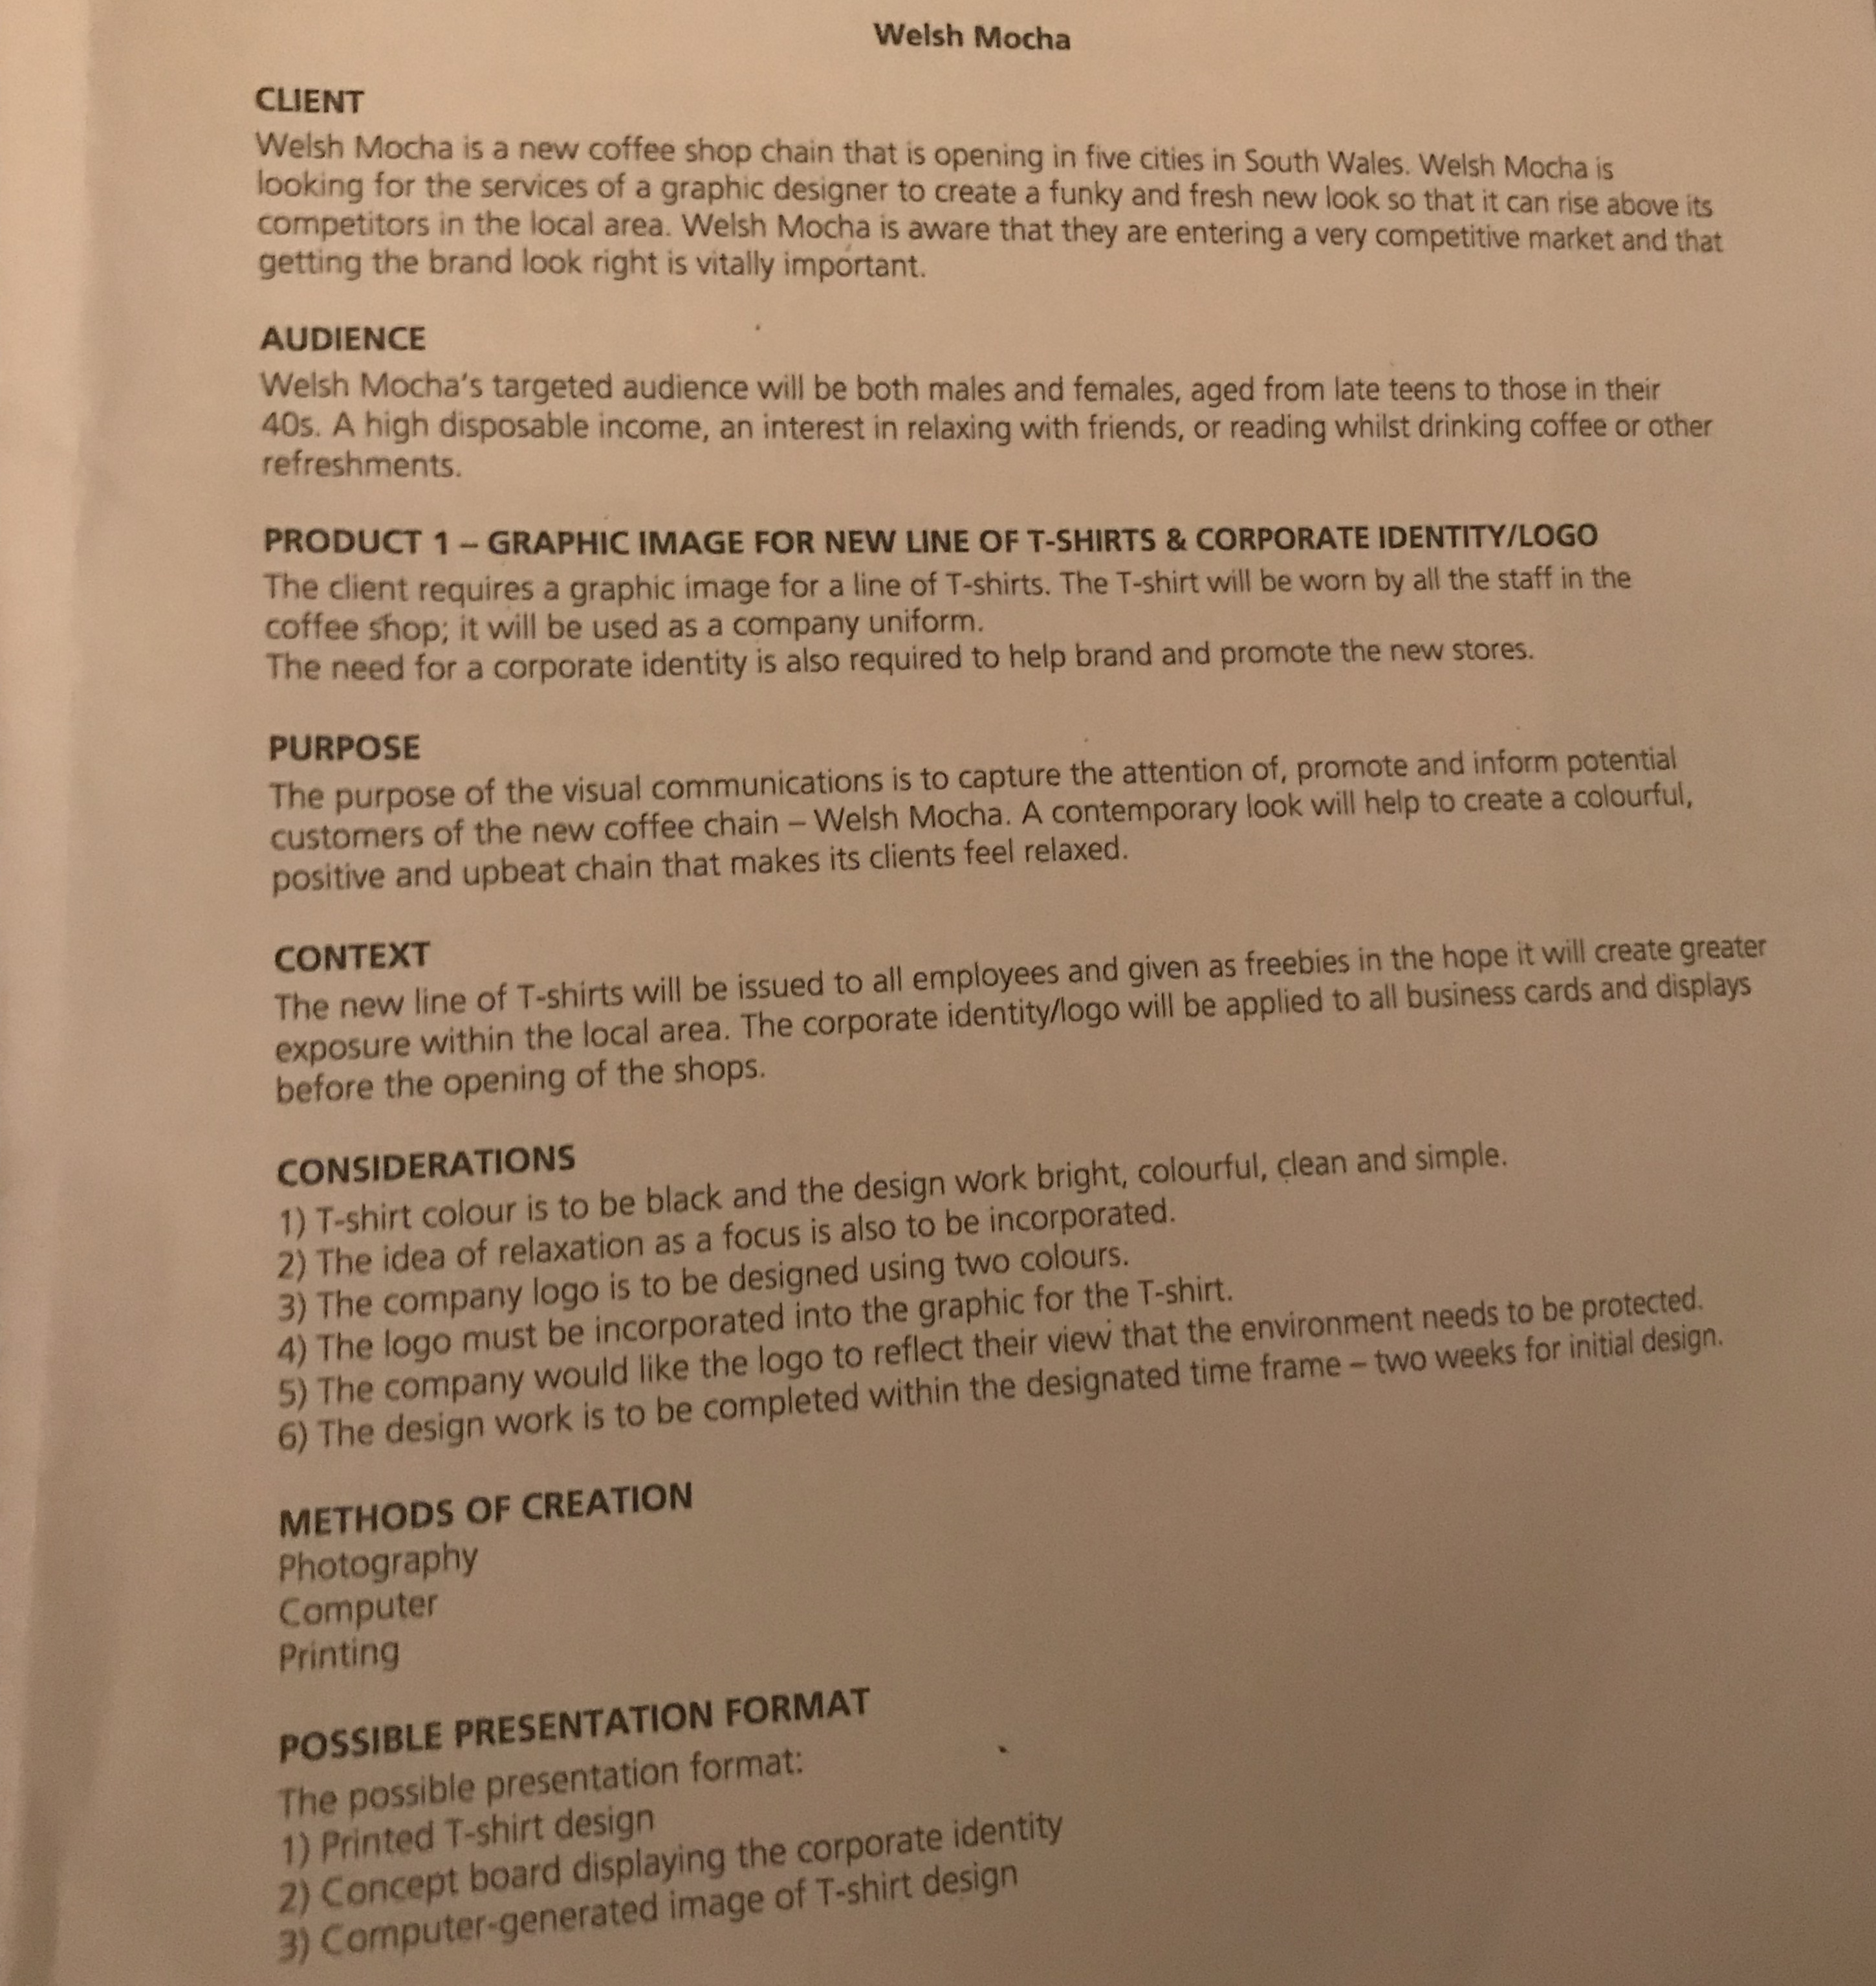
Task 2 – 1) Create a mind map for two possible solutions to the below brief.
2) Carry out a SWOT analysis on each of the solutions to decide which one to take forward and present to the client .
3) write roughly 200 words on why you chose that solution and how the SWOT analysis helped you.
This is a photo – you’ll need to save the image and zoom in.
Use the internet to work out costs to strengthen your SWOT

Slide 6
Final Task
Research the definition of a ‘gantt chart’ and create a blogpost thinking about how it is used in planning and creating a media product.

