Slide 1
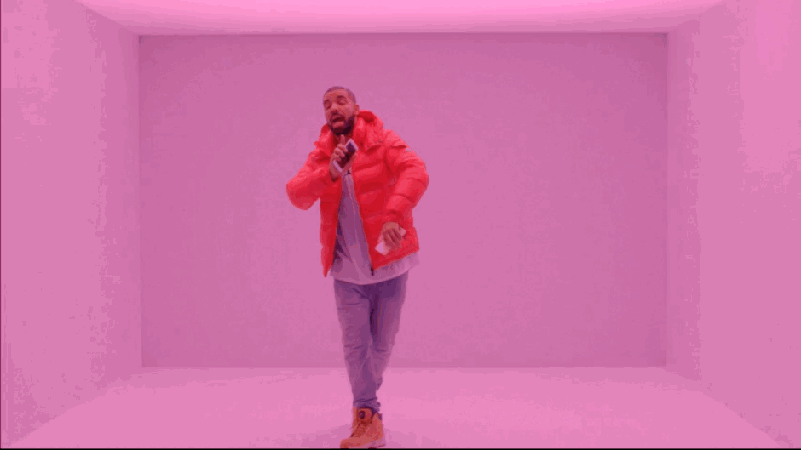
Unit 15: Create and Audio Visual Promo
Learning Objective 2:
To produce concept material and designs. (P2)
To create pre-production materials. (P3)

Slide 2
To complete this part of the unit you need:
P2:
Moodboard
Think showers/blue sky thinking
Concept document including: target audience, synopsis/outline, running time,
medium (music video, film trailer, advert) and genre.
P3:
Storyboards
Notes and pics from recces
Rough sketches of scene including action sound.
Production diary.
Learning Objective:
To produce concept material and designs. (P2)
To create pre-production materials. (P3)

Slide 3
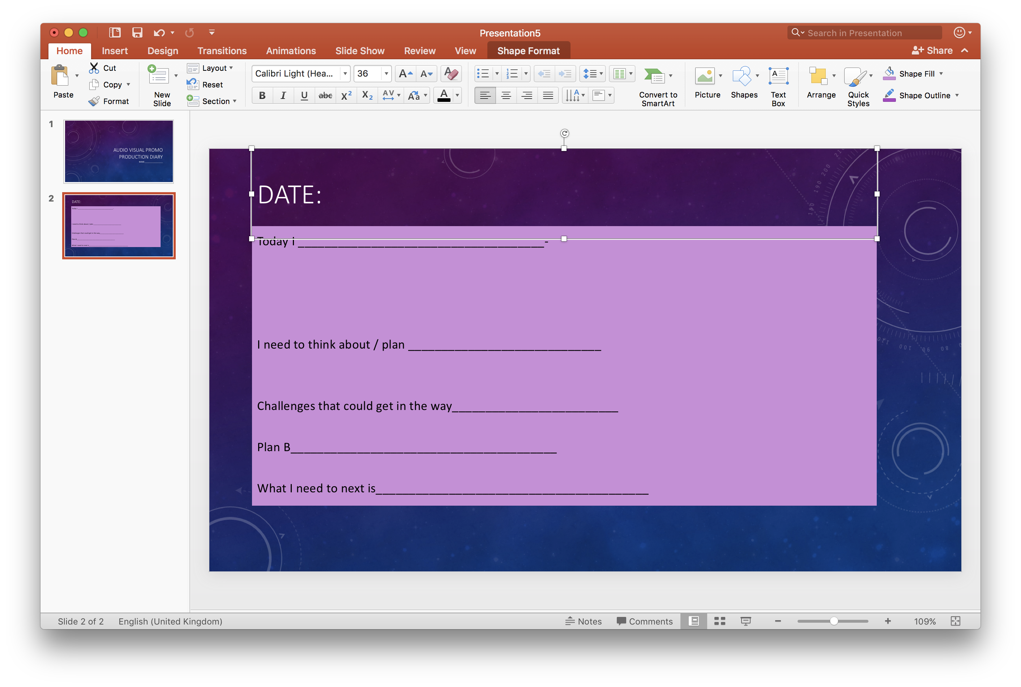
Production diary – to be complete every lesson or when you work on unit

Slide 4
Learning Objective:
To produce concept material and designs. (P2)
To create pre-production materials. (P3)

Slide 5
Task – period 4 and 5.
Complete this by end of day and get on your blog.
Complete storyboard
Annotate it with camera shots, editing, sound effects used, voiceovers.
Think about where text and information is shared.
With TV teasers think about alternative endings or more information shared.
Stretch and Challenge: List resources you need to include. What costume, location or props might you need?

