Slide 1
Pre-Production Planning
Learning Objective: To create a proposal suitable for the advertising industry.

Slide 2
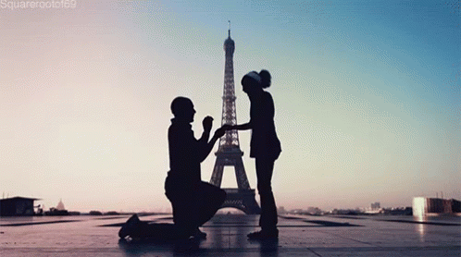
What is a proposal?
Learning Objective: To create a proposal suitable for the advertising industry.

Slide 3
Proposal – A formal written plan produced for others to assess the validity of a project.
Word processed or a pitch presentation.
SELL your idea = GREEN LIGHT
One page summarising your project, which can also be known as a High concept document.
Learning Objective: To create a proposal suitable for the advertising industry.

Slide 4
Proposal Writing
The audience is normally non-technical – language in proposal needs to be easy understand and visualise.
Enough detail to be clear to client as to what you want to create.
Written proposals require much more detail.
Learning Objective: To create a proposal suitable for the advertising industry.

Slide 5
Proposal Writing
Today’s task: Create a pitch and a written proposal for your advert.
As a minimum should include:
Data about proposed target audience
Sufficient detail to clearly explain the solution to the client.
An outline of the resources required
An outline of potential costs, with data to back up the comments
Information showing how you will be able to create the product within the set timescale.
Learning Objective: To create a proposal suitable for the advertising industry.

Slide 6
Project Outline Documents
Stretch and Challenge
This is an initial document which is given to various members of a production team.
The purpose of this is to provide the team with enough detail about the project, so they are clear what is to be produced.
The production team need this to plan further details of the project.
The outline should include:
Details of the narrative of the project.
Resource requirements
Budget limitations
A timeline of production.
Learning Objective: To create a proposal suitable for the advertising industry.

Slide 7
Treatment Document
Challenge yourself even further
This is even more depth than the outline document.
The exact structure depends on the type of media product (research online to look at some example treatments).
The audience for this product is two-fold:
The production team – as a reference point. So they are clear on the product and what it contains. This is VITAL when there is a large team developing the media production as this will help ensure that people do not go off track. This is the starting point for other documents to be created: storyboards, scripts and shooting scripts are formed from details in this document.
The treatment document can be shown to the client and potential investors so that they are given clearer understanding of what the final product will be.
Learning Objective: To create planning documents suitable for the advertising industry.

