Slide 1
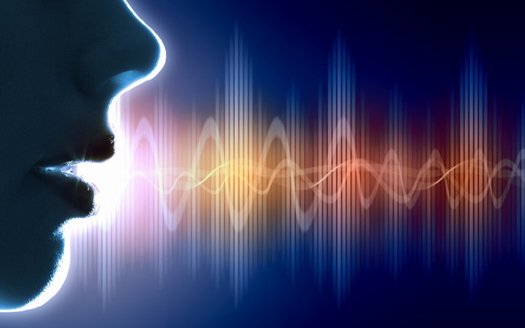
Learning Objectives:
To explain how the structure of a radio works.
To create a broadcast clock and explain how it works in radio.
To create a treatment proposal for a radio show
Unit 14: Radio Production

Slide 2
Why is the clock important to a radio producer?
STARTER
What time would your documentary be best on Radio 1?
What time is best for a lifestyle programme on Radio 1?
Learning Objectives:
To explain how the structure of a radio works.
To create a broadcast clock and explain how it works in radio.
To create a treatment proposal for a radio show

Slide 3
Task 1:
Learning Objectives:
To explain how the structure of a radio works.
To create a broadcast clock and explain how it works in radio.
To create a treatment proposal for a radio show
In your group read through the station running order.
What do you notice about the timings? Format?
What’s included in that show?
Decide which station it’s for:

Slide 4
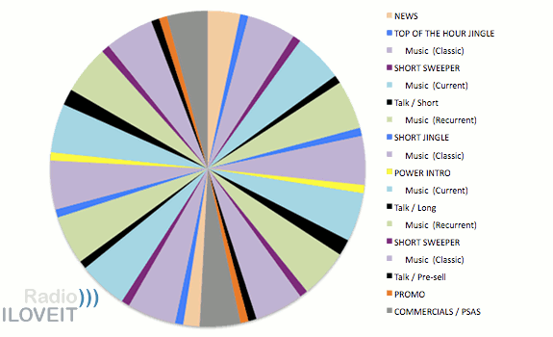
Learning Objectives:
To explain how the structure of a radio works.
To create a broadcast clock and explain how it works in radio.
To create a treatment proposal for a radio show

Slide 5
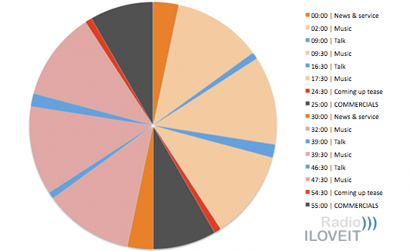
Learning Objectives:
To explain how the structure of a radio works.
To create a broadcast clock and explain how it works in radio.
To create a treatment proposal for a radio show

Slide 6
For your own programme you can create your own clock either by using a ruler and colouring in pens/pencils
Or create one on: www.uclock.it
Learning Objectives:
To explain how the structure of a radio works.
To create a broadcast clock and explain how it works in radio.
To create a treatment proposal for a radio show

Slide 7
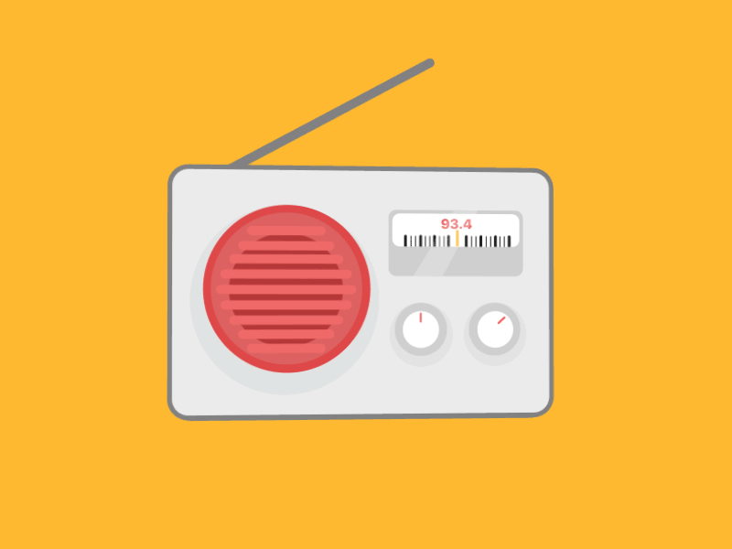
Task: In Groups
Learning Objectives:
To explain how the structure of a radio works.
To create a broadcast clock and explain how it works in radio.
To create a treatment proposal for a radio show
Create a one hour clock using the running order.
Colour code your clock
Label it up.

Slide 8
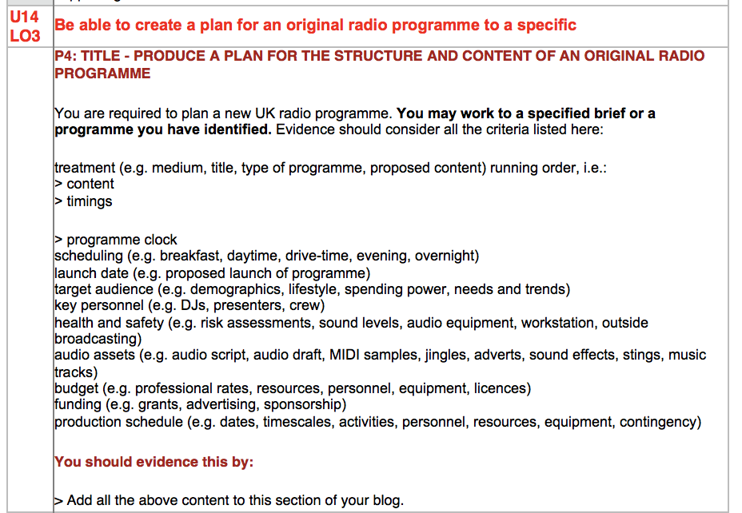
Learning Objectives:
To create a broadcast clock and explain how it works in radio.
To create a treatment proposal for a radio show
Choose ideal start time for the content of your show. (Start 15 minutes past the hour). Fill 1st 15 with schedule news/music track/promo.
Draft your running order & clock.
List your key personnel in your treatment proposal.
Keep a log of interview questions / resources / recordings. (Use templates on the website).

