Slide 1
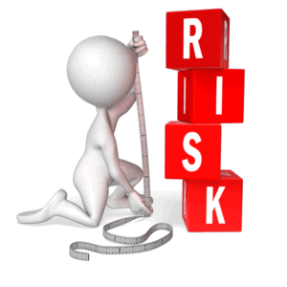
Pre-Production Planning
Learning Objective:
To recap and recall learning from the course
To create a risk assessment for your project.

Slide 2
Starter:
What have you learnt about so far?
Confident
Ok-ish
Not sure at all

Slide 3
What is a risk assessment?
Who is a risk assessment for?

Slide 4
Risk assessments protect you, your crew, your actors and your equipment. They look at hazards which can harm and can effect your production and put a PLAN B in place.

Slide 8
Task
Use the HSE.GOV.UK website and research what different health and safety issues you might need to consider for your advert. Also explore if there are any issues you need to consider with your other current units. (E.G special effects or News)
http://www.hse.gov.uk/entertainment/index.htm
Create a risk assessment and evaluate whether risks are low, moderate and high. What is your plan B? Try to be thorough with your RA forms.
Collate all your documents together and finally create a prop and costume list (or sound effect list if radio advert). Get these on your blog and be ready to record.

