Slide 1
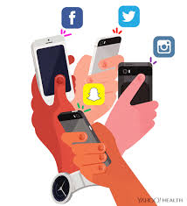
UNIT 6:
Social Media and Globalisation

Slide 2
Learning Outcomes
1: Able to explain how online and social media products are used.
2: Write about the impact of social media and globalistation on media audiences and producers.
3: Explore and establish how global industries use social media.
4: Students are able to plan a successful social media campaign and illustrate how to manage it.

Slide 3
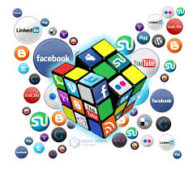
Two hour exam – 60 marks
Throughout this unit you will receive various case studies, practical tasks and extra help to guide you through the exam.
Section A is worth 30 marks and Section B is worth 30 marks.

Slide 4
L01.1 – Understanding Social Media Usage
Social Media App | How often do I use the app? | Why do I use the app?
In pairs pick four social media apps that you used (or have used in the past) and discuss the questions. Fill your table with your answers, ready for feedback.

Slide 5
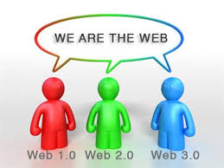
WEB 1.0 → 3.0 Quiz
Some of the answers will need googling, some your own thinking
and some you may need to ask your peers or Miss Samuels.
Use the quiz sheet to find out all about the developments of online technology which is split into 3 parts: Web 1.0, Web 2.0 and Web 3.0

Slide 6
Keywords
Hypertext – text which contains links, which was common and began on read-only websites of 1.0
Collaboration – The way 2.0 has allowed producers to use social media and work together on large scale projects. (Often international)
Prosumer – An amateur producer who used online/digital technologies to create and distribute media products. (Vloggers, YouTube music artists, Vimeo short film makers)
Semantic Web– The way, by 3.0, machines are allowed to understand the meaning of hyperlinked information to personalise content to audiences. (Facebook adverts / Amazon recommendations).

Slide 7
What are negatives in this development?
What are the benefits of Web 3.0?
What is next for the Web?

Slide 8
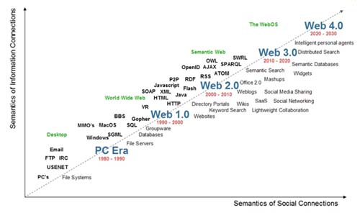
Evolution of Online technologies

Slide 9
Write up your learning so far
Explain about the differences between Web 1.0, Web 2.0 and Web 3.0.
What are the benefits of Web 3.0? What could be negatives?
What are key social media platforms for media producers and how might they use them?

