Slide 1
Unit 6: Social Media and Globalisation
LO1.3 Purpose of social media products

Slide 2
Viral marketing campaigns
Blair Witch (1999) highest grossing independent film with use of website viral marketing mixed with newspaper advertising and posters.
Cloverfield (2008) using enigma to really get people talking.
Dark Knight (2008) interactive for fans of the comic – crossing over with the real world
Hunger Games (2014) a clever campaign with articles, posters and online marketing.

Slide 3
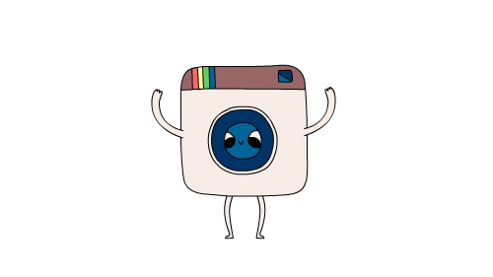
Professional uSE VS PERSONAL USE

Slide 4
1943 – HIERARCHY OF NEEDS (maslow Pyramid)

Slide 5
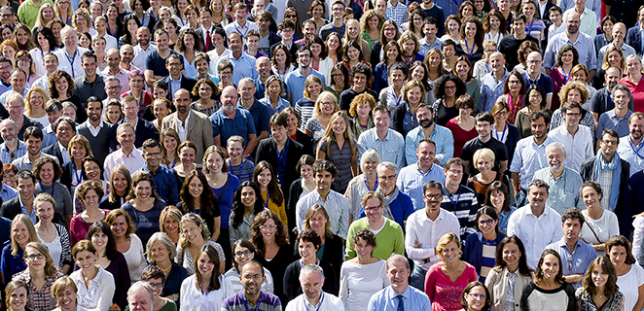
The Well – Virtual community
First social network
Share ideas, interests and content beyond their friendship groups
Made by fans of rock group - The Grateful dead.
Allowed them to reach fans on a global level, to share their passion across the world.
https://www.well.com/aboutwell.html

Slide 6
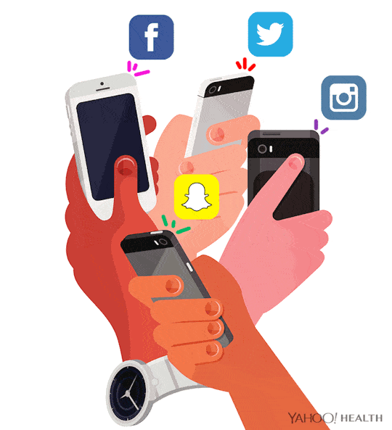
Global reach and gLOBALISATION
SOCIAL MEDIA has contributed to the increase in the globalisation of society.
Users can connect together and collaborate ideas within an instant.
Negative aspects have been generated through this with bigger issues such as riots, trolling and abuse.
Globalisation has changed the way news is now distributed.
The prosumer generation (Web 2.0) has changed how we view, experience and take part in the online world.

Slide 7
Blog your learning from LO1
What is the difference between Web 1.0, Web 2.0 and Web 3.0?
What did David Gaunlett mean by the term “prosumer”?
Explain Henry Jenkin’s Participatory Culture and talk about swedes.
Explain viral marketing and give and example of this.
How has social media contributed to globalisation?
How are social media platforms used now? Who uses them? What is their purpose?

