Slide 1
Unit 6: Social Media and Globalisation
Shared sow
lEARNING OBJECTIVE: tO EXPLAIN HOW MEDIA PRODUCERS USE SOCIAL MEDIA TO CREATE, PROMOTE AND PROTECT THEIR PRODUCT

Slide 2
tODAY
Hear back from your presentations.
Review key social media campaigns
Explore social media apps
Look at building your own viral campaign

Slide 3
Some significant Viral marketing campaigns
Blair Witch (1999) highest grossing independent film with use of website viral marketing and IMDB mixed with newspaper advertising and posters. (before the introduction of social networking and apps)
Cloverfield (2008) using enigma to really get people talking.
Dark Knight (2008) interactive for fans of the comic – crossing over with the real world
Hunger Games (2014) a clever campaign with articles, posters and online marketing.
Suicide Squad (2016) using Snapchat filters for promotion.

Slide 4
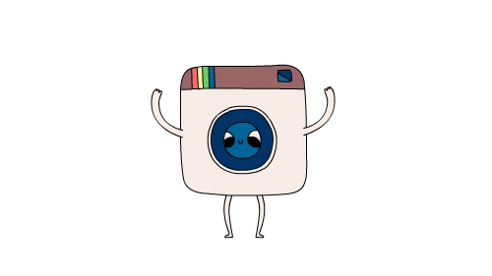
wHAT APPS DO YOU USE? wHAT ARE FOR Professional uSE VS PERSONAL USE?

Slide 5
vIRAL CAMPAIGN
Lo2: explain the impact of social media and globalisation on media audiences and producers
In pairs choose a local business of your choice
Pick 3 social media channels
Outline the benefits that using social media might have on the business
Explain how you would advertise using that social media channel and why? Is it the right channel for the right audience?
Working on this Monday with Miss Samuels & Mr B
Prepare to present back

Slide 6
Extension TASK
In groups of 2-3
Group A: Vicky Pattison, Taylor Swift, Harry Styles
Group B: Kylie Jenner, Maya Jama, Jemma Lucy
Group C: Holly Hagan, Kem Cetinay, Aaron Chalmers,
Group D: Kim Kardashian, Casey Batchelor, Lethal Bizzle
1.Analyse the content of the last 5 images they have posted on instagram.
2.Is the content appropriate for young people?
3.Is there any sponsorship shown? How is this portrayed?
4.Have they created a positive or negative representation?
5.What are your overall thoughts on this user’s account? Is it useful social media content?
Write up your responses, ready to share in future lessons
Lo2: explain the impact of social media and globalisation on media audiences and producers

Slide 7
1943 – HIERARCHY OF NEEDS (maslow Pyramid)
How do you think this is relevant to our social media use in today’s world?

Slide 8
Task: Research now to present back in Mr Baxter’s lesson
Research, try out and explore your 2 apps.
Create a presentation on both explaining:
How do they work? How easy are they to operate?x
Who is the target audience?
How do they function? What do they look like?
What are the negatives and positives with the app?
How do you communicate?
How do you experience content?
Which is a better app and why?

Slide 9
What are the benefits of accessing social media through an app?

Slide 10
Presentations: SOCIAL MEDIA APPS

Slide 11
tASK: wRITTEN PIECE
Compare how two social media channels can be used for different purposes. Use examples to support your answer.
You can use any social media apps of your choice, as long as you use clear examples.

Slide 12
Task: Peer assessment and improving your written answers

Slide 14
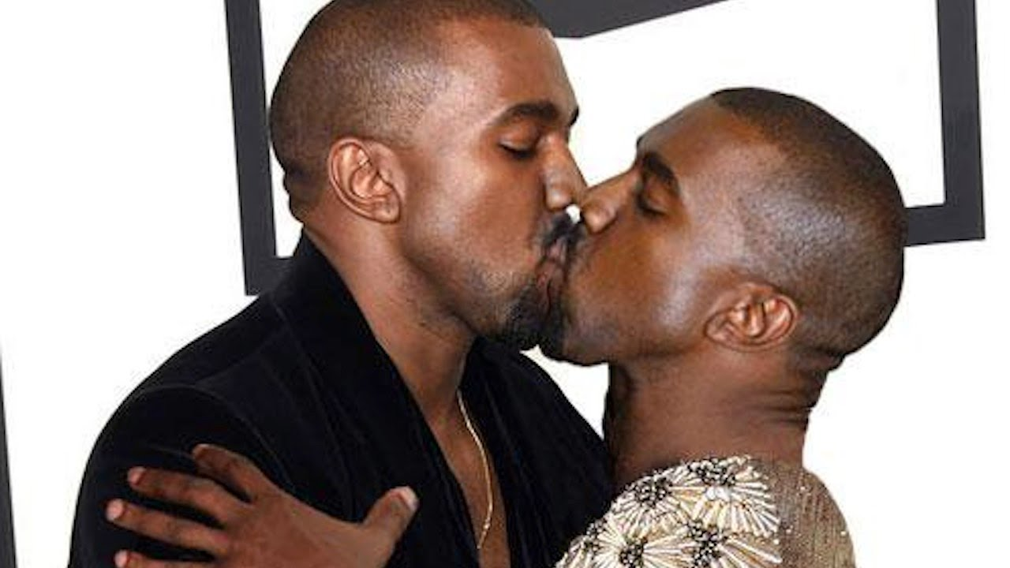
Wikinomics – connecting ideas of people
What other advantages does social media give us?
What negatives does social media create for media professionals?

Slide 15
Ethical and legal social media considerations

Slide 16
What constraints and issues should you be aware of when using social media as a producer in foreign markets?
Discuss and list in groups, ready for feedback
Notes:
Censorship of content
Different social norms
Different privacy laws
Freedom of speech bban
Religious beliefs
Bias
Ideology

Slide 17
What is the best way to use social media in the work place? Why should you not express personal grievances against your work on social media?
Discuss and list in groups, ready for feedback
Notes:
Censorship of content
Different social norms
Different privacy laws
Freedom of speech bban
Religious beliefs
Bias
Ideology

Slide 18
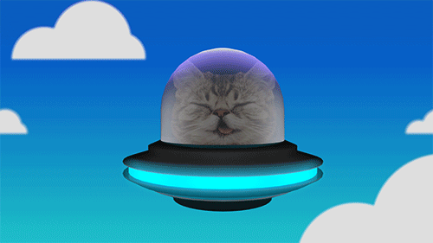
Pair task
Aliens have just landed in Cambridge and want to start fitting in with sensible Millennials. Create a “Use Social media like a millennial pro” guide for them. What are the do’s and don’ts! How will the Aliens best use the internet?

Slide 20
A successful campaign example (Unit 2 comes in handy)
Clear communication with the client – Skype conferences, email communication
GANTT Charts and clear schedules, strong milestones
Target audience considerations
Variety of platforms
Review dates to refine campaign, analyse traffic and response
Audience engagement key.

Slide 21
Sony Records have signed “Ryan” a rapper from South London. His new debut single is called “Fries” and his album is set to launch in February. The artist is expected to generate a lot of interest from teenagers aged 15-18 as Ryan used to be on reality TV show “London Town” which had high ratings on E4.
Develop a social media campaign for the launch of Ryan’s album “Food for Thought”.
Include:
Timescales, milestones and review dates.
Channels used to reach audience.
Content plans

