Slide 1
Wednesday’s Lesson
Learning Objective: Developing and strengthening knowledge of how online and social media products are used.
Allowing each student to confidently explain social media products and utilise these in a marketing campaign.

Slide 2
Word of mouth - online
Learning Objective: Developing and strengthening knowledge of how online and social media products are used. Allowing each student to confidently explain social media products and utilise these in a marketing campaign.

Slide 3
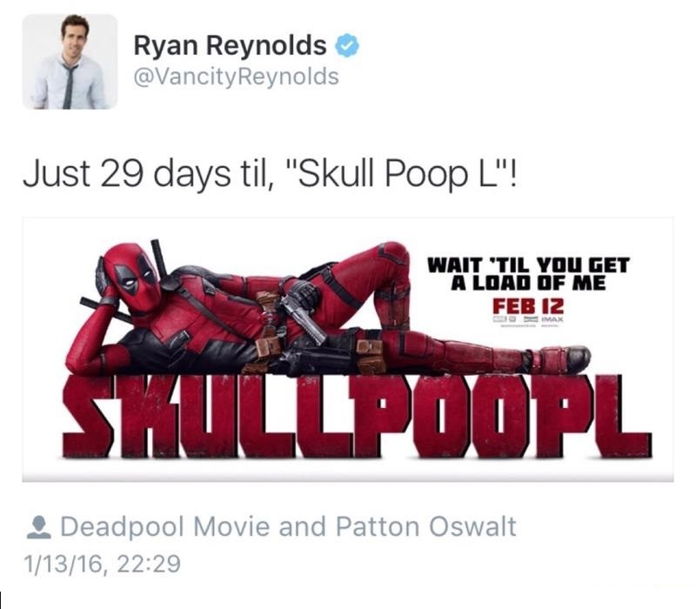
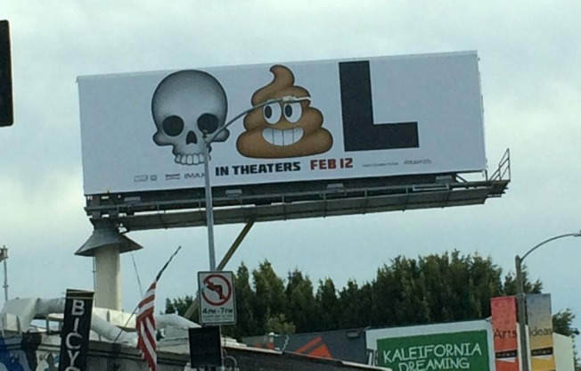

Slide 4
Twitter played a massive part in the Deadpool campaign
Using Ryan Reynold’s STAR POWER and asking the audience to produce photos of any images they see in relation to Deadpool
Youtube played the strongest part in the Be Kind Rewind with the introduction of audience made swedes.
Both are a modern day word of mouth. Both campaigns ask the audience to take part.
Learning Objective: Developing and strengthening knowledge of how online and social media products are used. Allowing each student to confidently explain social media products and utilise these in a marketing campaign.

Slide 5
In your envelope groups:
Choose another envelope
Decide how you could promote your media product
Make it a cross-promotion – one element MUST be your original social media platform
Encouraging an audience participation element.
What might encourage more people to hear about your product?
Learning Objective: Developing and strengthening knowledge of how online and social media products are used. Allowing each student to confidently explain social media products and utilise these in a marketing campaign.

