Slide 1
Social Media and Globalisation Revision Lesson
Learning objective:
To feel confident to explain the impact of social media in the exam
To be able to create a concrete social media plan for the exam

Slide 2
How do you feel about the exam?
What did you find easy?
What did you find challenging?
What were your overall thoughts?
If you could sum it up in one word what would it be?

Slide 3
Group Feedback
Write this down
Clarity is needed. Be precise. Be clear. E.G: Smartphone or apps on smart phone.
Some of the questions relate back to your unit 1 and 2 exam lessons. E.G: Planning tools.
READ the question, underline keywords it if you need to.
Ensure you’re answering that question and not going off on a tangent.
Compare and Contrasts need to be explained more.
WELL DONE: Great use of creativity with social media plans.
Fantastic results by all.

Slide 4
1.B– Exploring the answers

Slide 6
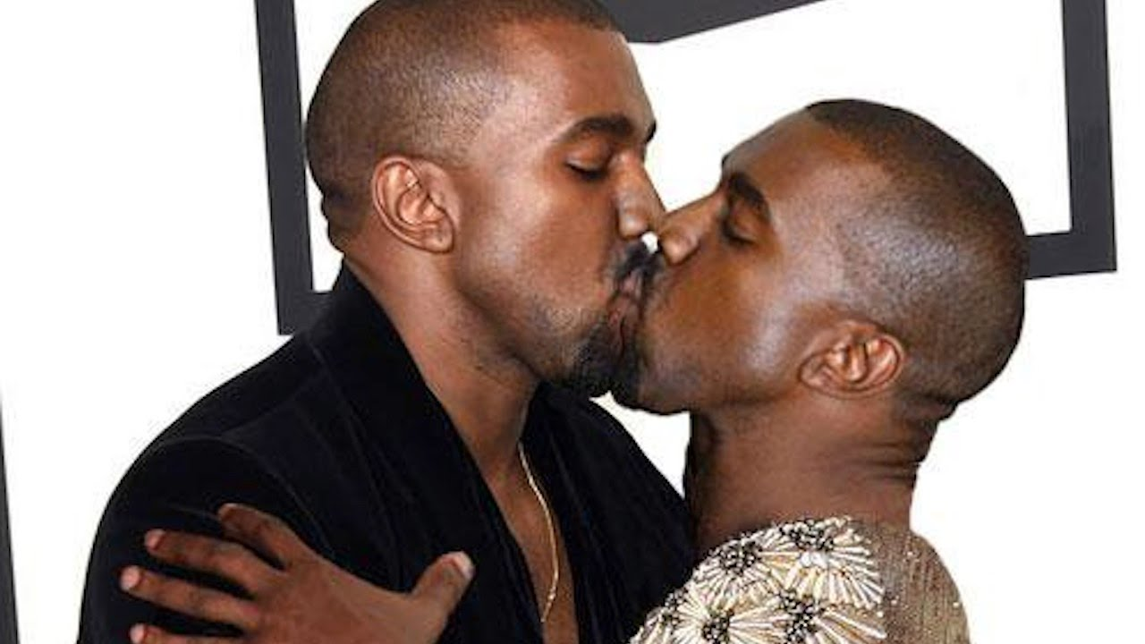

Slide 7
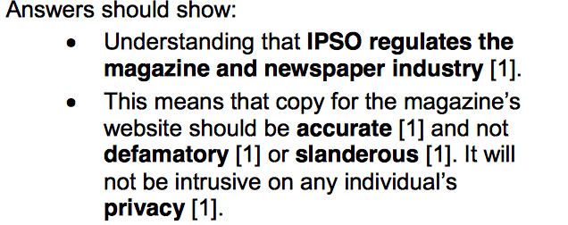

Slide 8
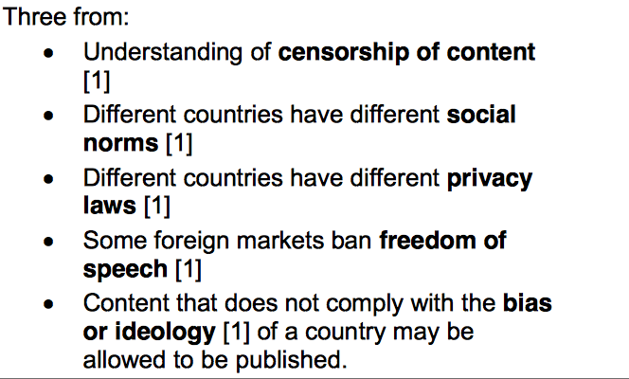
Ethical or Legal

Slide 9
Question 4 and 5 we’ll explore on Friday

Slide 11
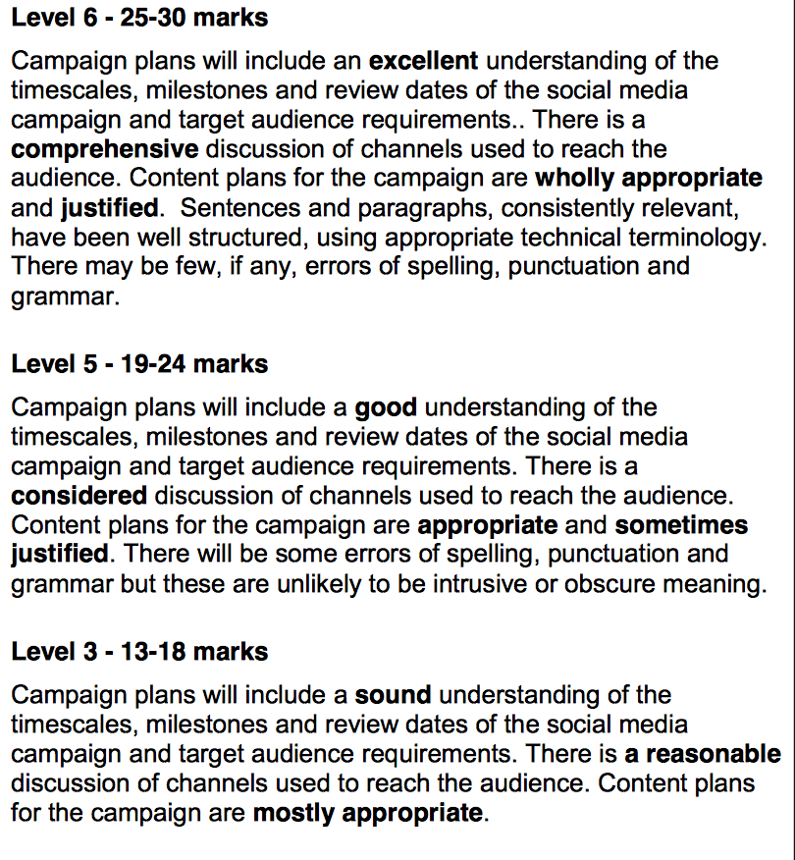
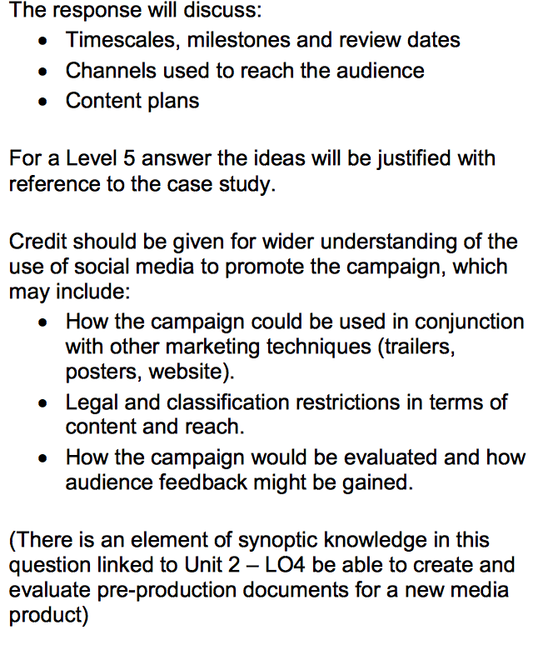

Slide 13
Sony Records have signed “Ryan” a rapper from South London. His new debut single is called “Fries” and his album is set to launch in February. The artist is expected to generate a lot of interest from teenagers aged 15-18 as Ryan used to be on reality TV show “London Town” which had high ratings on E4.
Develop a social media campaign for the launch of Ryan’s album “Food for Thought”.
Include:
Timescales, milestones and review dates.
Channels used to reach audience.
Content plans

Slide 14
Let’s try another question:

Slide 15
What tools do you need to create a successful campaign?
Email
Skype or other conferencing tools to collaborate with others.
Scheduling tools – online diary or gantt chart
Hootsuite to integrate, plan and analyse traffic.
Wikinomics : the theory and practice of mass
Analytical tools to help review trends, audiences and views.

Slide 16
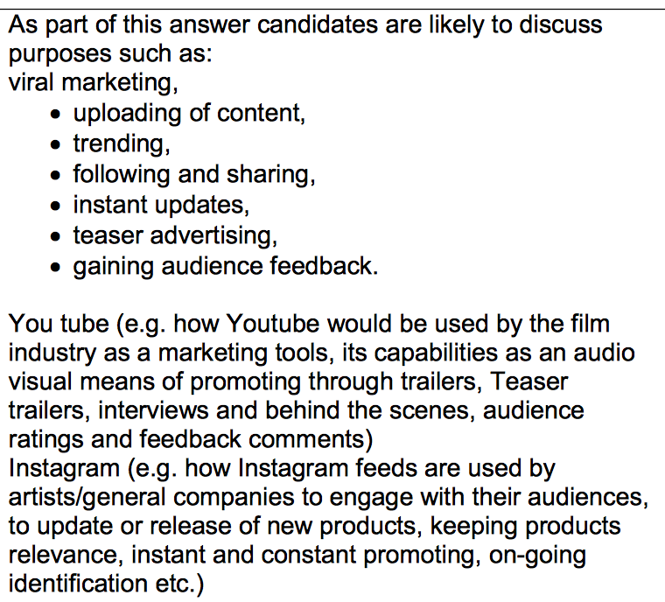

Slide 17
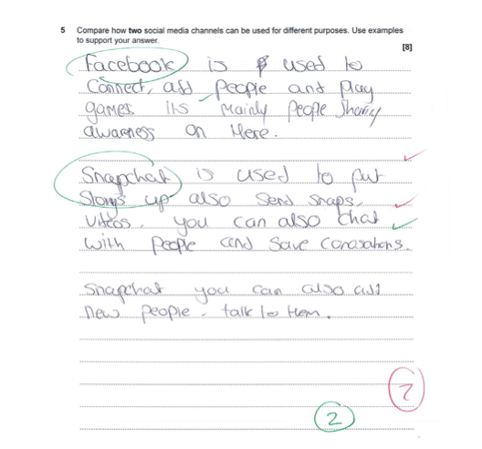

Slide 20
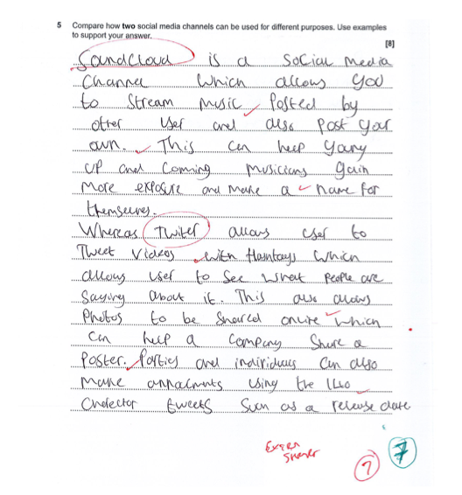

Slide 21
Little Mix have a brand new album coming out. Compare and contrast two social media platforms and how they can contribute to their album launch:

Slide 22
Little Mix have a brand new album coming out. Compare and contrast two social media platforms and how they can contribute to their album launch:
The photo based app Instagram is a great tool for Little Mix to use to promote their new album.
This is because the app allows the prosumer to instantly add photo/video content which can receive instant feedback from its audience. With instagram feedback can be analysed through likes and comments.
Similar to this, Twitter can instantly upload videos and photos, even though the focus is more on written characters. However, Twitter differs with audience feedback because there is the retweet option to allow fans to broadcast to a bigger audience and share, unlike insta.
The content for both apps is where the biggest contrast is. For example Instagram has permanent posts which are visual focussed, however Twitter is limited to the timing of video content and because it works on a news feed, content can be missed.
EXAMPLE…..

