Slide 1
Learning Objective:
To explain what a target audience is and why it’s important to digital game producers.
To create a survey which allows you to evaluate audience needs for digital games
To explain what a vox pop is and create questions to use for future vox pops.
Unit 91 Designing a Digital Game Concept
Lesson: Target Audiences

Slide 2
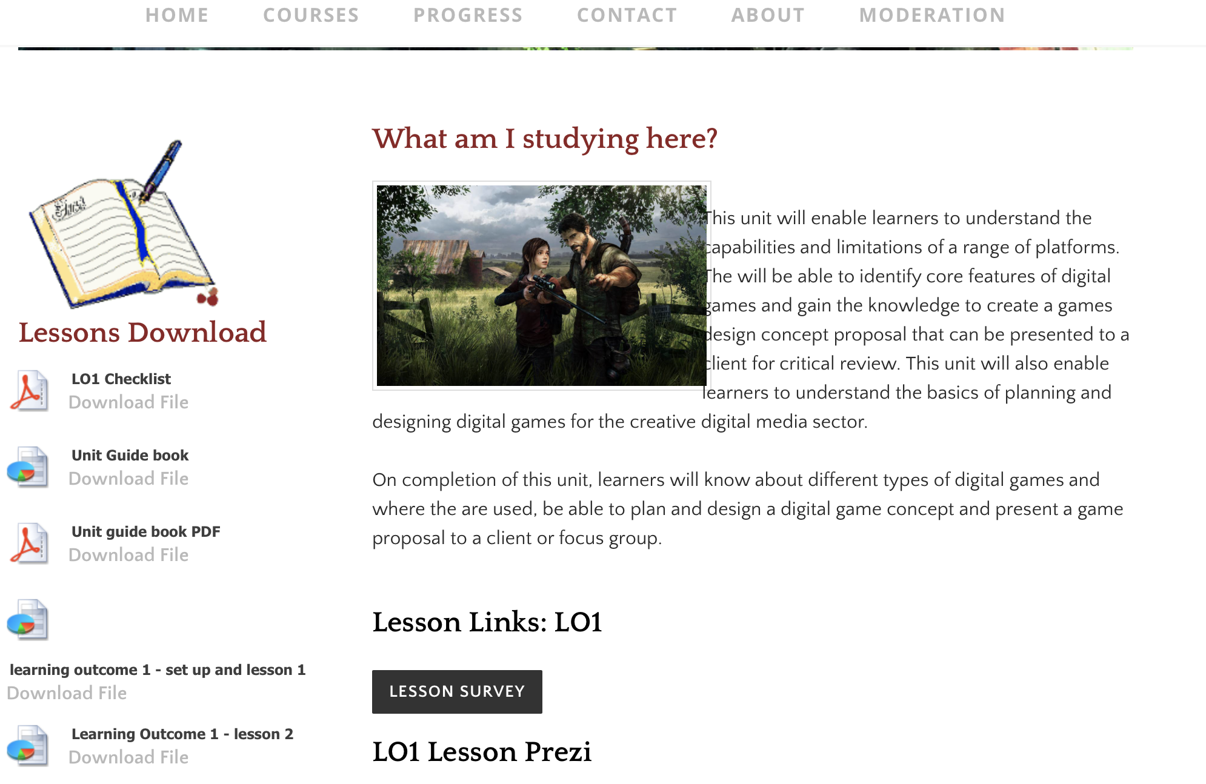
Starter Task:
Log on (if you know your computer is slow grab an iPad)
Go to Media Website: Unit 91
Find the Lesson Survey button (shown on board)
Fill in the survey in silence
Think about what is the purpose of the survey? What might you use it for?
Learning Objective:
To explain what a target audience is and why it’s important to digital game producers.
To create a survey which allows you to evaluate audience needs for digital games
To explain what a vox pop is and create questions to use for future vox pops.

Slide 3
What do we want to know about our audience?
This questionnaire is to compliment your game genre research task. Ask questions to work out what audiences feel about these games and their performance.
What consoles / platforms they like?
What they don’t like?
What do they choose in game genre?
What stops them buying a game?
What don’t they like about digital games?
What would they like in a game?
Learning Objective:
To explain what a target audience is and why it’s important to digital game producers.
To create a survey which allows you to evaluate audience needs for digital games
To explain what a vox pop is and create questions to use for future vox pops.

Slide 4
vOX pOPS
Click here for VOX POP TIPS
Learning Objective:
To explain what a target audience is and why it’s important to digital game producers.
To create a survey which allows you to evaluate audience needs for digital games
To explain what a vox pop is and create questions to use for future vox pops.
Click here to go back to the Prezi

Slide 5
Task:
Learning Objective:
To explain what a target audience is and why it’s important to digital game producers.
To create a survey which allows you to evaluate audience needs for digital games
To explain what a vox pop is and create questions to use for future vox pops.
(In pairs) create a survey monkey and share it through email / with friends & family/ on social media
Screenshot the results you get and add them to your Prezi (or a separate PowerPoint if you prefer)
(Individually) Write a paragraph analysing the results – what is the most common console / game etc.
Then create questions for your Vox Pops – before next lesson you need to collect 5 vox pops (include 1 adult voice)
Stretch and Challenge: Get the vox pops onto your prezi and analyse the results.
Homework: Ensure your Vox Pops are recorded for next lesson

