Slide 1
Unit 2: Understanding Target audiences
Learning objective: to compare psychographic and demographic audiences.

Slide 2
Task 1:
Need a little help? Watch this: https://www.youtube.com/watch?v=dwa7Y4T28bU
Create a blog post entitled: Target Audience. We will look at this more on Thursday together. For now, research and write up what you think a target audience is?

Slide 3
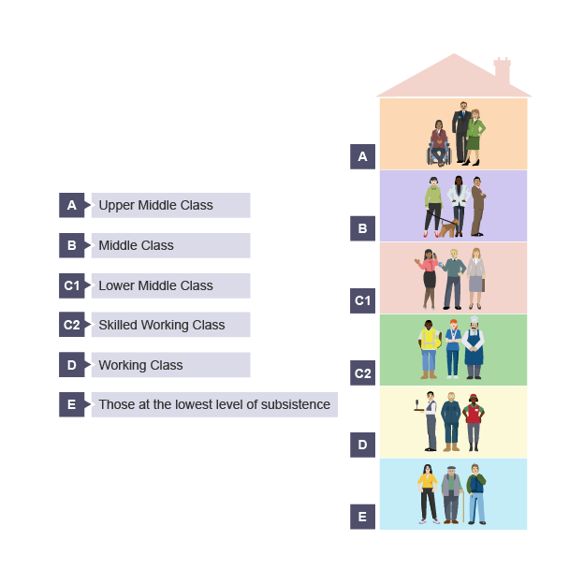
Watch this video now and write down at least 4 bullet points on what is said about Demographic audiences.
https://www.youtube.com/watch?v=qZUUjq4ZEfY
DEMOGRAPHIC
AUDIENCE PROFILE

Slide 4
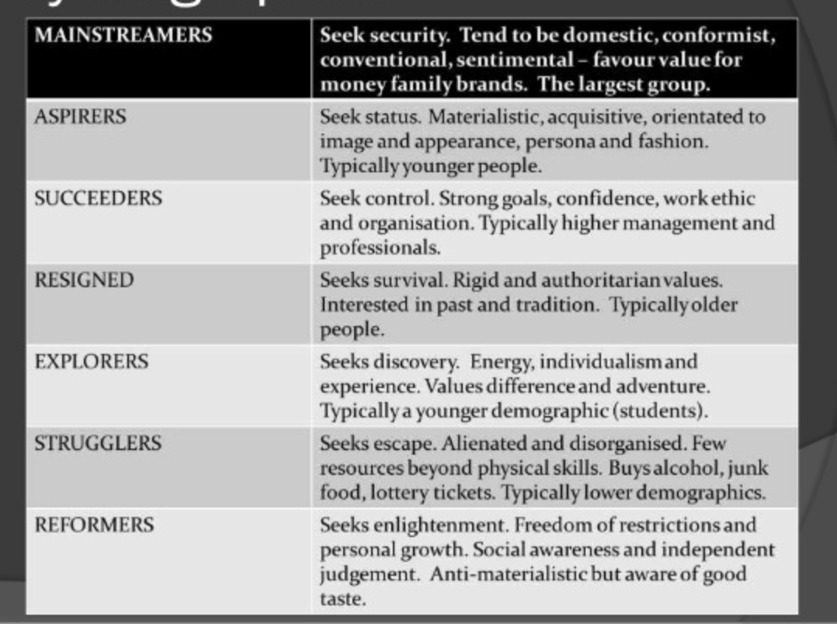
Watch this video now and write down at least 4 bullet points on what is said about Psychographic audiences
https://www.youtube.com/watch?v=xhby7s9OJv0

Slide 5
Write a blog post: How does categorising audiences help in
media products and services? Which, do you think, audience type suits which type of media product?

