Slide 1
Target Audience
Exploring factors to consider with target audiences and planning.

Slide 2
Exploring factors to consider with target audiences and planning.
What target audiences need to be considered?

Slide 3
AGE
Exploring factors to consider with target audiences and planning.

Slide 4
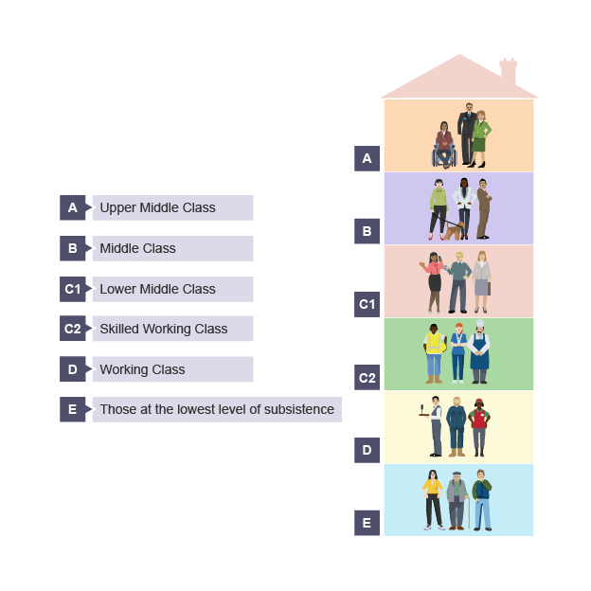
DEMOGRAPHIC
AUDIENCE PROFILE
Exploring factors to consider with target audiences and planning.

Slide 5
Why are considering target audiences important?
Exploring factors to consider with target audiences and planning.

Slide 6
Exploring factors to consider with target audiences and planning.

Slide 7
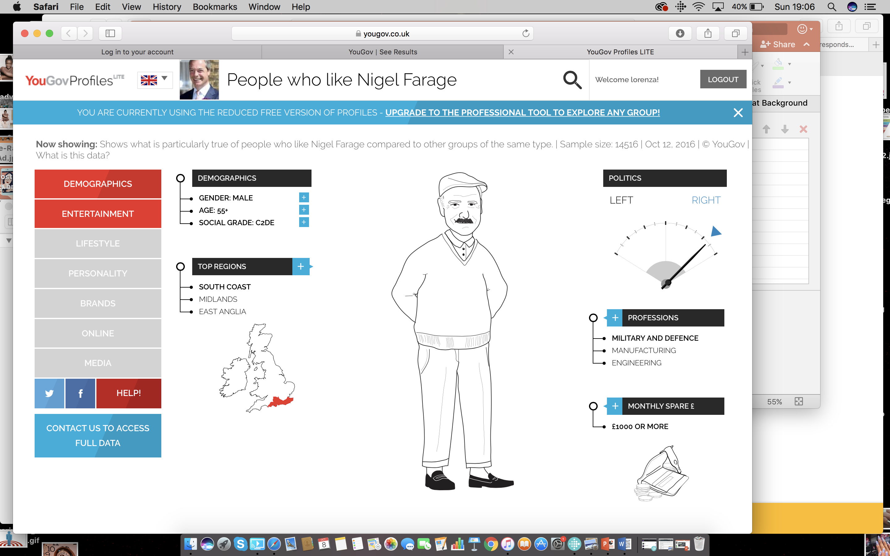
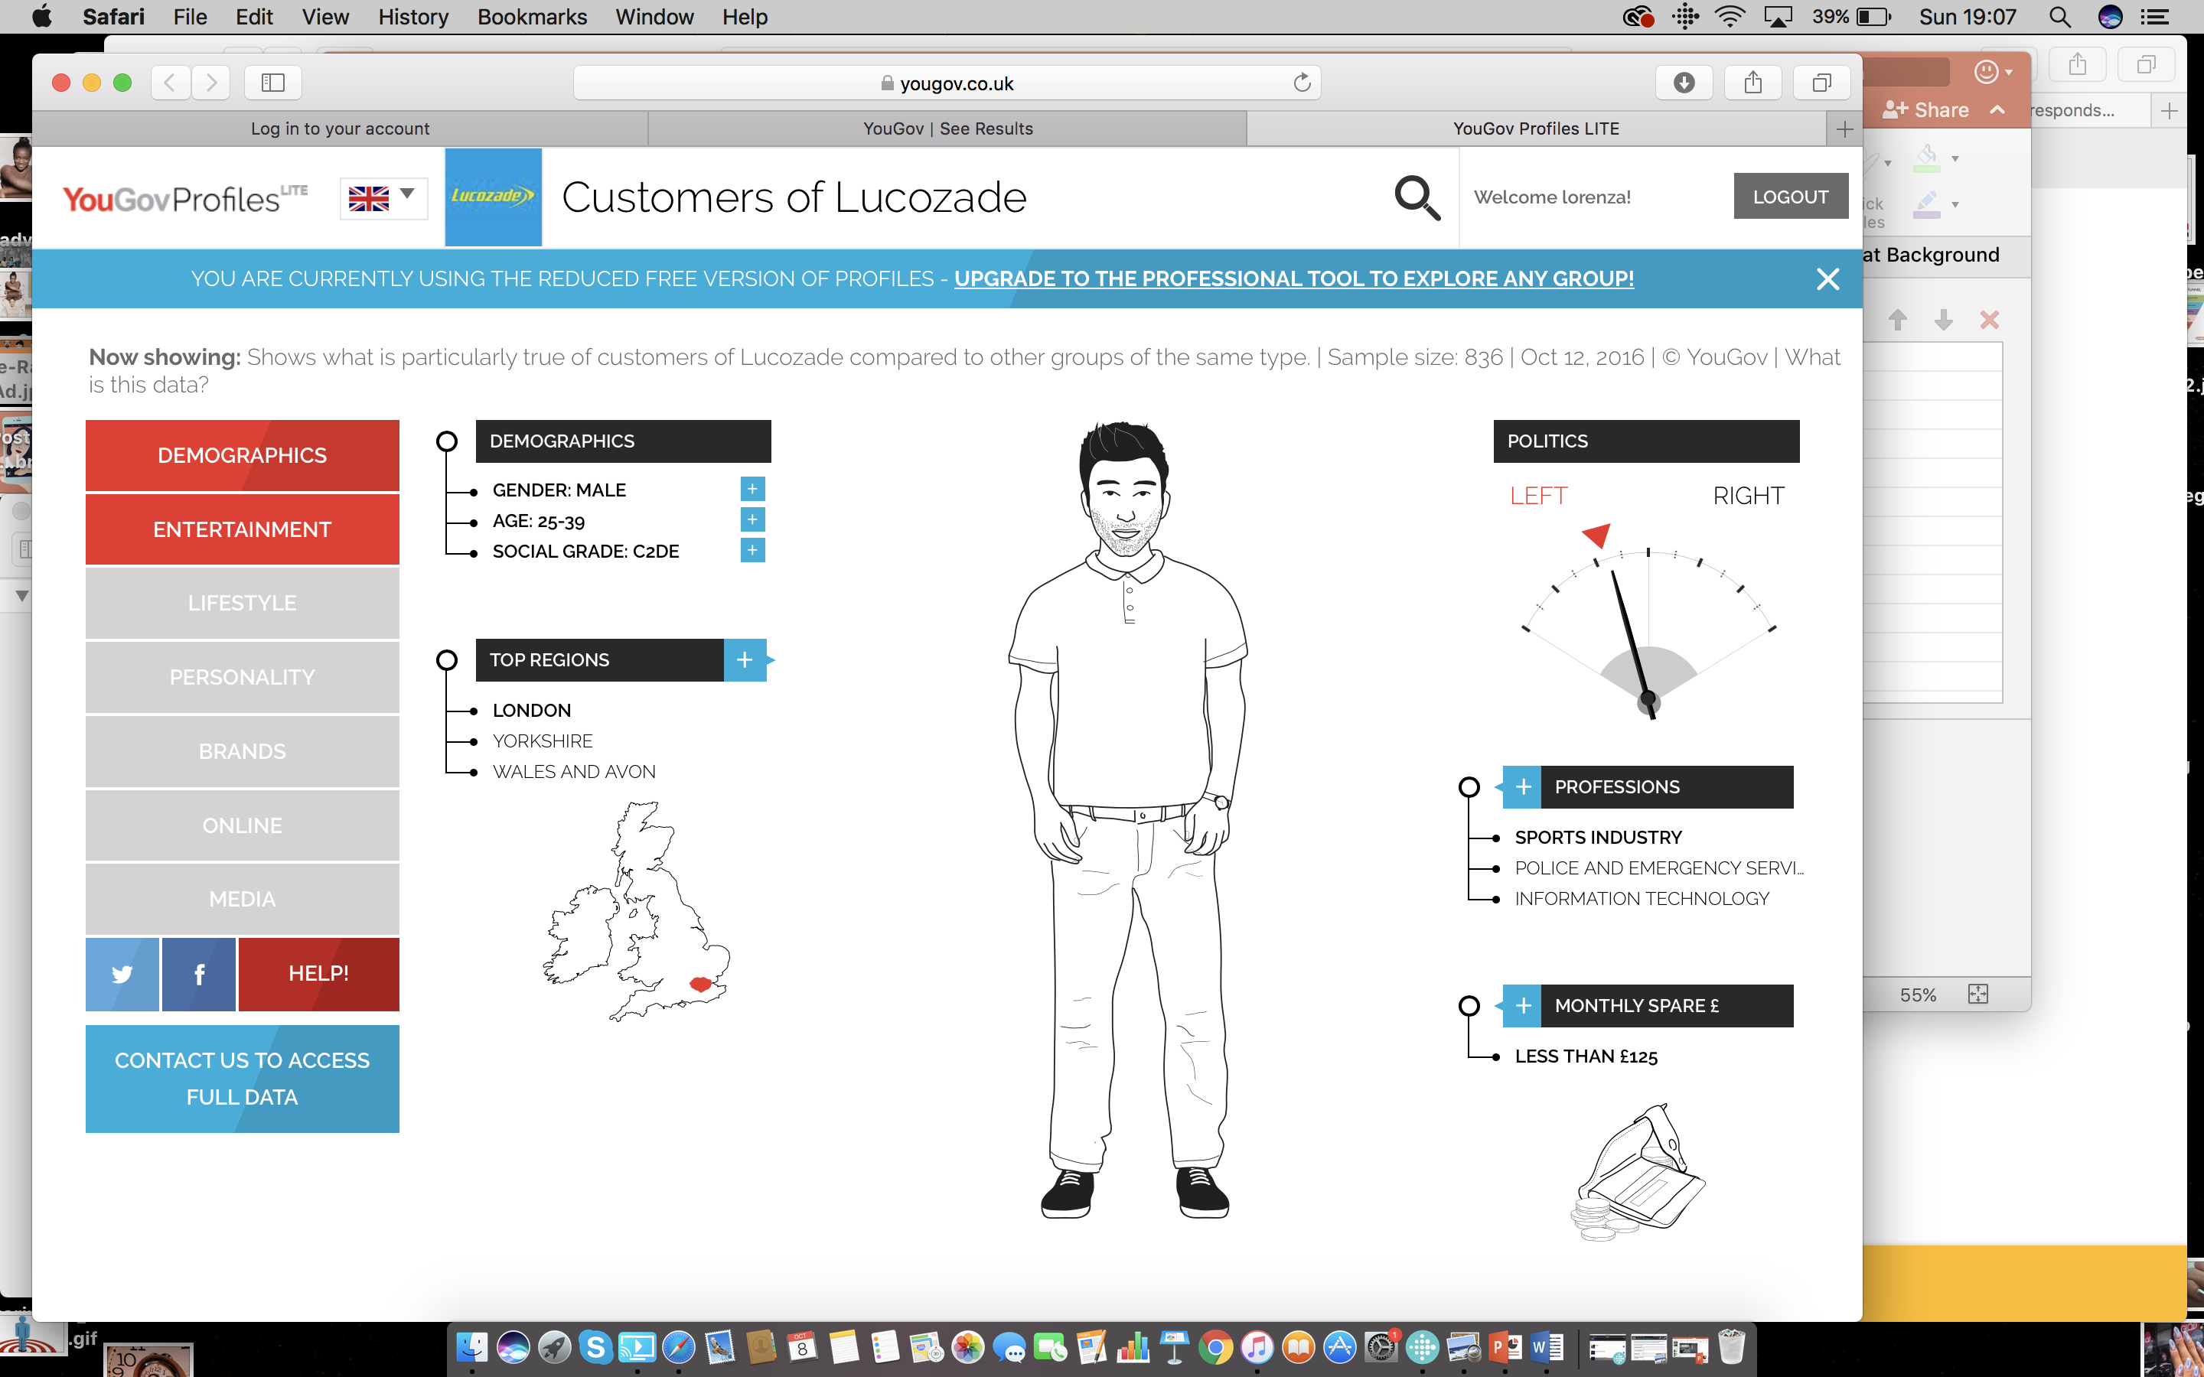
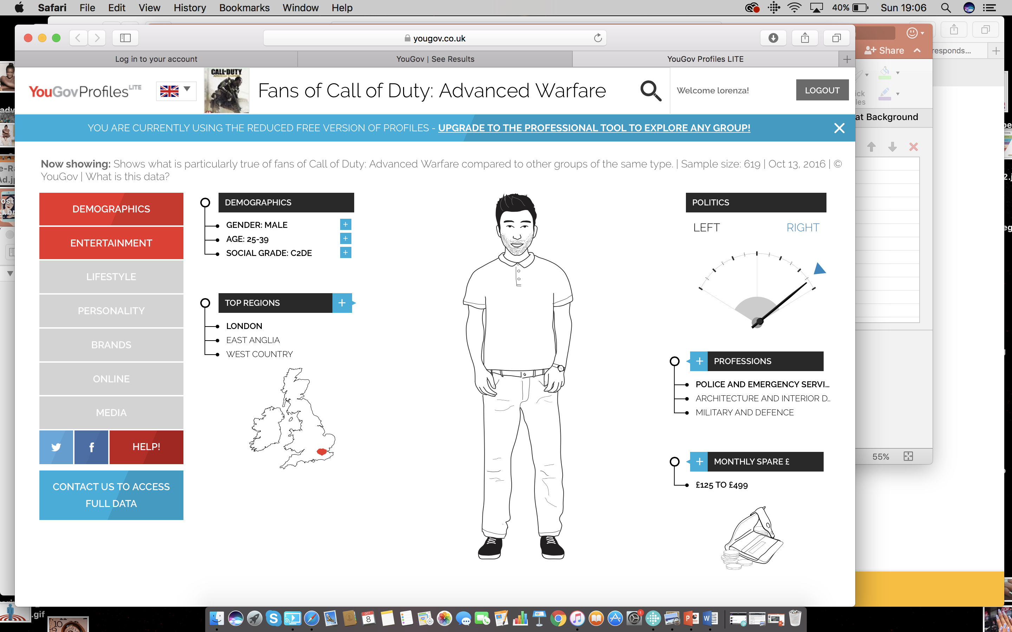
https://yougov.co.uk/profileslite#/
Exploring factors to consider with target audiences and planning.

Slide 8
What is a niche audience?

Slide 9
Project (Part A)
Using what you have learnt about Target Audiences create an idea for a breakfast cereal TV advert.
This is to get out to the widest audience possible.
Create “Blue sky thinking” or a “Mind map” to develop your ideas. How will it look and sound?
Stretch and challenge yourself:
Regarding your target audience – what do you need to be careful of when creating your advert?
What do you need to consider? Why?
Exploring factors to consider with target audiences and planning.

Slide 10
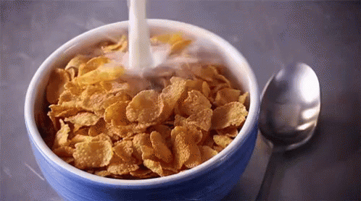
Learning objective: Plan the pre-production of a media product.

Slide 11
Learning objective: Plan the pre-production of a media product.
Project (Part B)
Using your advert plans from yesterday identify the resources you will need to complete this.
Divide these resources into the following categories:
Prop Equipment Person Other

Slide 12
After analysis of brief:
Learning objective: Plan the pre-production of a media product.
The project will split into three stages:
Pre-production
Production
Post-production

Slide 13
Project Management Software
Learning objective: Plan the pre-production of a media product.
Key elements found in all PM Software
Task Allocation
Scheduling
Resource Allocation
Report Creation/printing

Slide 14
Learning objective: Plan the pre-production of a media product.
Task allocation and Scheduling
Pre- Production Phase
Decide who will take on each role
Then create a schedule
Project Research
Proposal Treatment
Storyboard, script outline, mood board
Location Recce, resource allocation
Cue sheet, shooting script, page layout
Production scheduling
Stretch yourself: Create a colour-coded gantt chart to track the tasks and timing

