Slide 2
Component One Section A:
A reminder…
Learn about Media Language and Representation as an essential basis for analysing media products
•analyse critically and compare how media products construct and communicate meanings
•use theories and specialist subject-specific terminology appropriately
•debate key questions relating to the social, cultural, political and economic role of the media
•construct and develop a sustained line of reasoning in an extended response

Slide 3
Component One Section A: Advertising & Marketing -
Tide print Advert
Driving Question:
How do I analyse media language in the advert?
What are Structuralism & Semiotics?

Slide 4
Learning Outcomes
I will know what structuralism and semiotics are
I will understand how media language elements can create meaning
I will be able to analyse an advert in terms of media language and the theoretical framework

Slide 5
Representation
The way something is re-presented to the audience – events, issues, a group of people, a place etc.
The media make choices about how to represent something.
Representation can reinforce, misrepresent or challenge stereotypes. They can convey and reinforce our values, attitudes and beliefs about the world
They will be represented through the use of media language (Colour; Sound; Images; Camera angles; Editing )

Slide 6
Media
Language
How the combination of media language can create meaning.
How audiences might respond to and interpret the aspects of media language
How technologies affect media language

Slide 7
Our examination set text
What are your initial thoughts?

Slide 8
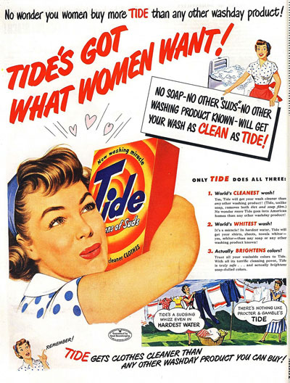

Slide 9
Historical Context
The post WWII consumer boom of the 1950s included the rapid development of new technologies for the home, designed to make domestic chores easier. Vacuum cleaners, fridge freezers, microwave ovens and washing machines all became desirable products. Products linked to this technology also developed, such as washing powder.

Slide 10
Cultural Context
Print adverts from the 1950s conventionally used more copy than we are used to seeing today. Consumer culture was in its early stages of development and with so many ‘new’ brands and products entering the market potential customers needed more information about them than a modern audience.

Slide 11
Look at the television adverts for Tide. How are they targeting audiences?
https://www.youtube.com/watch?v=BJ5EjNkHeU0
How do these adverts create a desirable product?
What is the American dream? How do the adverts sell the American Dream?

Slide 12
Tide Print Advert Media Language Analysis
Analyse the following points on your copy of the advert.

Slide 13
Composition/layout and design (reading in a Z formation & rule of thirds): how is the advert constructed? Consider where the image is placed and the effect of this.
Central image: what is it and why has it been chosen? What does it communicate about the product?
Typography and graphics: what can you say about the font styles, graphics etc. How do they persuade the audience? Headings, subheadings and slogans
Visual codes: how has the advertisement communicated messages through the use of colour, expression, gesture and technique?
Colour: is there a colour scheme and if so what does it suggest? Does it link to the product? Part of the branding? Message it communicates?
Print technical codes: camera angles, shots, editing etc. How do they communicate messages?
Language and mode of address: how the advert ‘speaks’ to the audience. Words/language used (alliteration, hyperbole etc.) and what it says about the product. Hard sell or soft sell?
Attitude and beliefs: what attitudes and beliefs are conveyed through the advert? How will the product ‘change your life’?
Associations: does the advert use intertextuality, so we make associations with other media forms and products? If so, why?

Slide 14
Comparable adverts
What similarities and differences are there in other print advertisements from the 1950s?

