Slide 1
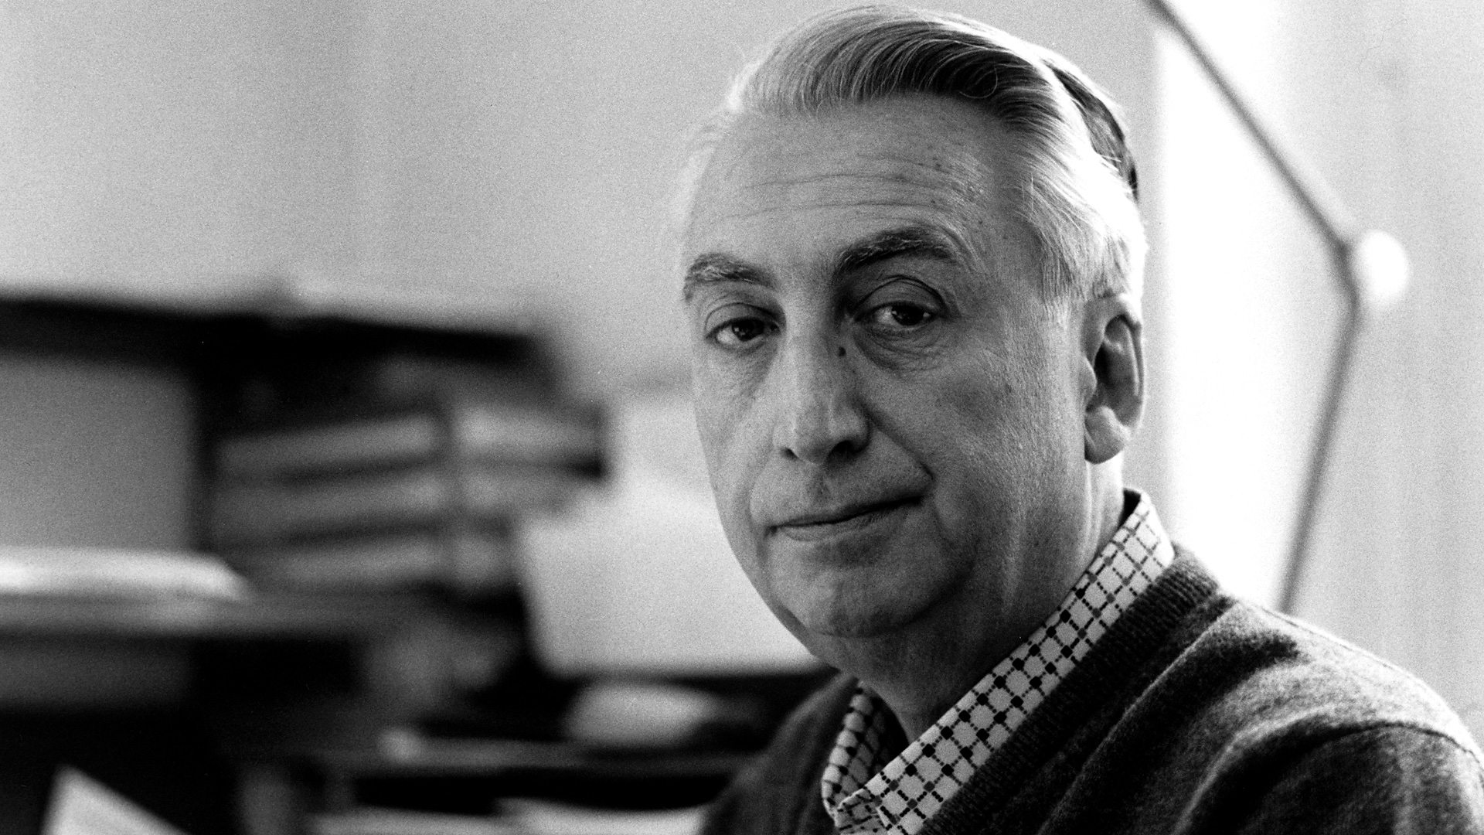
Semiotics – Roland Barthes
THEORY
Semiology is an approach that can be used to understand how media texts make meaning for their audiences. Texts communicate their meanings through a process of signification; they are constructed using a variety of signs. Everything that can be seen or heard on a screen or that is on a page is a sign.
A sign is a discrete unit of meaning. Signs are not limited to words but also include images, gestures and sounds - essentially all of the ways in which information can be communicated within a media text.
Signs can function at two levels:
•Denotation – the literal meaning
•Connotation – involves meanings that are associated with or suggested by the sign

Slide 2
Constructed meanings can come to seem self evident, achieving the status of myth through a process of naturalisation. For example, the myth of purity is constantly reinforced within commercial communication. Advertisements containing unrealistic airbrushed models enforce the myth that this ‘pure’ and idealistic version of beauty is attainable through their product, which causes society to accept this myth of purity (after repeated exposure) and then strive and aspire to become pure and perfectly beautiful themselves.

Slide 3
How can we apply this theory to the Tide advertisement?

Slide 4
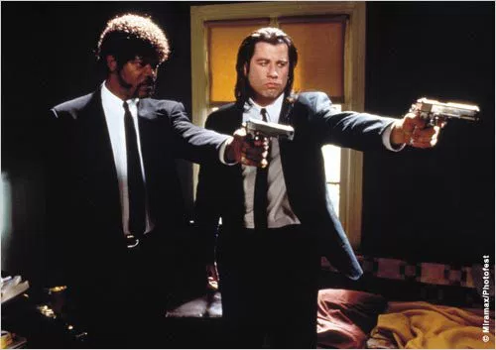
Enigma Codes - Roland Barthes
THEORY
This is the theory that texts contain a piece of mystery or ‘intrigue’ in order to draw the audience in and question “What does this mean?”, encouraging them to then engage with the text fully.
Action codes: this is the theory that a sign within a text represents something within the narrative, in order to move the narrative along at a faster pace. Take the image from Pulp Fiction; by showing guns, this signifies that someone is in danger of being shot and moves the plot along faster than the actors saying, “We’re going to shoot you.” Therefore, in this image the guns are action codes.

Slide 5
The exam board sum up what you need to know…
the idea that texts communicate their meanings through a process of signification
the idea that signs can function at the level of denotation, which involves the ‘literal’ or common-sense meaning of the sign, and at the level of connotation, which involves the meanings associated with or suggested by the sign
the idea that constructed meanings can come to seem self-evident, achieving the status of myth through a process of naturalisation
all elements of a media text are codes that need to be read: things they are (denotative level) and the responses they create (connotative level)

Slide 6
The enigma code here is the model Kate Moss’ facial expression. Her sultry, slightly parted full lips and slightly closed eyes present an atmosphere of mystery and intrigue. The audience would wonder what the model was pondering and then engage fully with the poster in order to discover their answer. The action code would be the lipstick; rather than simply stating that Rimmel are promoting a new lipstick, they place an image (or action code) of the lipstick, in order to move the narrative of the text along (which is that the lipstick Kate Moss is wearing, is the lipstick displayed in the poster).
The advertisement also contains many other signs and signifiers such as the use and combination of the colour red and a heart – which both have connotations of love, lust and romance. This suggests that by endorsing in this product, it will improve your love life and make you sexually desirable – part of Roland Barthes mythologies theory.
THEORY

Slide 7
We could add more terminology related to Barthes’ Semiotics theory, but which ones suit our text better?

Slide 8
THEORY
The Hermeneutic Code/Enigma Code - This code refers to mystery within a text. Clues are dropped, but no clear answers are given. Enigmas within the narrative make the audience want to know more. Unanswered enigmas tend to frustrate the audience. It is about the way the story avoids telling the truth or revealing all the facts, in order to drop clues in throughout to help create mystery.
The Proairetic (Action Code) This code contains sequential elements of action in the text. Proairetic elements add suspense to the text; the way the tension is built up and the audience is left guessing about what happens next
The Semantic Code (SEM) ( the voice of the person) The semantic code points to any element in a text that suggests a particular, often additional meaning by way of connotation which the story suggests. Connotation = cultural/underlining meaning, what it symbolises.
The Symbolic Code This code is about symbolism within the text. It exercises opposites to show contrast and create greater meaning, creating tension, drama and character development.
The Cultural Code/Referential Code ( the voice of science) Looks at the audiences wider cultural knowledge, morality and ideology

Slide 9
How can we apply this theory to the Tide advertisement?

Slide 10
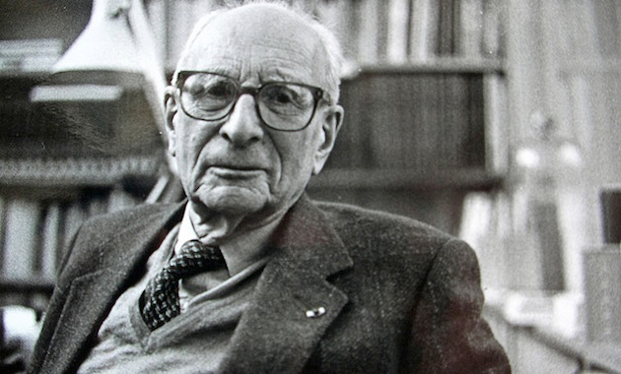
Structuralism - Claude Levi Strauss
THEORY
Levi-Strauss became one of the most prominent figures in structuralism, which suggests that there are universal patterns to human thought and culture; that there are universal structures that basically underlie all human actions and social life.
Levi-Strauss felt that culture is composed of hidden rules that give it meaning; the concept of binary oppositions. He believed that all human thought works by thinking through binaries, or opposites. Take a few examples:
man, woman
death, life
morning, night
raw, cooked
These oppositional structures are universal patterns that make up human thought. Levi-Strauss thought that all cultures think like this and these binaries only make sense in relation to one another. In other words, 'morning' only has meaning to us when we think about its opposite, 'night.'

Slide 11
How can we apply this theory to the Tide advertisement?

Slide 12
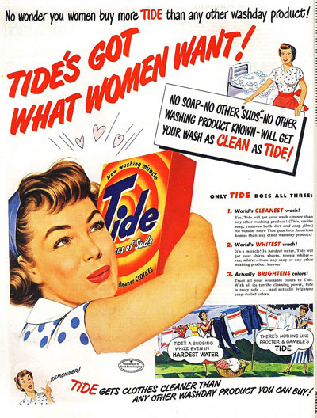
Applying Media Theory
THEORY
Semiotics - Barthes
How does the top of the advert create enigma codes for the audience? (Hermeneutic)
What are the connotations of the hearts? How do they link to the overall message of the advert? (Semantic)
Structuralism - Levi-Strauss
How does the advert create conceptual binary oppositions between Tide and their competitors?

Slide 14
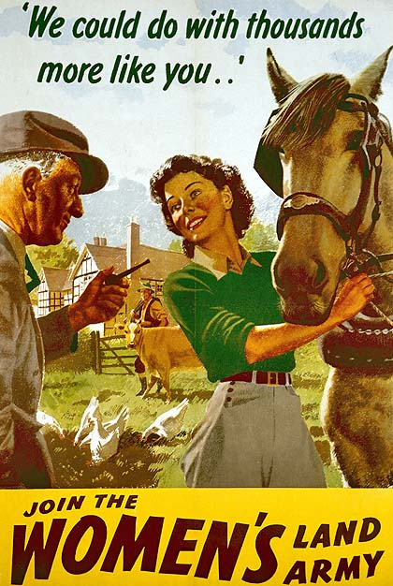
How do the representations in these adverts differ from the Tide advert?
Why - what’s the context?

