Slide 1
Component One Section A: Advertising & Marketing -
Tide print Advert
Driving Question
How are women are represented in the Tide print advert?

Slide 2
Learning Outcomes
I will know how women are represented in the Tide advert
I will understand how the representations reflect stereotypical representations of women in the 1950s
I will be able to draw clear comparisons in the representation of women between different print adverts

Slide 3
Social and Political Contexts
In 1950s men were being targeted for the post-war boom in America’s car industry and women were the primary market for the technologies and products being developed in the home.
Stereotypical representations of domestic perfection, caring for the family and servitude to ‘the man of the house’ became linked to a more modern need for speed, convenience and a better standard of living than women experienced in the pre-war era.

Slide 4
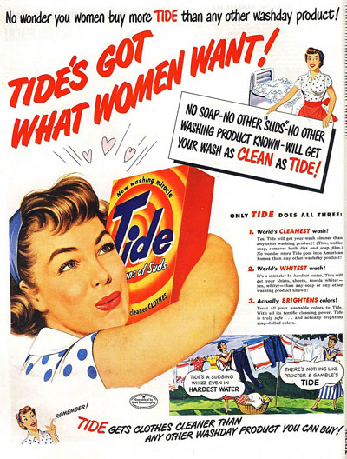
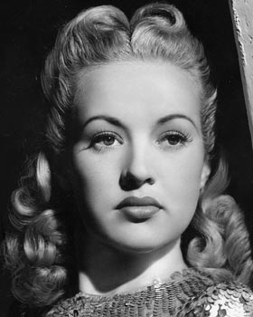
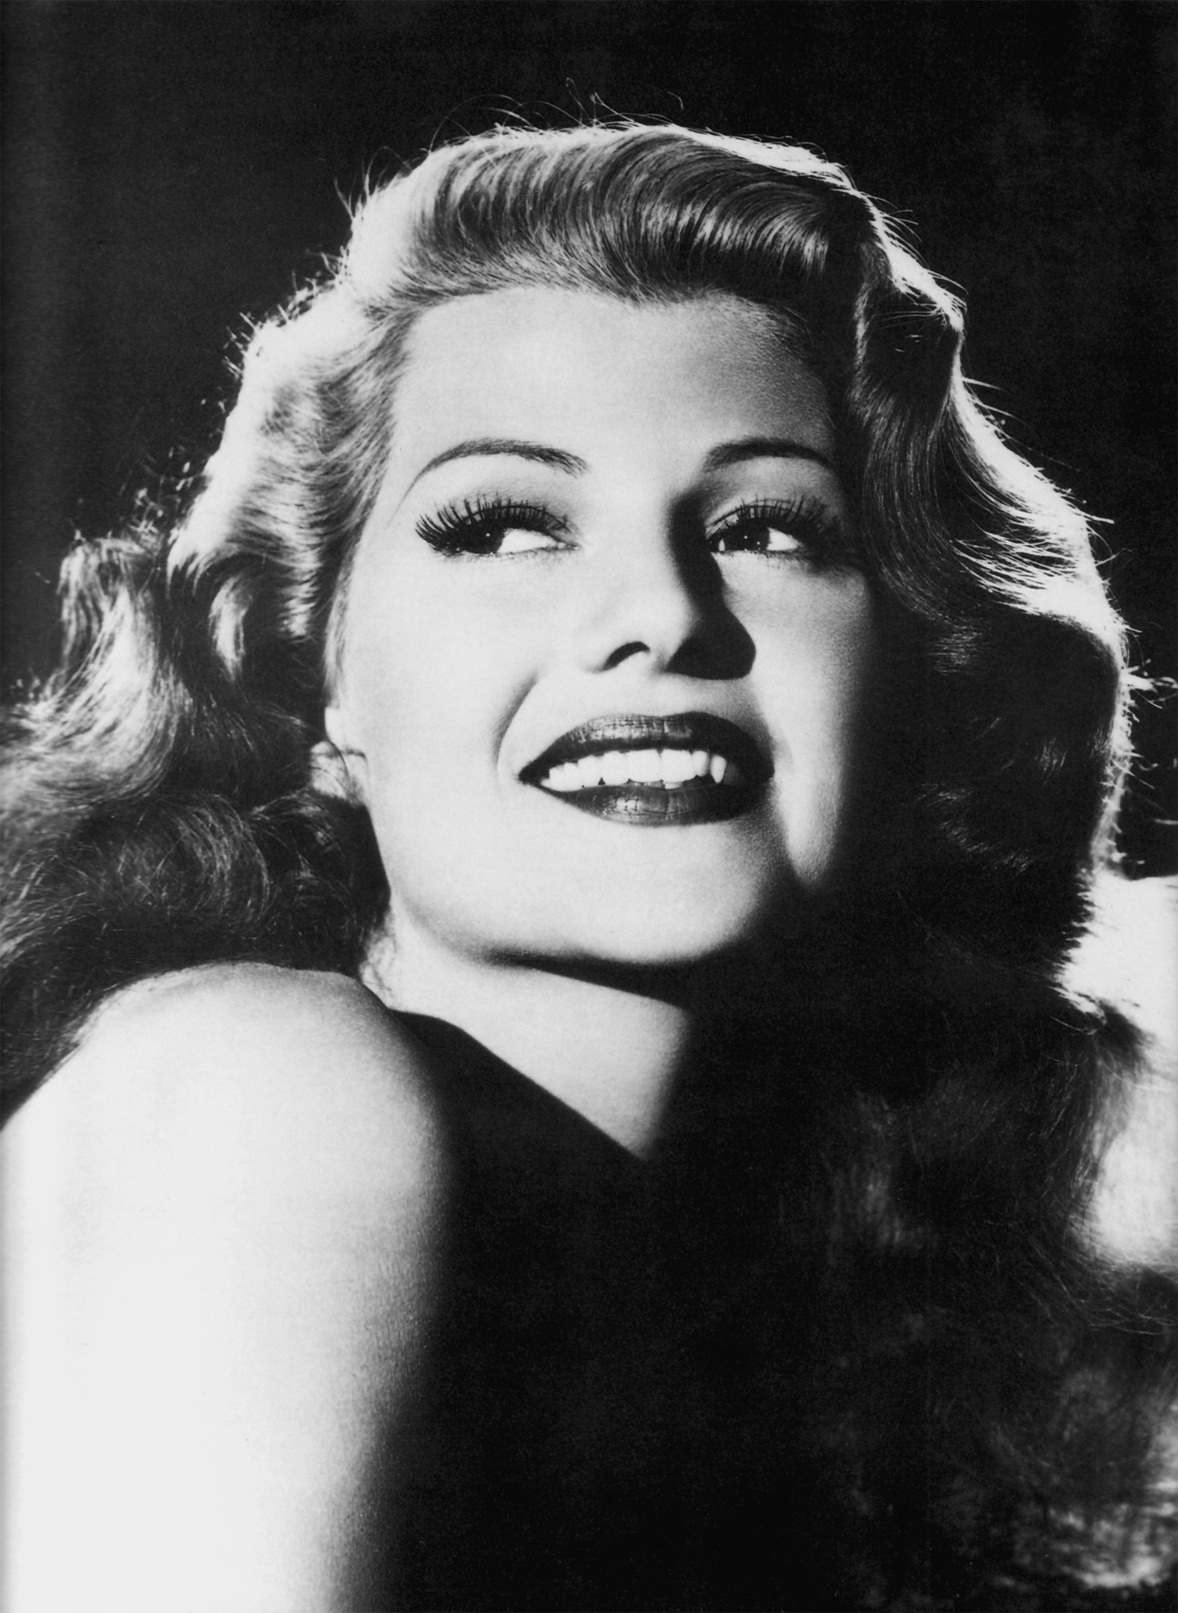
Analyse the representation of women in the Tide advert
Consider:
Clothing (including head scarf)
Hair & make-up
Body language & facial expressions

Slide 5
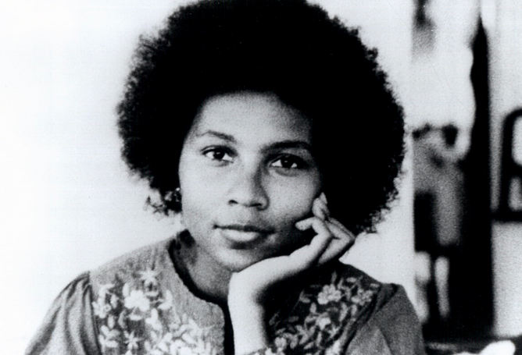
Feminist theory - bell hooks
THEORY
hooks suggested the idea that feminism is a struggle to end sexist/patriarchal oppression and the ideology of domination
hooks stated that feminism is a political commitment rather than a lifestyle choice
hooks also considered that race and class as well as sex determine the extent to which individuals are exploited, discriminated against or oppressed.

Slide 6
How can we apply this theory to the Tide advertisement?

Slide 7
Feminist theory - Van Zoonen
THEORY
Zoonen suggested that gender is constructed through discourse and that its meaning varies according to cultural and historical context
She stated that the display of women’s bodies as objects to be looked at, is a core element of western patriarchal culture
the idea that in mainstream culture the visual and narrative codes that are used to construct the male body as spectacle differ from those used to objectify the female body
Representation - Gauntlett & Hall
Ethnicity - Gilroy

Slide 8
How can we apply this theory to the Tide advertisement?

Slide 9
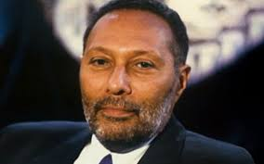
Representation - Stuart Hall
THEORY
the idea that representation is the production of meaning through language, with language defined in its broadest sense as a system of signs
the idea that the relationship between concepts and signs is governed by codes
the idea that stereotyping, as a form of representation, reduces people to a few simple characteristics or traits
the idea that stereotyping tends to occur where there are inequalities of power, as subordinate or excluded groups are constructed as different or ‘other’ (e.g. through ethnocentrism).

Slide 10
How can we apply this theory to the Tide advertisement?

Slide 11
Representation - David Gauntlett
THEORY
the idea that the media provide us with ‘tools’ or resources that we use to construct our identities
the idea that whilst in the past the media tended to convey singular, straightforward messages about ideal types of male and female identities, the media today offer us a more diverse range of stars, icons and characters from whom we may pick and mix different ideas.

Slide 12
How can we apply this theory to the Tide advertisement?

Slide 13
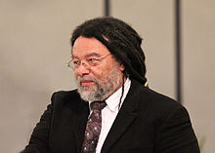
Ethnicity - Paul Gilroy
THEORY
the idea that colonial discourses continue to inform contemporary attitudes to race and ethnicity in the postcolonial era
the idea that civilisationism constructs racial hierarchies and sets up binary oppositions based on notions of otherness

Slide 14
How can we apply this theory to the Tide advertisement?

Slide 15
Applying theory
Gauntlett: The media provide us with ‘tools’ or resources that we use to construct our identities
Hall - Representation is the production of meaning through the signs in a text. Representation, reduces people to a few simple characteristics or traits
Van Zoonen - Gender is constructed through discourse (spoken or written communication), and that its meaning varies according to cultural and historical context
hooks - hooks also considered that race and class as well as sex determine the extent to which individuals are exploited, discriminated against or oppressed.
Gilroy - media texts reinforce colonial power

Slide 16
Component One Section A: Advertising & Marketing -
Tide print Advert
Driving Question
How do I compare the Tide advert with an unseen text?

Slide 17
Learning Outcomes
I will know what a Component 1 Section A question might look like
I will understand how to analyse the media language used in a moving image advert
I will be able to construct an answer using new and prior learning

Slide 18
Section A: Analysing Media Language and Representation
Question 1 is based on the unseen audio-visual resource and the Tide advertisement you have studied.
The audio-visual resource consists of a television advertisement which is part of the Bold Irresistible campaign, made in 2016.
You will be allowed one minute to read Question 1. The advertisement will be shown three times.
First viewing: watch the advertisement. Second viewing: watch the advertisement and make notes. You will then have five minutes to make further notes. Third viewing: watch the advertisement and make final notes. Once the third viewing has finished, you should answer Question 1.
Compare how media language is used to present messages & values in the ‘Bold’ moving image advert and the ‘Tide’ print advert.
In your answer you must:
consider how the representations construct versions of reality
consider the similarities and differences in how audiences are positioned by the representations
make judgements and draw conclusions about how far the representations relate to relevant media contexts. [30]

Slide 19
Analysis of unseen text - Bold New Irresistible, 2016
consider how the representation construct versions of reality
consider how audiences are positioned by the representation here
make judgements and draw conclusions about how far the representations relate to relevant media contexts.
Similar or different to representations in Tide?

Slide 20
Analysing Media Language in Print and Moving Image
Images | Language | Layout/design
Use of colour Clothing and physical appearance Body language Facial expression Photographic codes – angle, shot type, composition Mise en scene - Lighting, sound, props | Connotations of name etc. Vocabulary used Mode of address Persuasive techniques Use of slogans | Typography – font style, size, colour Use of graphics Design techniques Composition/framing Editing

Slide 21
How is Media Language used in the moving image advert?
Mise en scene (sound, lighting, props)
Images
Camera angles, framing, composition
Editing
Social and cultural context (representation of gender)
Application of media theory

