Slide 1
Unit 14: Radio Production
Learning Objectives:
To create a treatment proposal for a radio show

Slide 2
1.Take a post it note from the desk 2. Think about what content might feature on this show. Discussions? Debates? Ideas? 3. Decide what time is ideal for this show and the target audience.
Learning Objectives:
To create a treatment proposal for a radio show
Starter

Slide 3
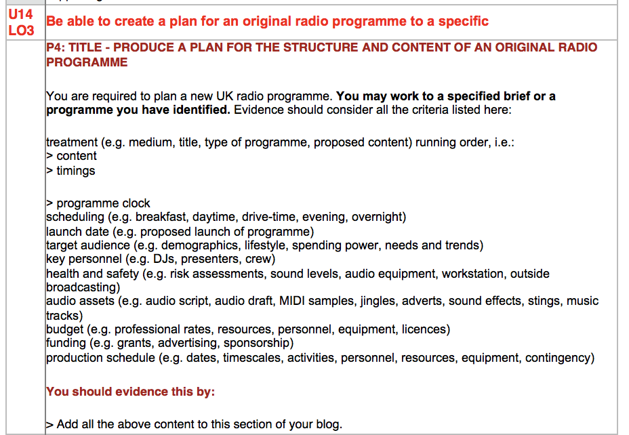
Learning Objectives:
To create a treatment proposal for a radio show
Create your programme treatment proposal
List resources, content, contributors
Make your show sound appealing and ready for commission
Think about how you will make it suitable for your target audience
FINAL PASS PART! YAY!!!!

Slide 4
Learning Objectives:
To create a treatment proposal for a radio show
Download and use the treatment proposal template

Slide 5
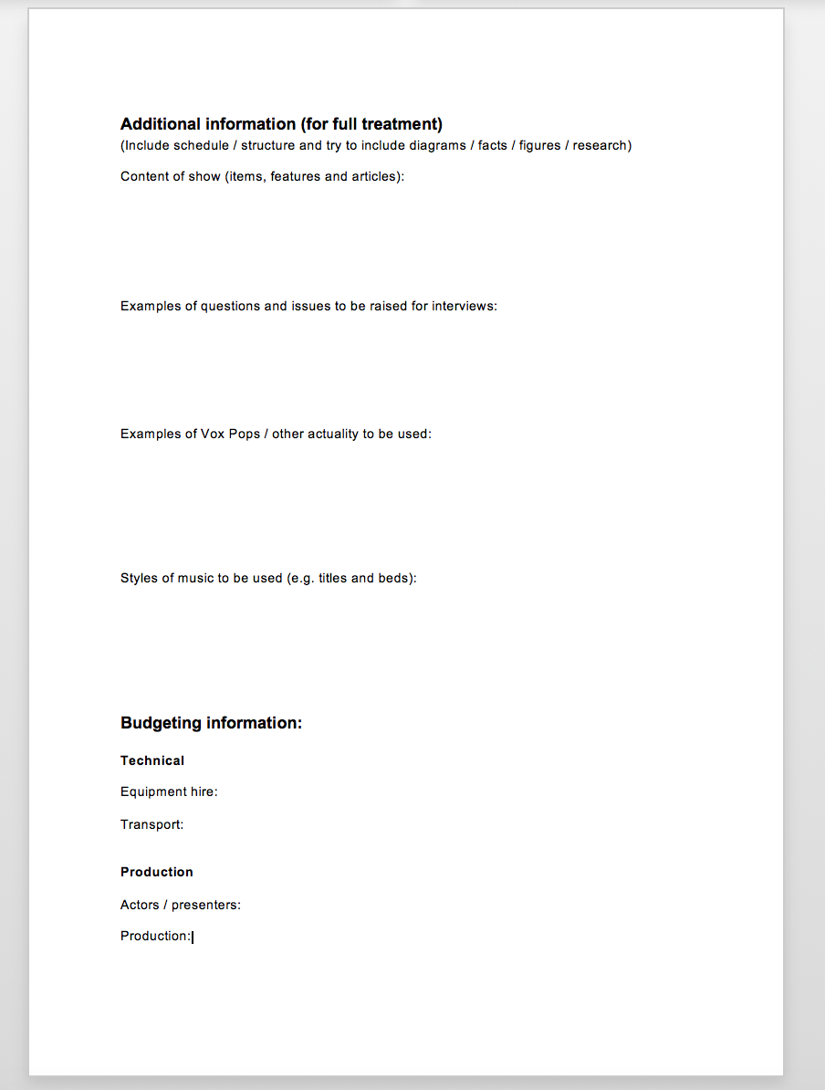
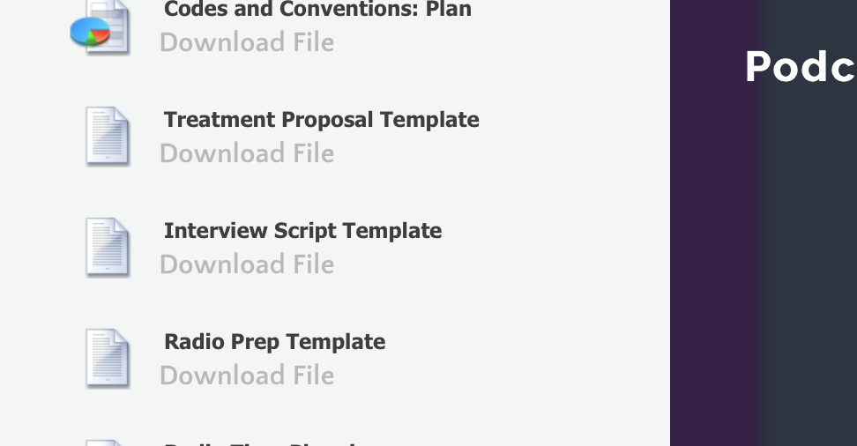
Learning Objectives:
To create a treatment proposal for a radio show
Find the main documents to complete on the website under unit 14 lessons

Slide 6
LO4 – Radio Production Diary.
Learning Objectives:
To create a treatment proposal for a radio show

Slide 7
Learning Objectives:
To create a treatment proposal for a radio show
We’ll look at running orders in lesson 5
Stretch & Challenge:
Think of a hook intro to entice the audience

