Slide 1
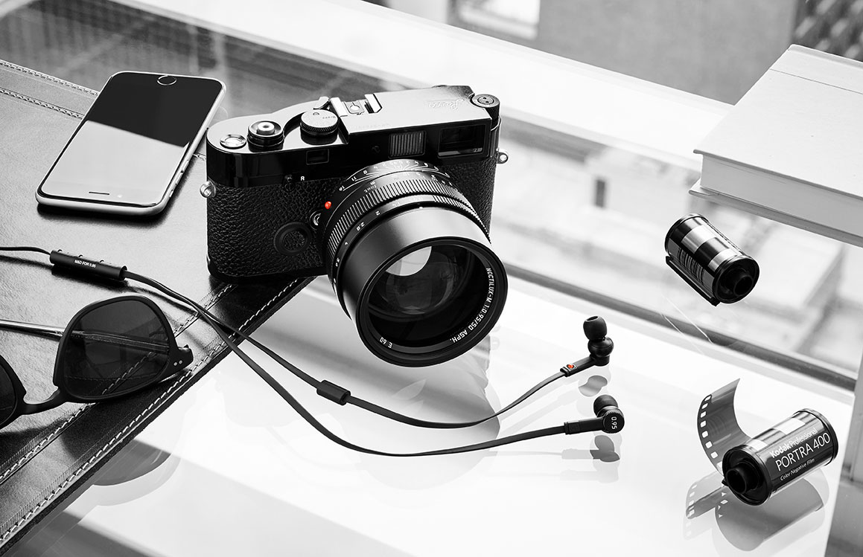
Audio Visual Promo LO2
Learning Outcome: To plan and create concept documentation for your projects.

Slide 2
LO2 P2
Learning Outcome: To plan and create concept documentation for your projects.

Slide 3
Silent Blue Sky Thinking
Learning Outcome: To plan and create concept documentation for your projects.
Spend 3 minutes reading the briefs again. Make notes or highlight.
Spend 5 minutes blue sky thinking. There are no wrong answers here. JUST IDEAS.
Take a photo – this will be part of your LO2 P2

Slide 4
Highlight 3-5 ideas which you think are best
Spend 3 minutes reading back over your ideas. What could you develop more? What is a ready to film idea? What needs to go to the scrap heap?
Learning Outcome: To plan and create concept documentation for your projects.

Slide 5
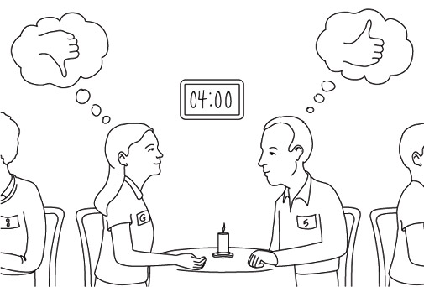
Speed Dating
Learning Outcome: To plan and create concept documentation for your projects.
When the horn sounds share your ideas.
Tell your dates what you think of their ideas.
What could they add?
What could they develop?
What might work differently?
Make notes on the feedback from your dates. These can be photo’d and added to your blog to help you develop your ideas!

Slide 6
Create a Mind Map and Moodboard
Learning Outcome: To plan and create concept documentation for your projects.
Using the feedback and your initial blue sky thinking, develop your ideas now with a mind map.
What themes? Music? Genre? Characters? Locations could you use?
What is the purpose of your audio-visual? Entertain? Education? Inform? Sell?
Finally create a moodboard to represent the visual styles & themes.
Photo and put on blog – we want real-life plans not “neat” typed ones

