Slide 1
Unit 15: Learning Objective 2
Learning Objective: (Pass 3) Create and produce pre-production materials

Slide 2
What are pre-production materials?
Pre-production documentation, i.e.
Work plans/production schedules (e.g. that shows weekly/daily activities and milestones, timings and contingency plans)
Call sheets for production team (e.g. that outline equipment needed for all locations)
Recce/risk assessment of locations and use of equipment (e.g. potential health and safety hazards)
Learning Objective: (Pass 3) Create and produce pre-production materials

Slide 3
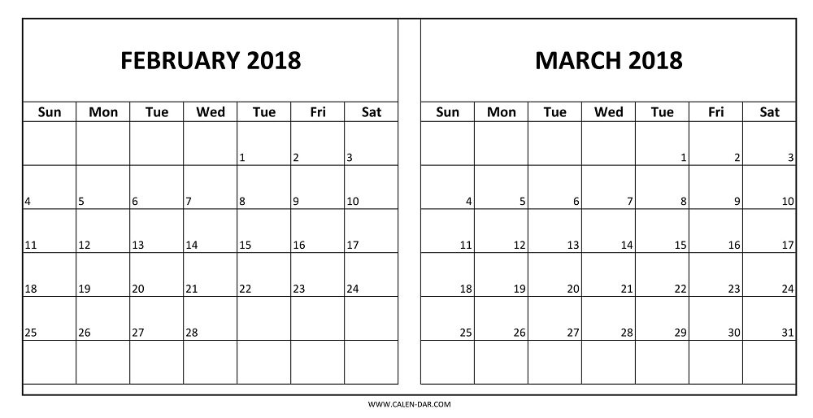
Plans to Miss Samuels deadline
FILMING WEEK
FILMING WEEK
FILMING WEEK
EDIT WEEK
EDIT WEEK
EDIT WEEK
This week
DEADLINE
Learning Objective: (Pass 3) Create and produce pre-production materials

Slide 4
Learning Objective: (Pass 3) Create and produce pre-production materials

Slide 5
Before you can film:
Learning Objective: (Pass 3) Create and produce pre-production materials
All need to be emailed to Miss Samuels before filming.
DEADLINE: 2nd March
Call sheets
Schedule (include milestones, social media coverage, filming, editing).
Risk assessment / recce.
Storyboard
Actors’ permission slips, location permissions.

