Slide 1
Unit 26 – LO2
Learning Objective: Be able to explain the correlation of the evolution of new media organisational cultures and the roles which have impacted on the product proposal

Slide 2
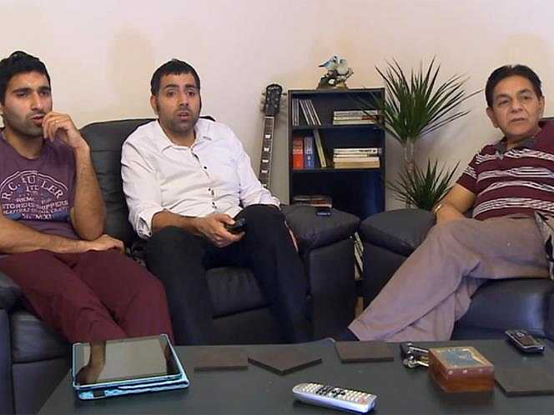
Is Gogglebox an example of a convergence product?

Slide 3
Recap
LO1 – PASS How technologies have developed over time (Your partner research, your notes from other presentations and then YOUR chosen proposal – so look at music video, news or radio/tv as a second focus) DUE TUESDAY.
MERIT – On website (last lesson slides) can be a blog post with pictures or a presentation.
Starting L02 – 2 PASS TASKS. DUE FRIDAY 18th. We’ll look in detail today at PASS 2, then PASS 3/M2/D1 on Friday & Wednesday next week.

Slide 4
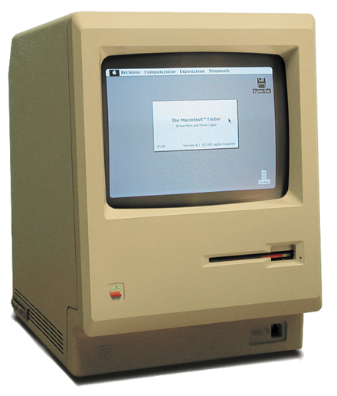
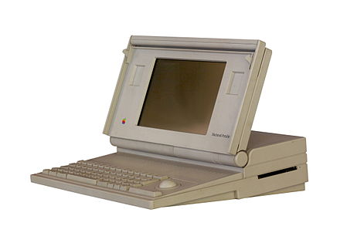
Let me tell you a story….
Learning Objective: Be able to explain the correlation of the evolution of new media organisational cultures and the roles which have impacted on the product proposal

Slide 5
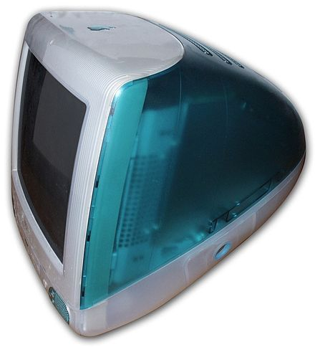
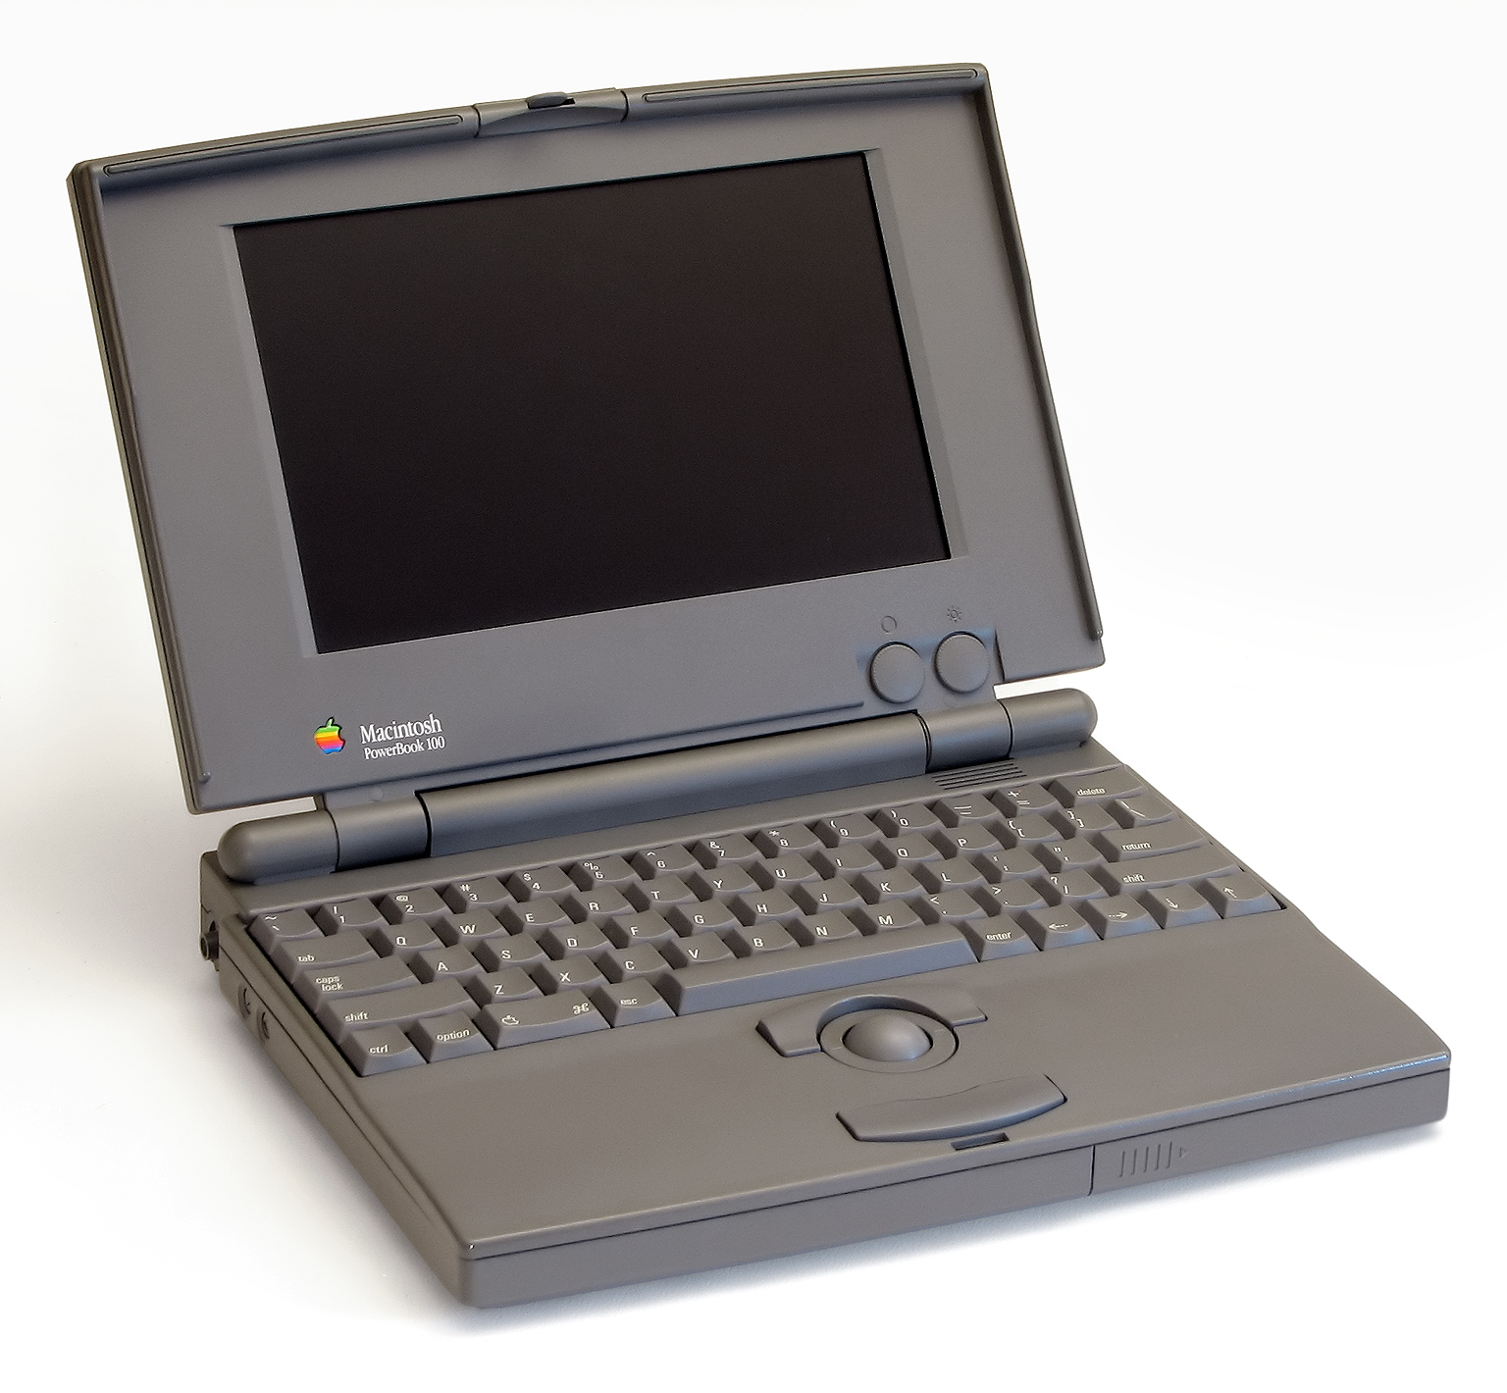
Let me tell you a story….
Learning Objective: Be able to explain the correlation of the evolution of new media organisational cultures and the roles which have impacted on the product proposal

Slide 6
Did Apple stop there?
Apple has constantly developed their products
Invested and merged with companies (over 95)
Created new products and broadened their subsidiaries.
WHY?

Slide 7
Find out your company’s evolution
When did they start as a company?
What did they start out as? E.G – Apple was a desktop computer.
How have their products evolved over time?
How have their products adapted to the digital era?
What companies have they bought or collaborated with?
How has that had an impact on the audience?
How has the developments had an impact on the company / staff / revenue?
Learning Objective: Be able to explain the correlation of the evolution of new media organisational cultures and the roles which have impacted on the product proposal

Slide 8
PASS 2
Learning Objective: Be able to explain the correlation of the evolution of new media organisational cultures and the roles which have impacted on the product proposal
Create a blog post or presentation with voiceover. How has the evolution of media changed the market place?
Use your group’s researched company AND 1 other which associates to your new proposal.
(Choice 1 is recommended to look at: NEWS CORP and BBC)
(Choice 2 is recommended to look at: Channel4 and Radio1)
(Choice 3 is recommended to look at: MTV and Amazon)

Slide 9
4 people in a dorm room -> 25,105 employees (Dec 2017)
Who do they need to work for their companies now?
29,494 copies sold daily in 2010
NOW 10,050 daily
Redundancies abundant
Learning Objective: Be able to explain the correlation of the evolution of new media organisational cultures and the roles which have impacted on the product proposal

Slide 10
PASS 3 – what different roles are needed to develop your content?
What is your proposal choice?
What is needed to ensure your proposal choice works effectively?
What staffing is needed for your proposal idea and why? (try to think about profit here)
What would their role be?
What skills do they need?
Detailed report, Prezi or voice over presentation (maximum 4 minutes)

Slide 11
MERIT 2
Create a podcast, video or job description report which :
1. Explains how traditional job roles in the media industry have developed as technology have evolved.
E.G the role of a Heart radio producer now means: videographer, website builder, content creator, audio editor, social media manager etc.
2. Explain how new roles have now been created due to technology developments e.g influencers, snapchat geo filter editors.
3. Compare how these roles will be utilised in your content or product.

