Slide 1
Unit 26 – LO3
Learning Objective:
To create a brand identity for your product
Be able to explain the legal and ethical considerations which could impact on the product proposal

Slide 2
Random Creativity Exercise
To make your album cover ... 1. Go to wikipedia and hit random or click http://en.wikipedia.org/wiki/Special:Random 2. Go to Random Quotations : Click http://www.quotationspage.com/random.php3 Scroll to the bottom and the last five or four words of the last quote on the page is the title of your album. 3. Go to Flickr : Click on https://www.flickr.com/explore/interesting/7days The third picture, no matter what it is, will be your album cover 4. Use photoshop to put it all together 5. export and email to Miss

Slide 3
Create a mood board or ident for your product
What images, colours and words represent your chosen proposal?
How can you make it work for your audience? How do you become memorable – such as Paramount or E4?

Slide 4
LO3

Slide 5
Privacy Laws have changed
What has recently changed due to GDPR in the EU?
Research and read news articles on Privacy laws.
Read up the new changes to privacy on the 3 apps you use most.
Write detailed notes so that you can understand and explain in class at the end of the lesson.

Slide 6
Case Study Example
New App “Musique” has launched which allows users to stream and download their favourite music videos wherever they are. They can refine the videos by genre, artist or theme.
The app is funded through advertising and subscriptions.
Users can sign up for the :
“Pro” service which enables them to watch and stream as many music videos they like with just 1 advert per hour.
“Medium”service which gives 2 adverts every 20 minutes
“Basic” service which shows 1 advert every 8 minutes.
PRO users can create playlists and add their own review videos to the playlist which gets shared Worldwide.

Slide 7
Group Task:
In groups list the issues and solutions you can think of for this new app and it’s distribution.
Things to consider:
Copyright and intellectual property
Data protection
Media regulation
Citizen journalism
Anti-social use of online technologies
Digital natives vs Digital immigrants

Slide 8
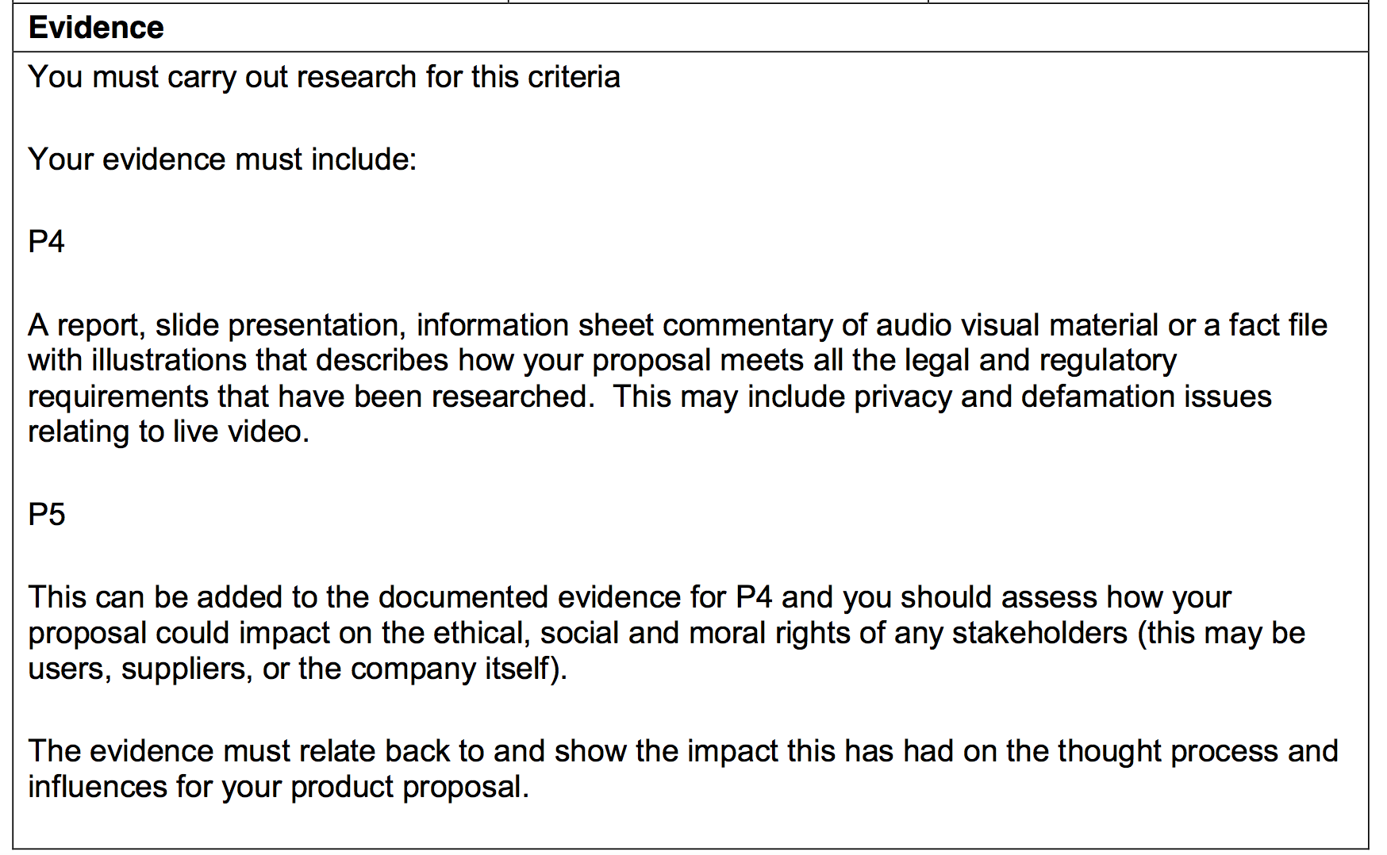
LO3

Slide 9
Coming up….
Wednesday LO4 introduced
Friday LO5 introduced…….
Let’s get you finishing off this amazing work and ready to complete the course!

